Slide 1
Let's Do Some Failure Analysis
· Compare the reported problem to main or contributing findings
Mechanical Condition
Normal Use, General Wear | Preventable Damage
Cosmetic items | Broken screw bosses or stand-offs
Non-skid pads worn or missing | Mechanical components damaged or missing
Velcro worn or missing | Housing damage
Loose hardware | Mechanical part fabrication or replacement
Screws missing | Connector housing damage
Coil stiffeners worn or broken | Connector contact damage(pins,etc.)
Insert stripped or missing | Cable trauma
Foam worn,broken-down | Foam torn

Slide 2
Compare the reported problem to main or contributing findings
Electrical Analysis
Normal Use, Random Electronic Failures |  | Preventable Damage
Capacitor failure | Blown fuse | Connector housing damage
Diode failure | Intermittent system cable | Connector contact damage (pins,etc.)
Resistor failure | Intermittent flex circuits | Cable trauma
Inductor failure | Worn/Intermittent wiring | Broken solder joints
SCR failure | Internal wires | Broken interconnects
FET failure |  | Component failure due to trauma
RF switch failure
Preamp failure
Logic control failure
EEPROM failure
Flectronic tuning

Slide 3
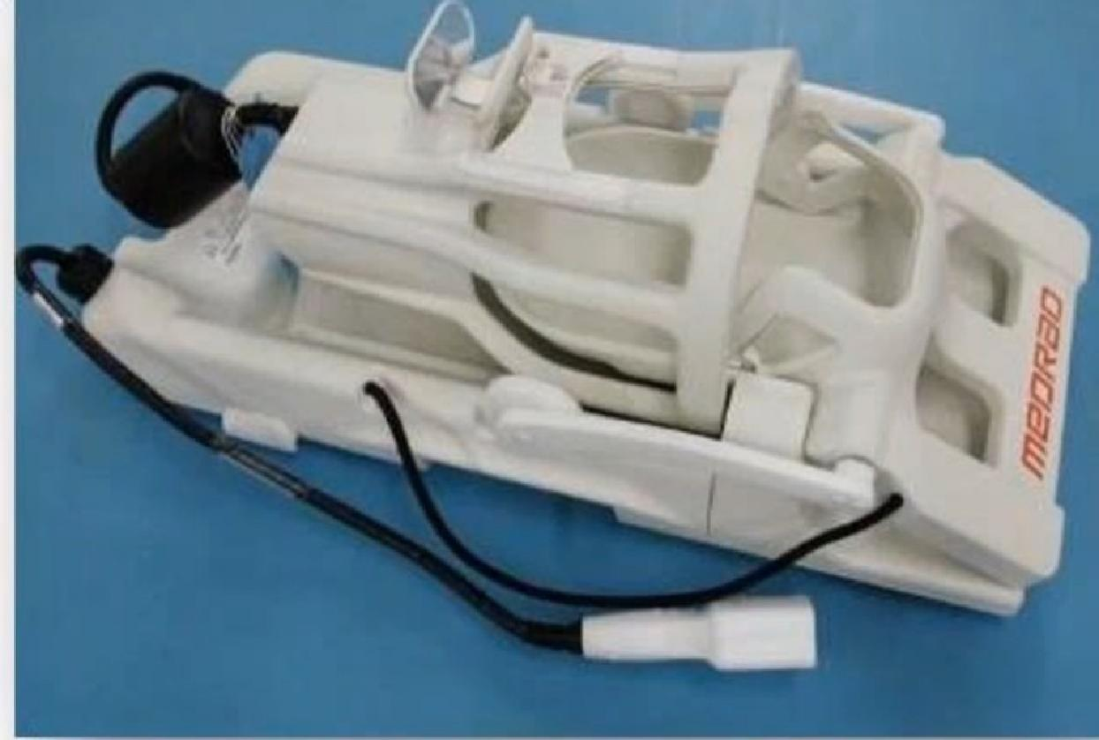
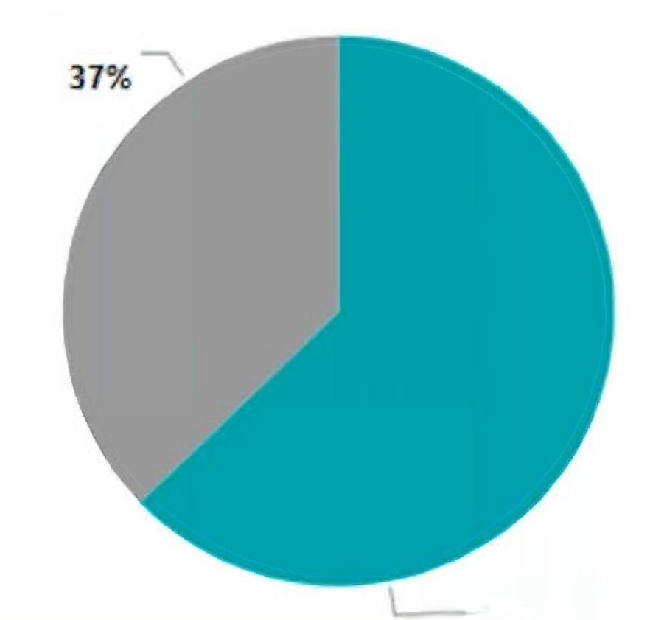
GE 1.5T Neurovascular Array
Part numbers:5117092-2,M3087JJ,M64NVA8-HD
>150 repairs
Most frequent failures
1. Intermittent solder connections and physical damage to electrical components
2. Cut,pull or damage to cable or strain relief
3. Random component failures
Normal Use/Wear
Preventable Damage
Component Fail
Cable trauma
Component Fail
Connector
trauma
Intermittent wiring
Electronic Worn wiring Intermittent
tuning flex traces

Slide 4
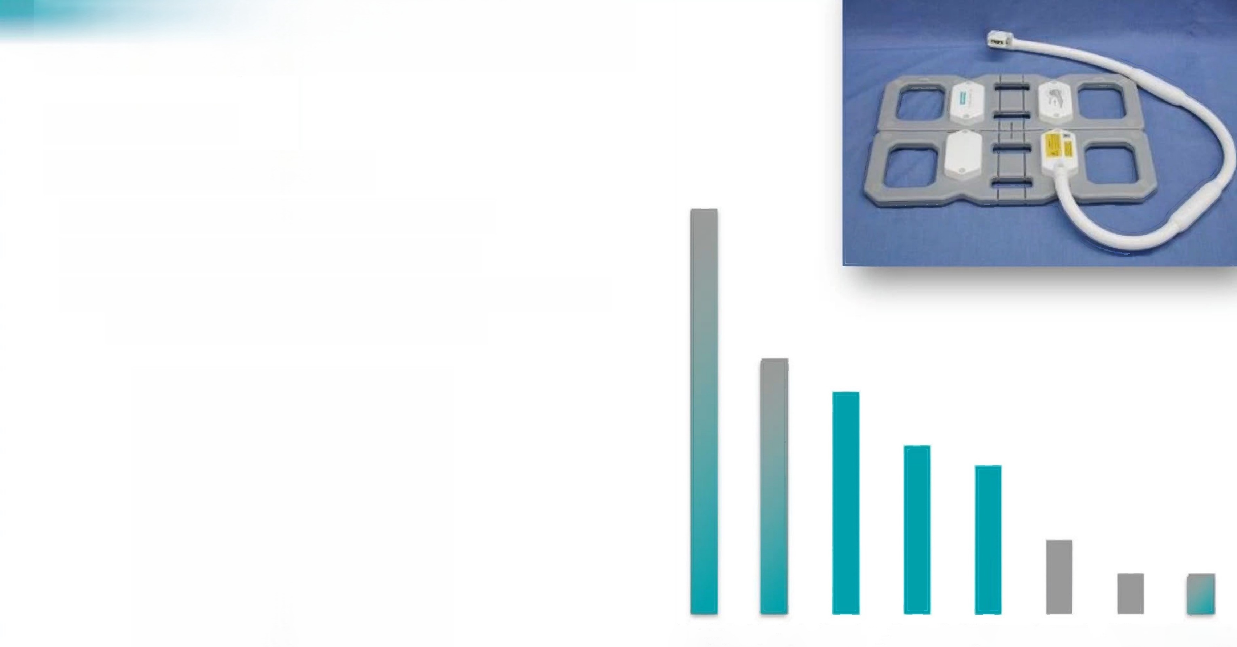
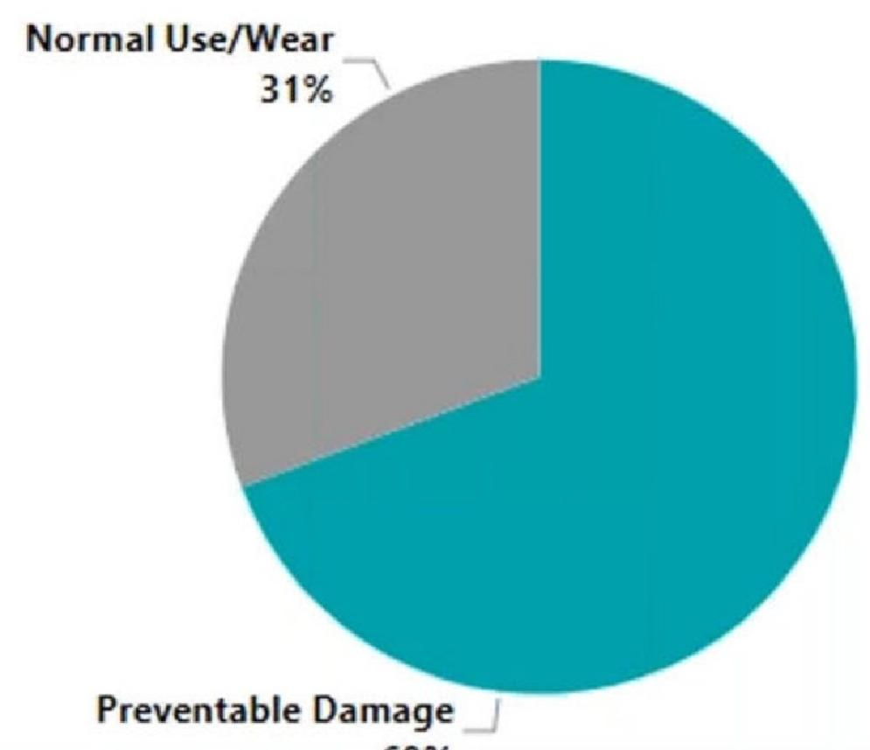
Siemens 1.5T Body Flex Array
Part numbers:7579555,5369554
>150 repairs
Most frequent failures
1. Intermittent flex traces and wiring
2. Bent/damaged pins in connector
3. Intermittent solder connections and physical damage to electrical components
Intermittent flex traces
Intermittent Wiring
Connector Trauma
Component Fail due to
Cable Trauma
Components fail
Electronic tuning
Worn Wiring

Slide 5
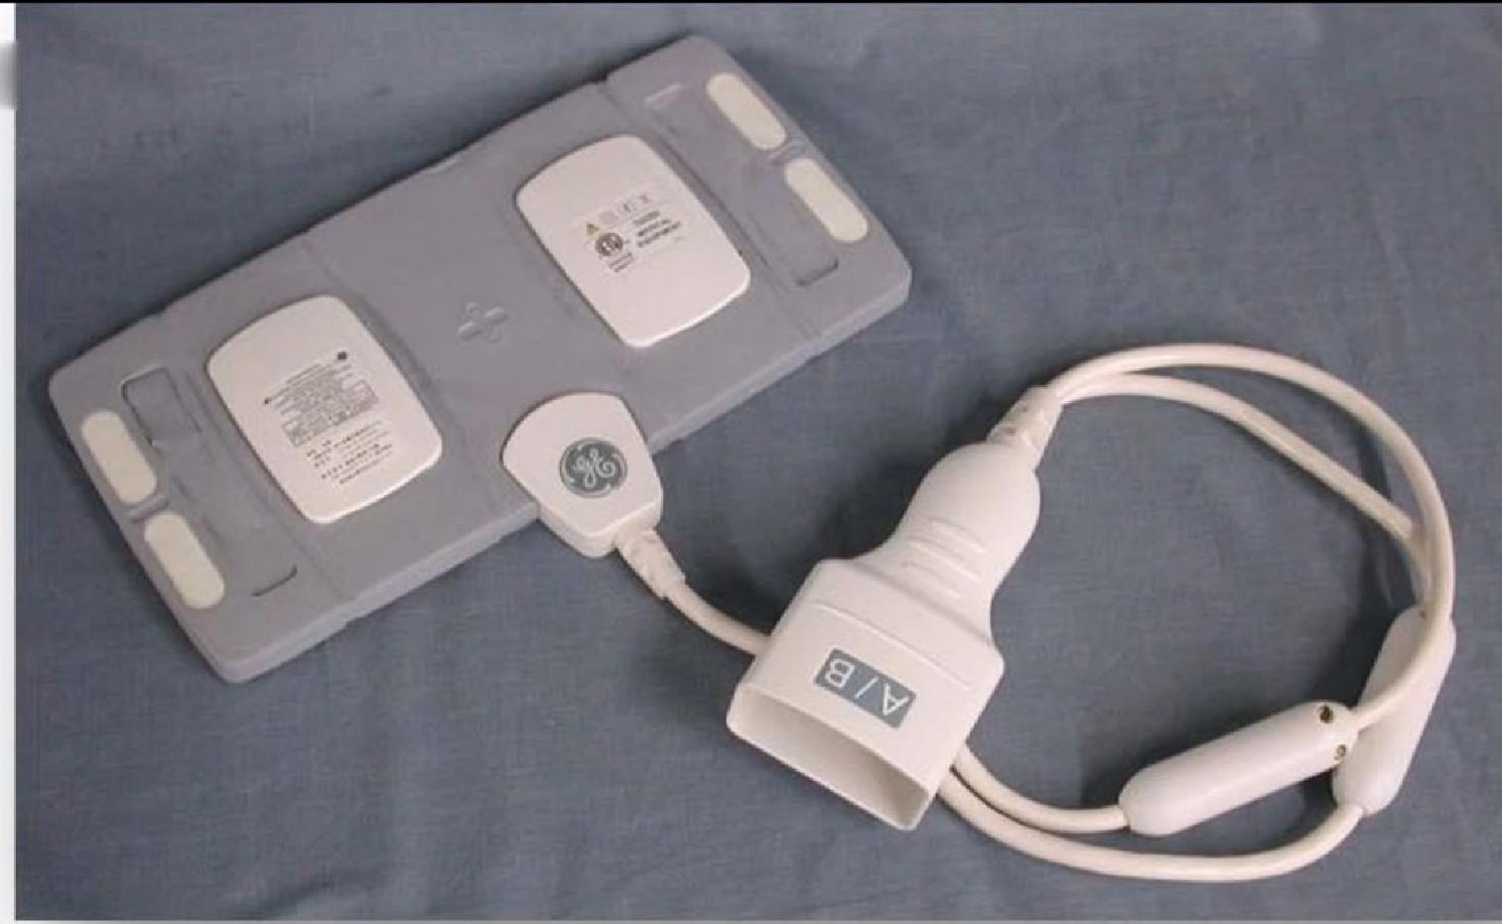
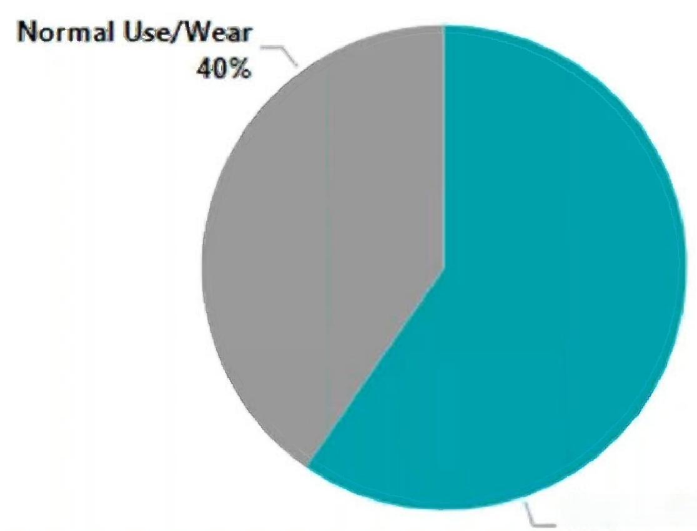
GE 1.5T 4Ch Small Flex Coil
Part number:5430692
>130 Repairs
Most frequent failures
1. Bent/damaged pins in connector
2. Intermittent/damaged wiring
3. Random component failures
Connector Trauma
Intermittent Wiring
Components fail
Component Fail due to
Electronic tuning
Cable Trauma
Worn Wiring
Intermittent flex traces
Preventable Damage:60%

Slide 6
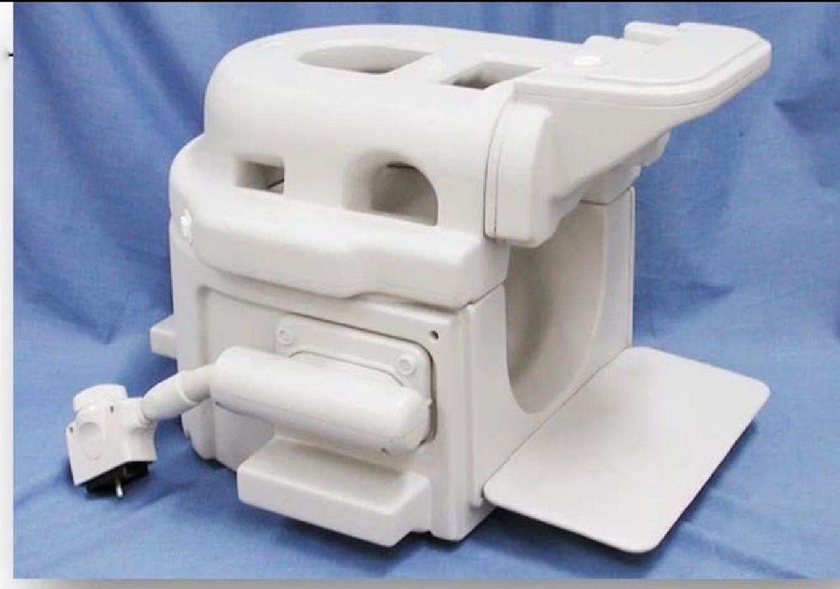
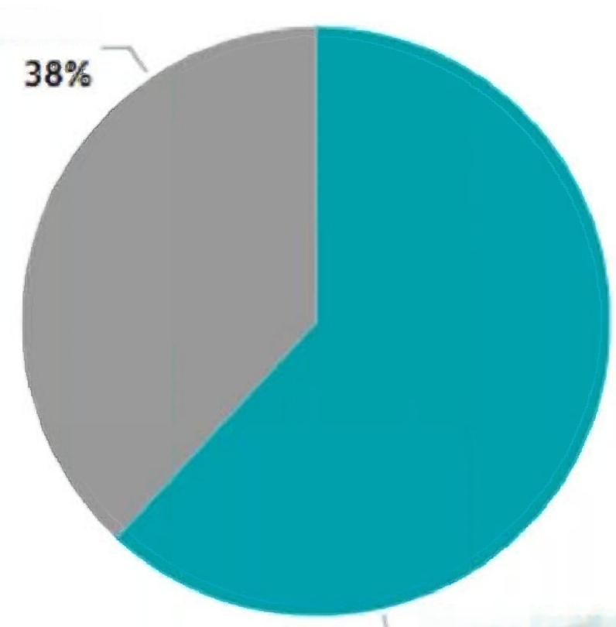
Toshiba 1.5T Neurovascular Atlas
Part numbers:MJAH-137A,2000205,2000206,2000207,2000208,5465781
>125 Repairs
Most frequent failures
1. Intermittent solder connections and
physical damage to electrical components
2. Damaged interconnects
3. Bent/damaged pins in connector
Normal Use/Wear
Preventable Damage
Component failure due to
Intermittent
flex traces
Connector
trauma
Component failure
Electronic
tuning
Cable trauma Worn
wiring
Intermittent wiring

Slide 7
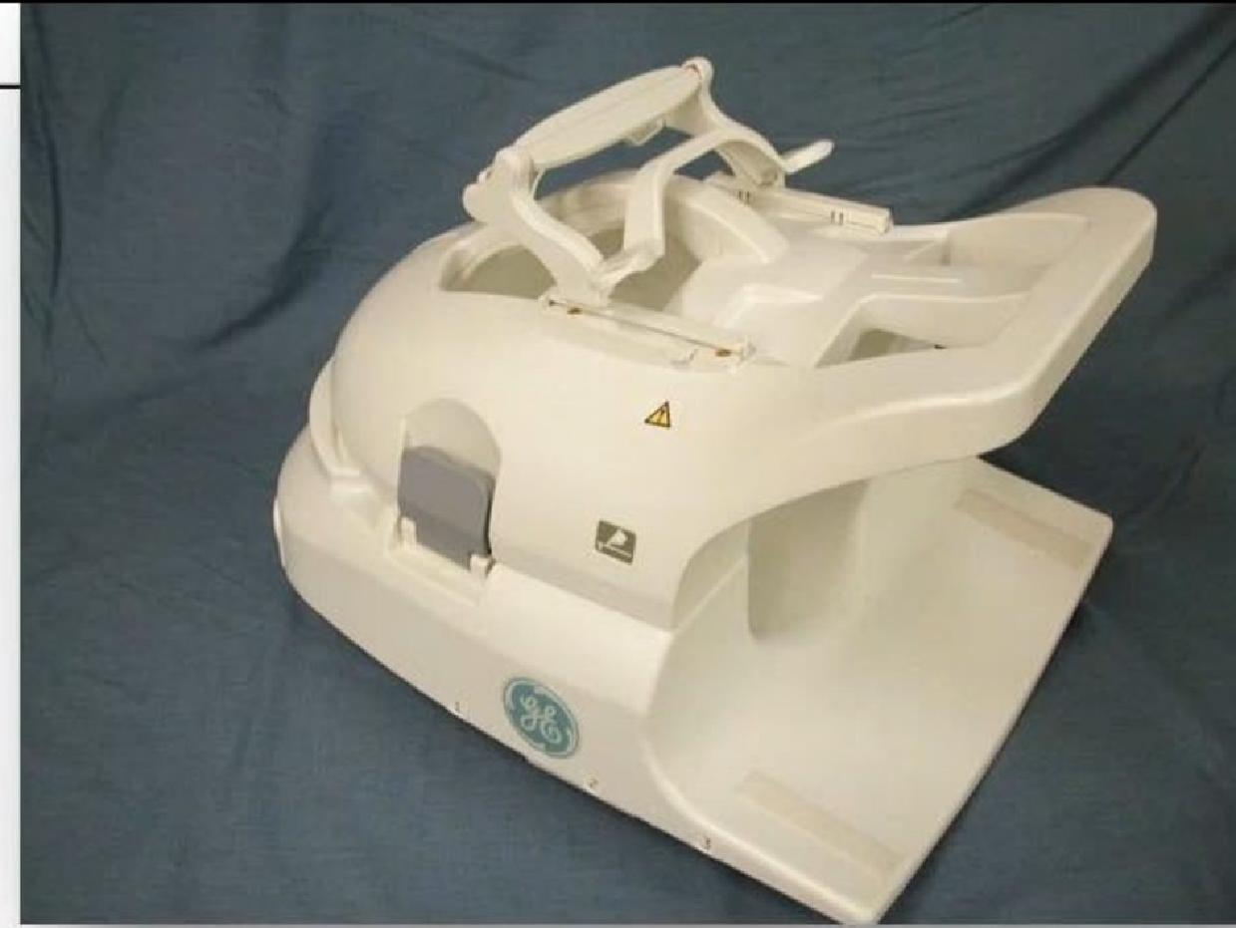
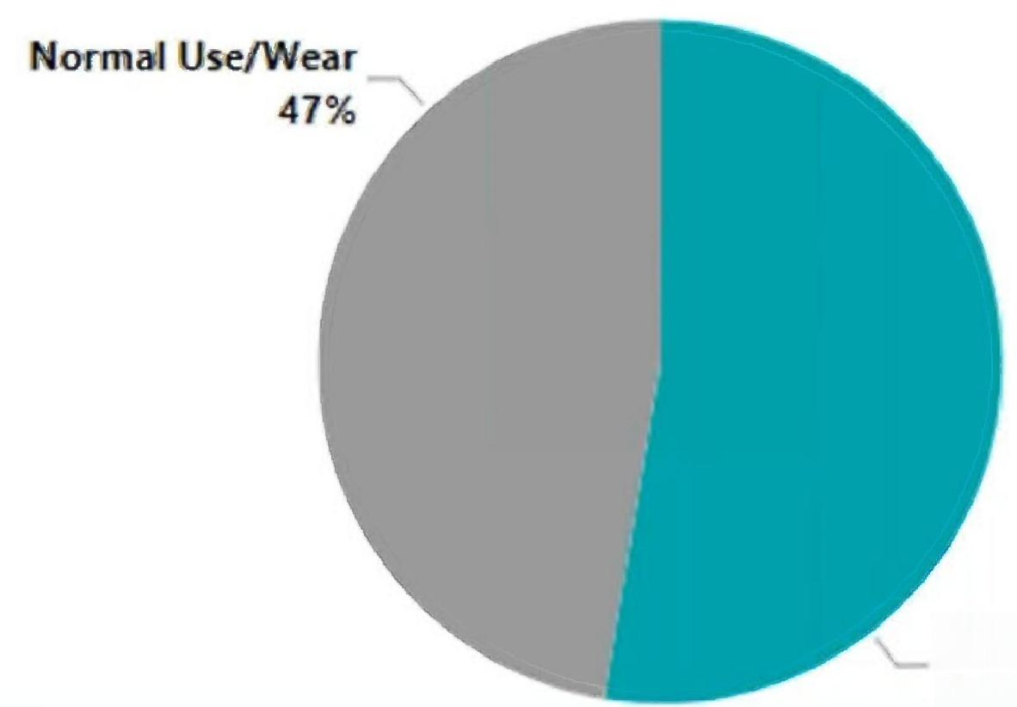
GE 1 .5T Express 16E Head Neck Array
Part numbers:5746586,5407991,5420021,M50002HL
>125 Repairs
Most frequent failures
1. Damaged interconnects
2. Intermittent solder connections and physical damage to electrical components
3. Random component failures
Preventable Damage 53%
Component
failure due to
Component failure
Intermittent flex
traces
Worn wiring
Electronic tuning
Intermittent wiring

Slide 8
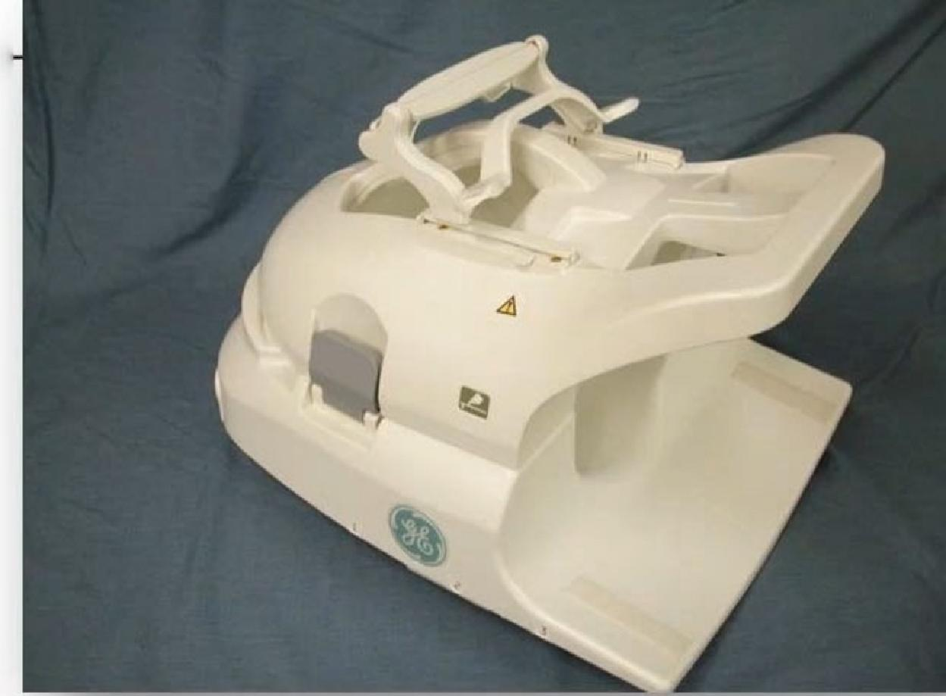
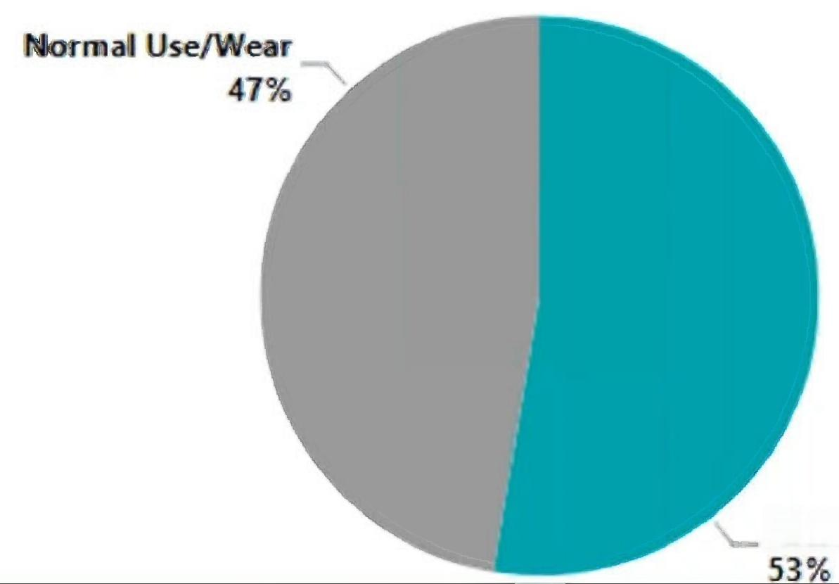
GE 1.5T Express 16E Head Neck Array
Part numbers:5746586,5407991,5420021,M50002HL
> 125 Repairs
Most frequent failures
1. Damaged interconnects
2. Intermittent solder connections and physical damage to electrical components
3. Random component failures
Preventable Damage
Component
failure due to
Component failure
Intermittent flex
traces
Worn wiring
Electronic tuning
Intermittent wiring

Slide 9
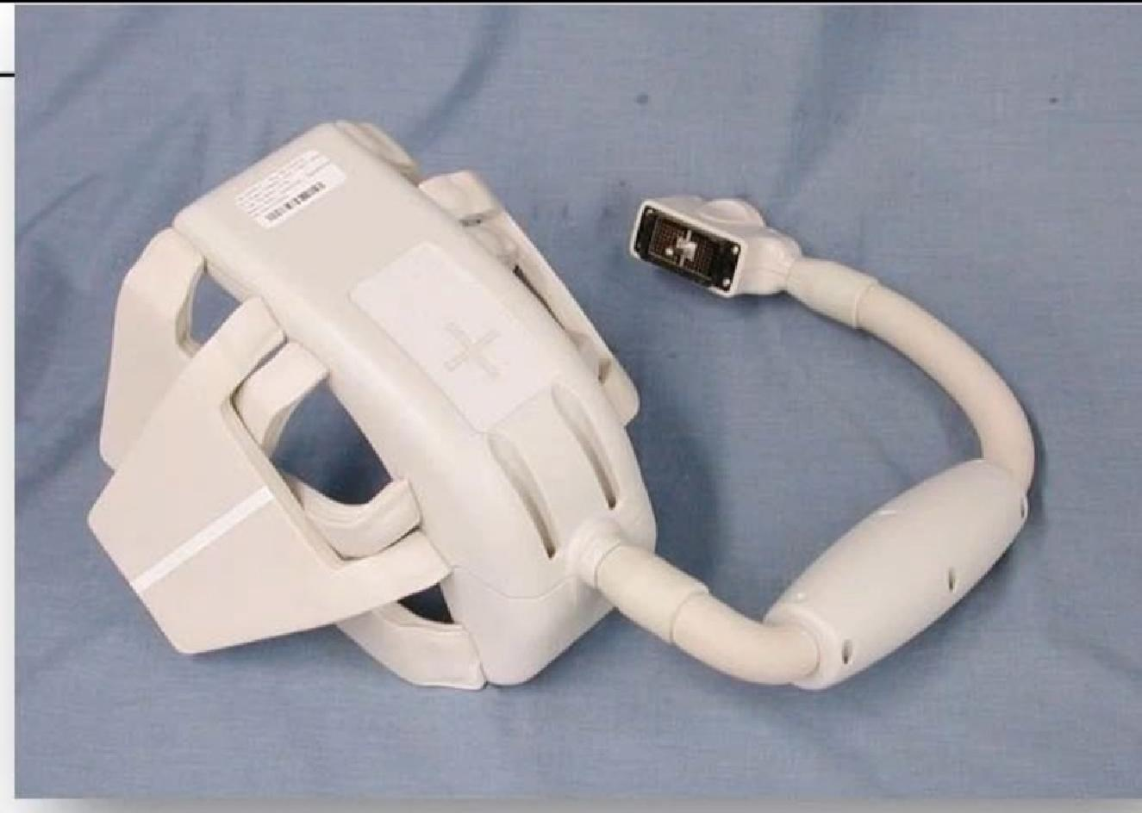
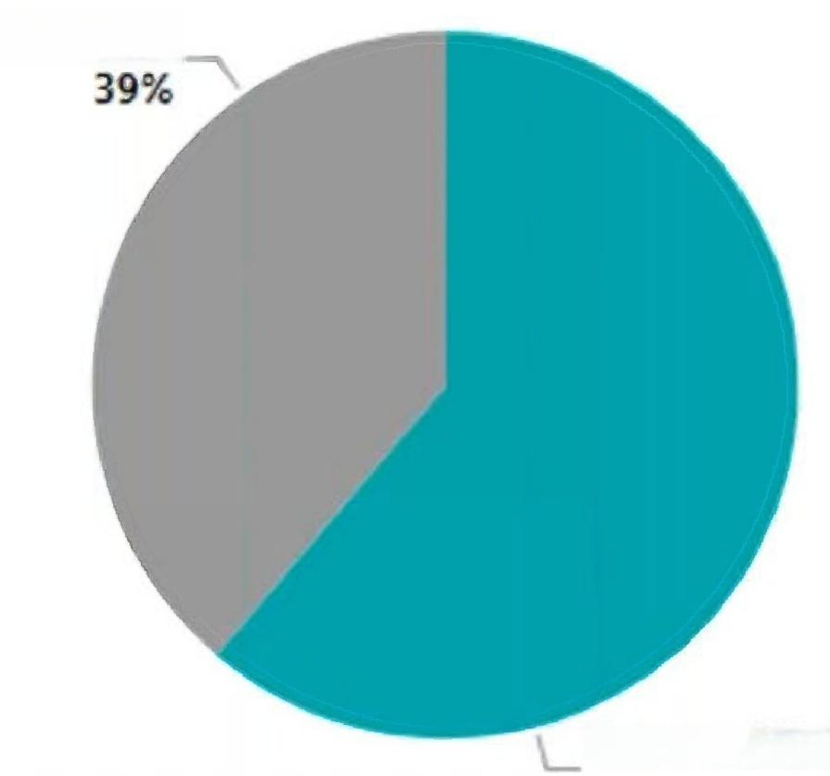
Toshiba 1.5T Shoulder Atlas Coil
Part numbers:MJAJ-177A,5464955
>90 Repairs
Most frequent failures
1. Intermittent flex traces and wiring
2. Bent/damaged pins in connector
3. Intermittent solder connections and physical damage to electrical components
Intermittent flex traces
Intermittent flex traces
Normal Use/Wear
Preventable Damage
Connector Trauma
Component Fail due to
Intermittent Wiring
Components fail
Worn Wiring
Cable Trauma

Slide 10
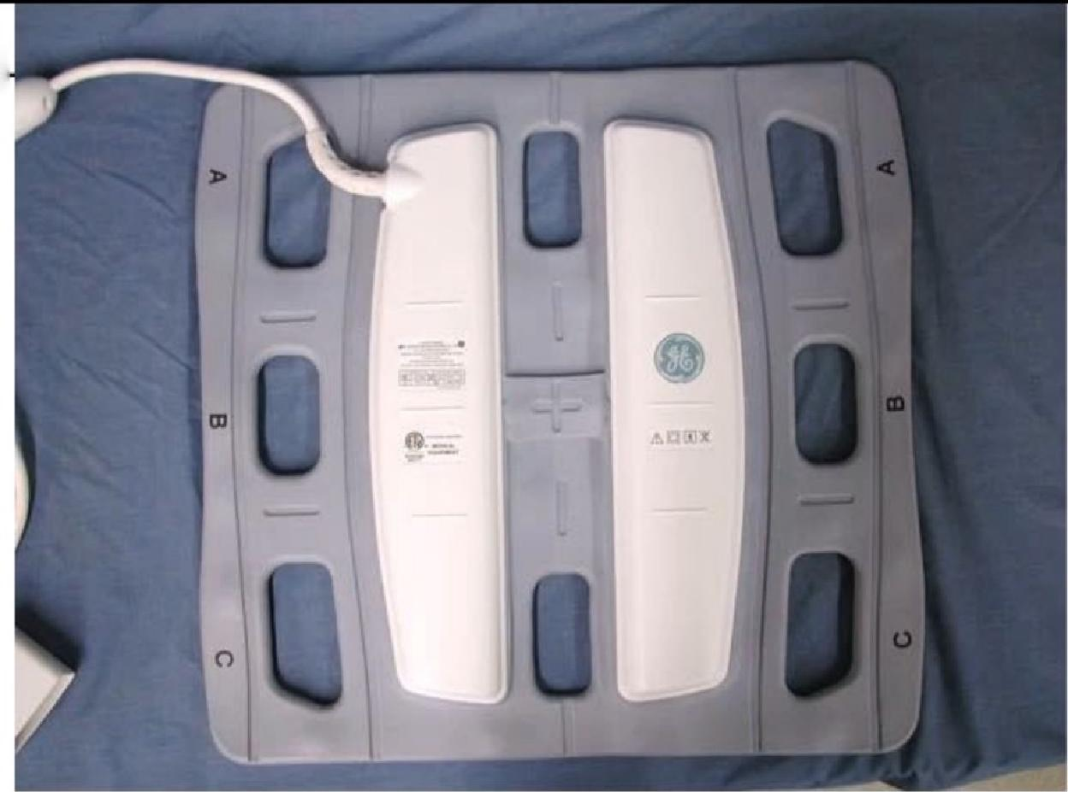
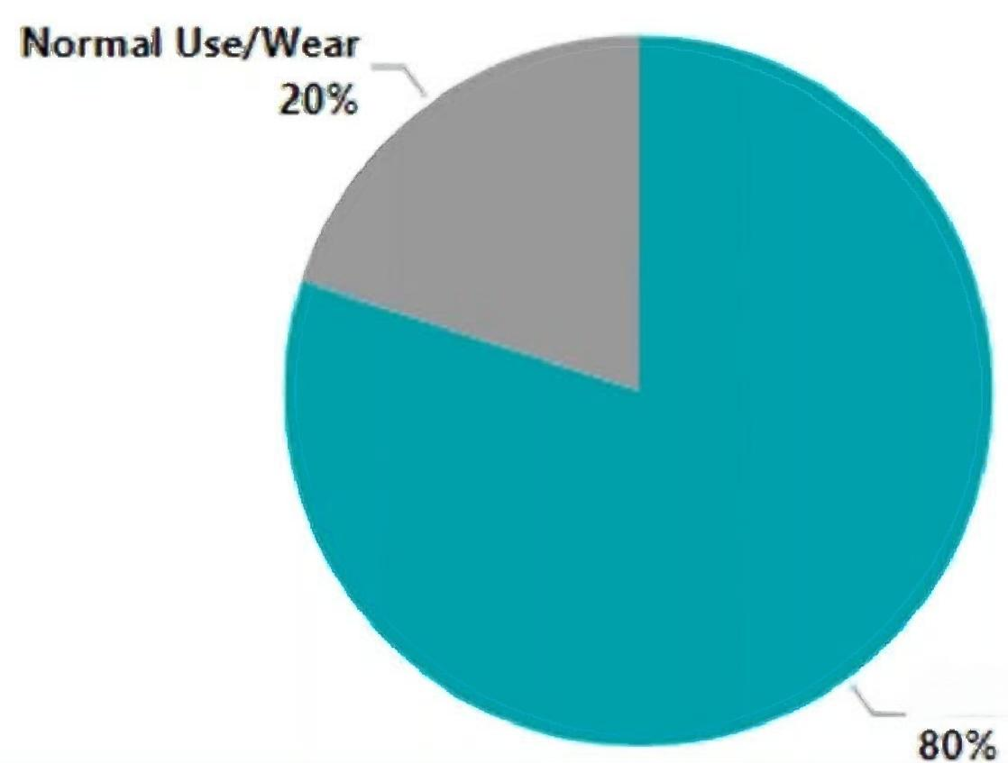
GE 1 .5T Express 9E Anterior Array
Part numbers:5407990,5433103,5746587,M50002HM
>80 Repairs
Most frequent failures
1. Intermittent flex traces and wiring
2. Random component failures
3. Bent/damaged pins in connector
Intermittent flex traces
Component Fail due to
Components fail
Cable Trauma
Worn Wiring

Slide 11
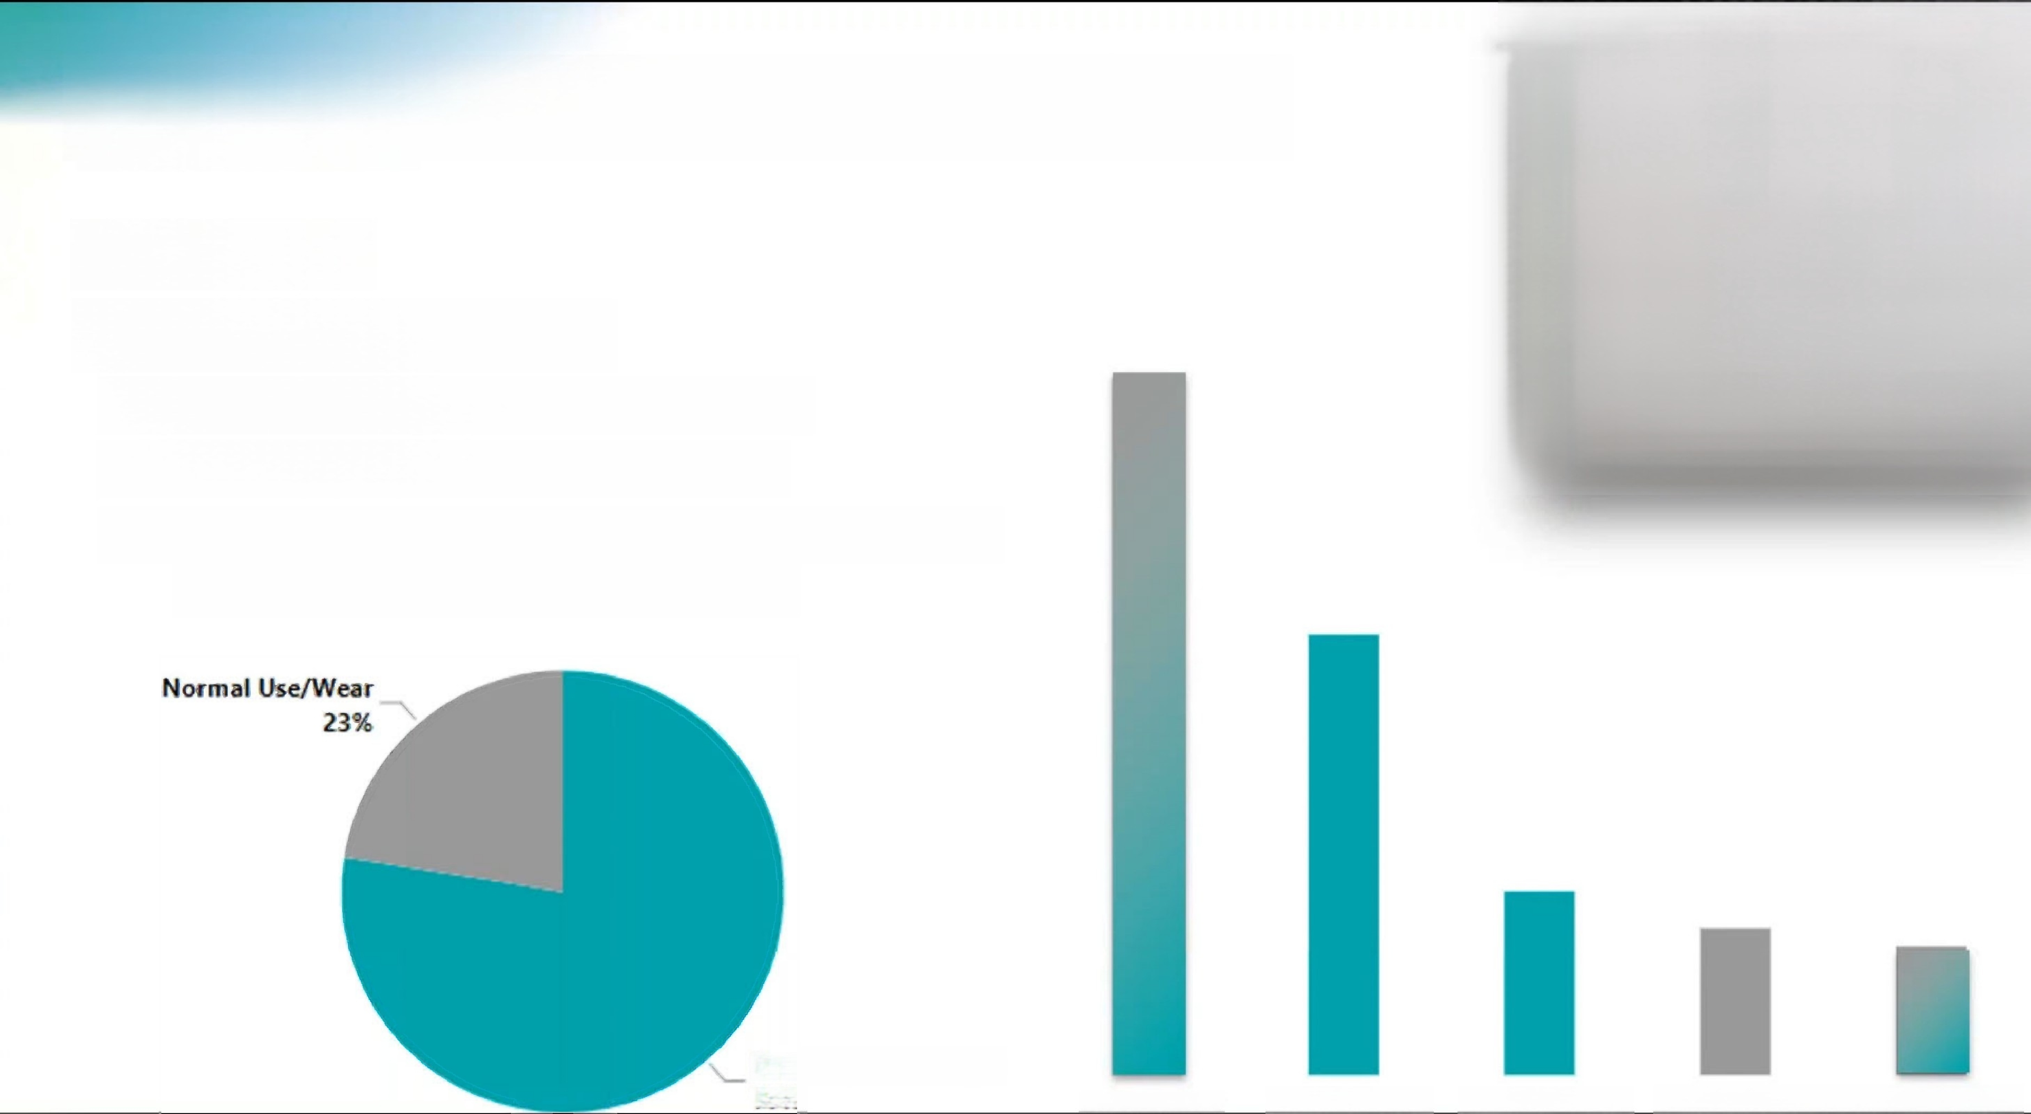
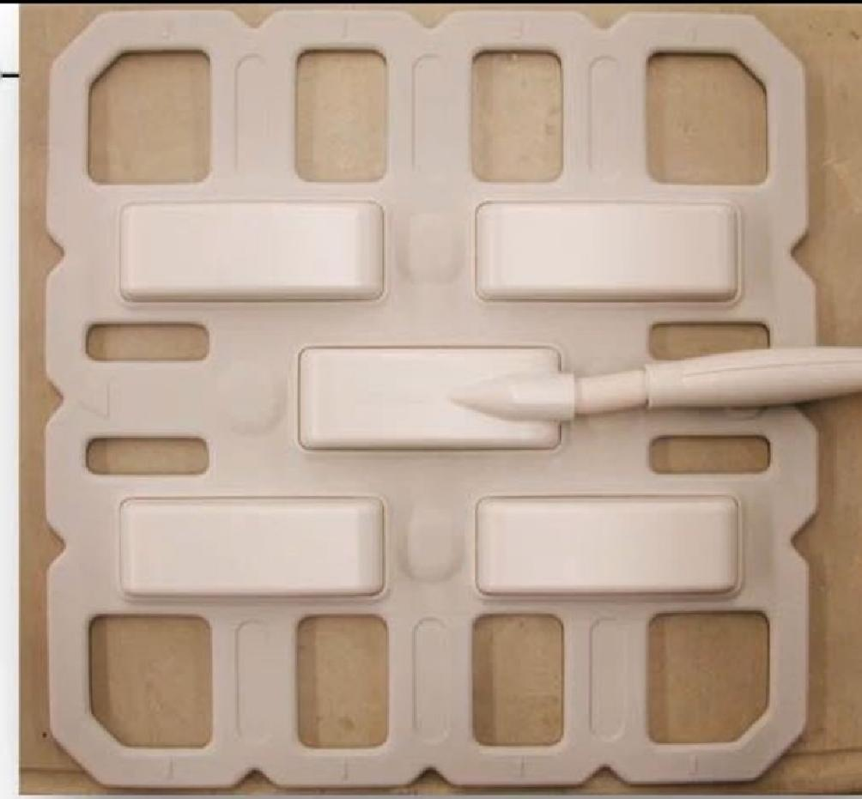
Toshiba 1.5T Body Atlas SPEEDER Coil
Part number:MJAB-167A
>70 Repairs
Most frequent failures
1. Intermittent flex traces and wiring
2. Bent/damaged pins in connector
3. Intermittent solder connections and physical damage to electrical components
Intermittent flex traces
Connector Trauma
Component Fail due to
Components fail
Intermittent Wiring
Preventable Damage
77%

Slide 12
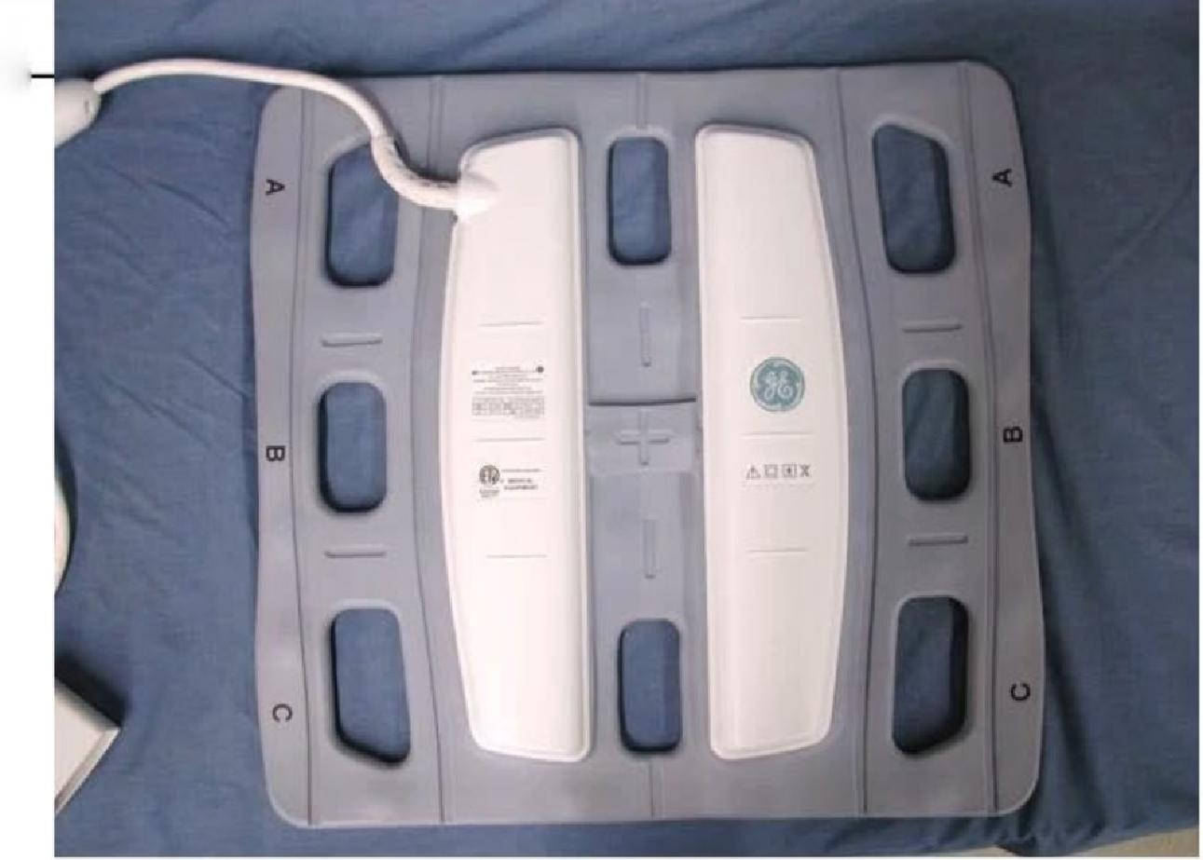
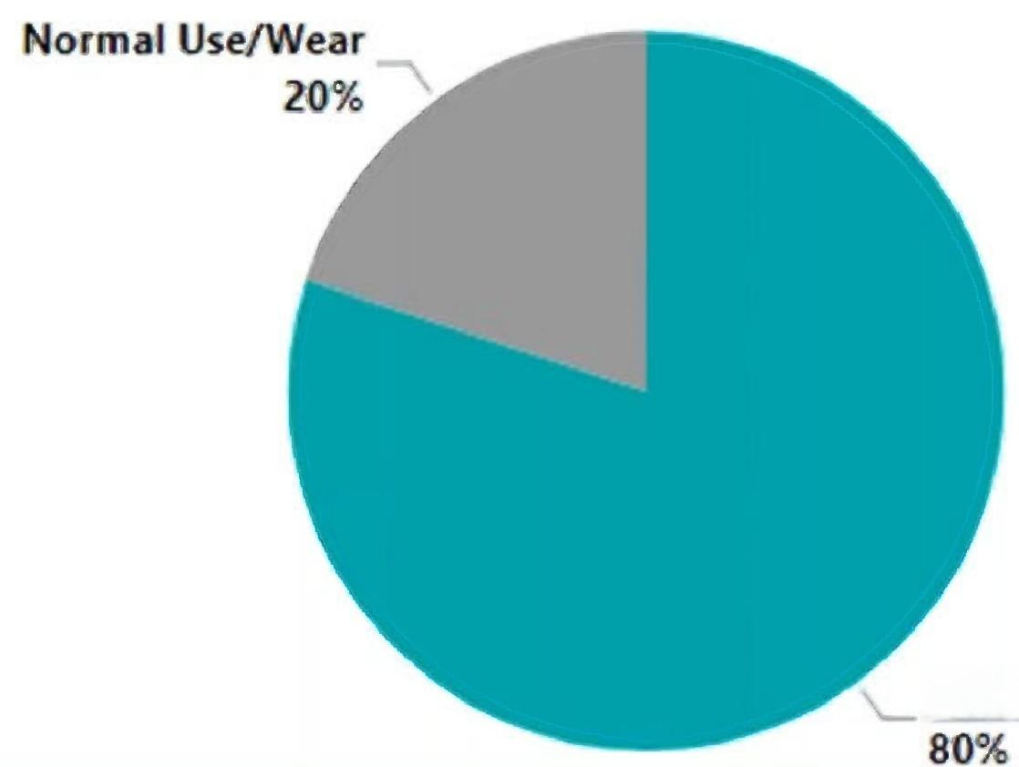
GE 1 .5T Express 9E Anterior Array
Part numbers:5407990,5433103,5746587,M50002HM
>80 Repairs
Most frequent failures
1. Intermittent flex traces and wiring
2. Random component failures
3. Bent/damaged pins in connector
Intermittent flex traces
Components fail
Component Fail due to
Preventable Damage
Cable Trauma
Worn Wiring

Slide 13
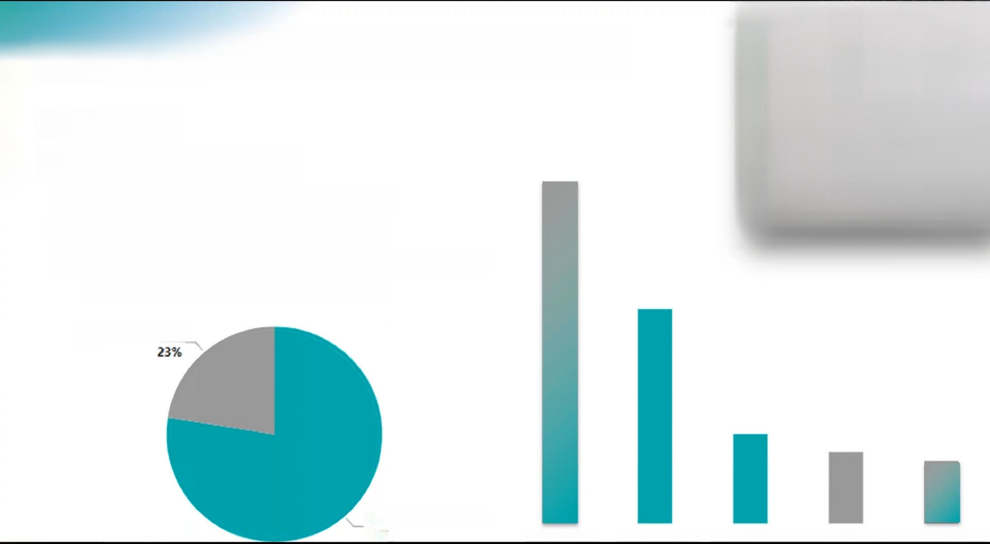
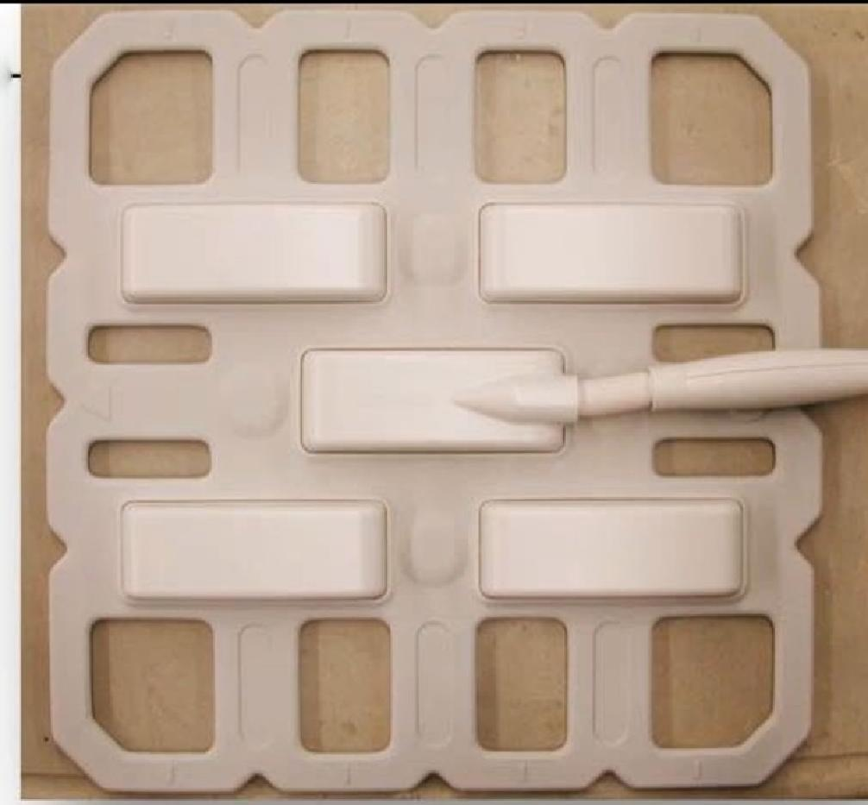
Toshiba 1.5T Body Atlas SPEEDER Coil
Part number:MJAB-167A
>70 Repairs
Most frequent failures
1. Intermittent flex traces and wiring
2. Bent/damaged pins in connector
3. Intermittent solder connections and physical damage to electrical components
Intermittent flex traces
Connector Trauma
Normal Use/Wear
Preventable Damage 77%
Component Fail due to
Components fail
Intermittent Wiring

Slide 14
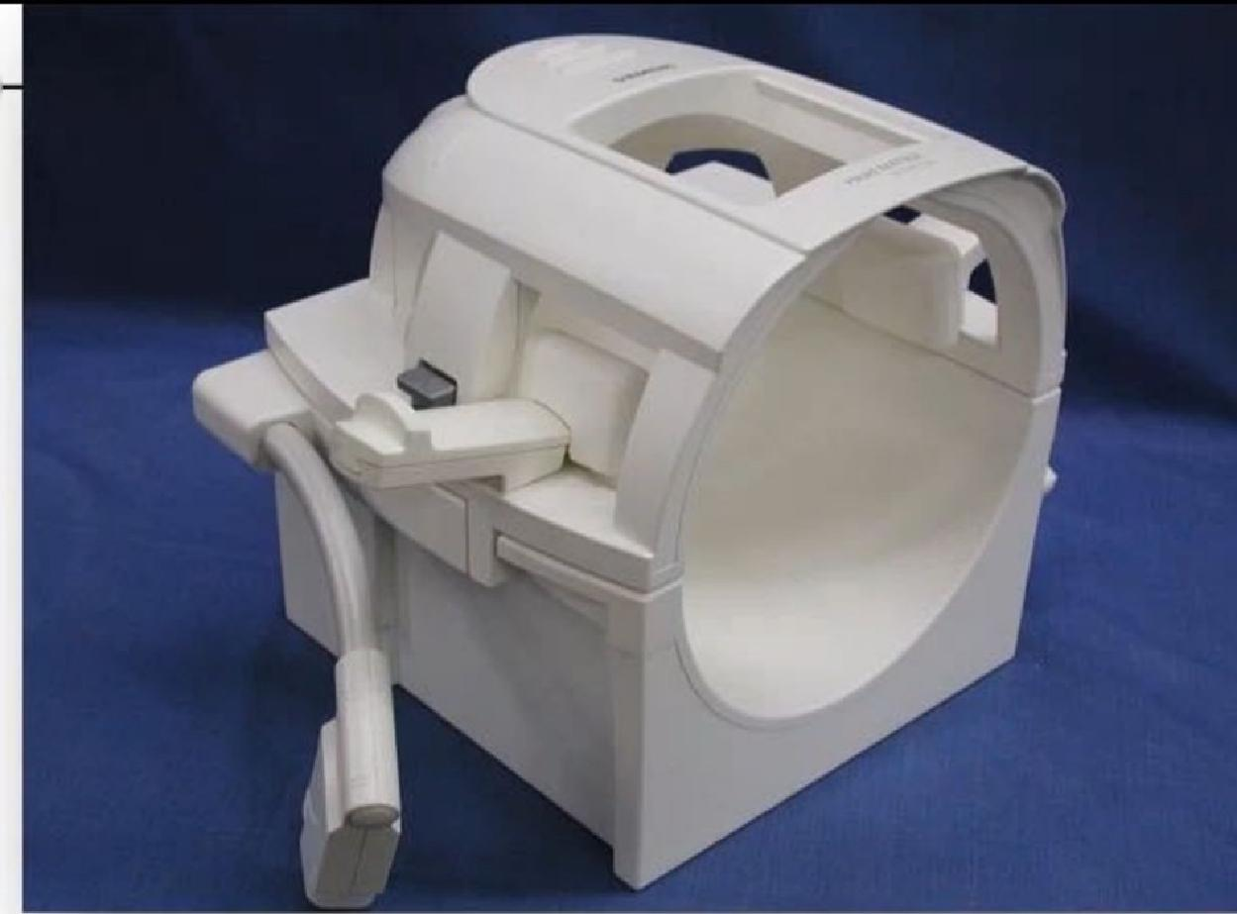
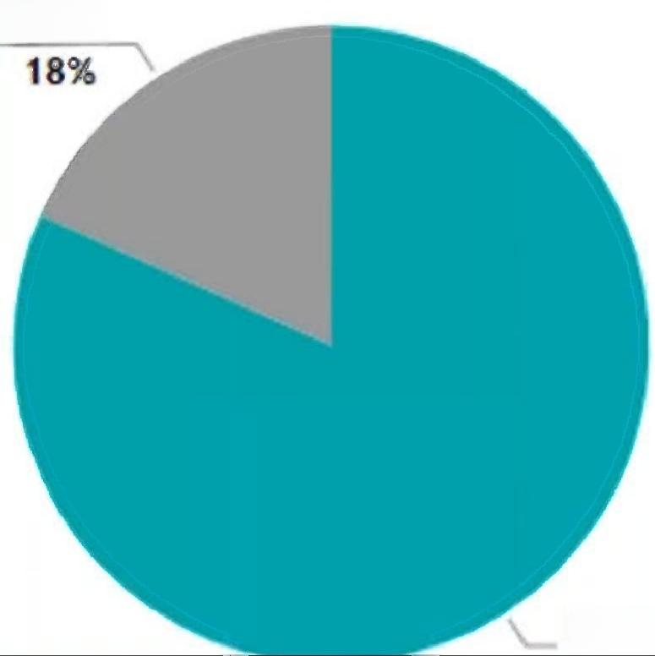
Siemens 1.5T Head Matrix Array
Part numbers:7577732,5319252
>60 Repairs
Most frequent failures
1. Bent/damaged pins and physical damage to connector
2. Intermittent solder connections and physical damage to electrical components
3. Intermittent wiring
Connector trauma
Component Fail due to
Normal Use/Wear
Preventable Damage 82%
Intermittent Wiring
Electronic tuning
Worn Wiring
Cable Trauma
Components fail

Slide 15
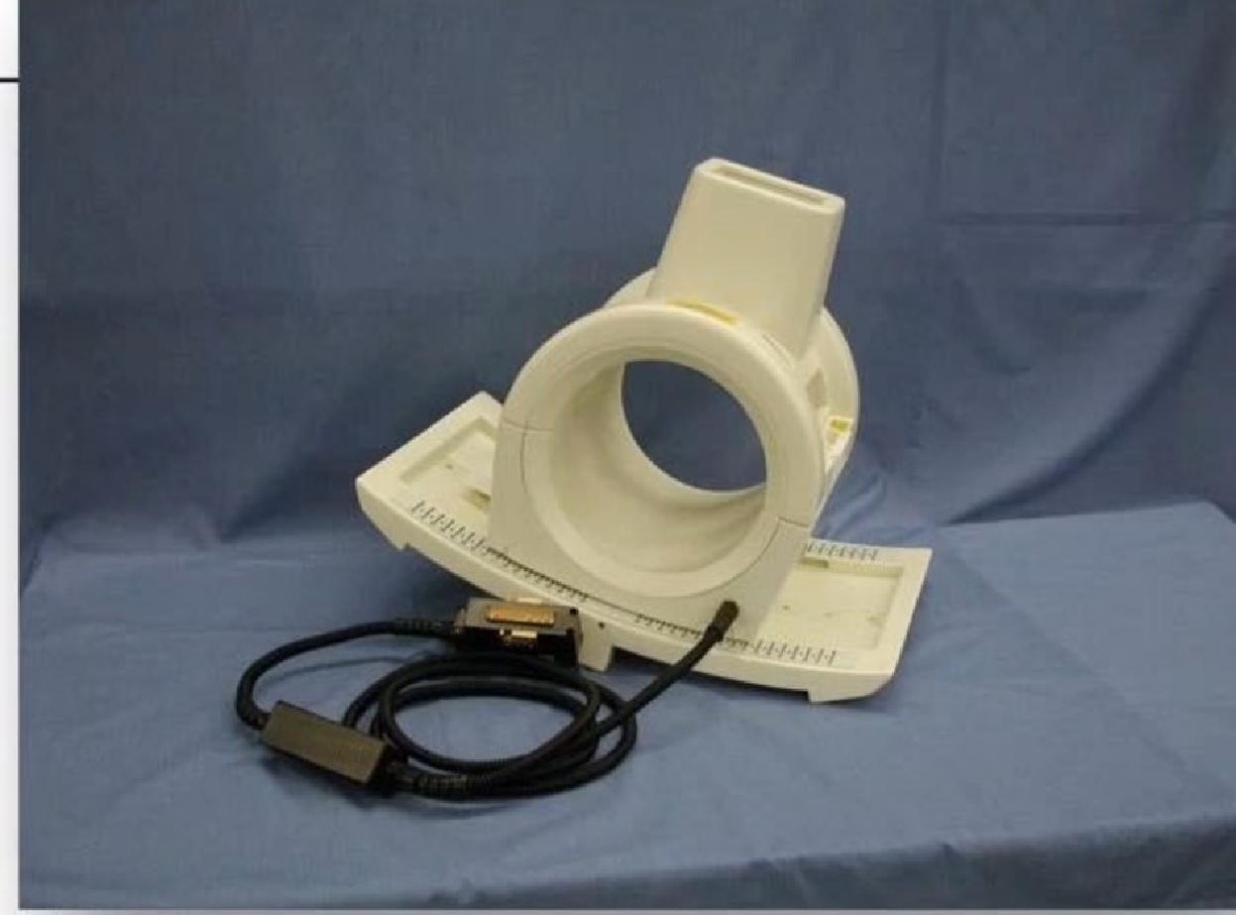
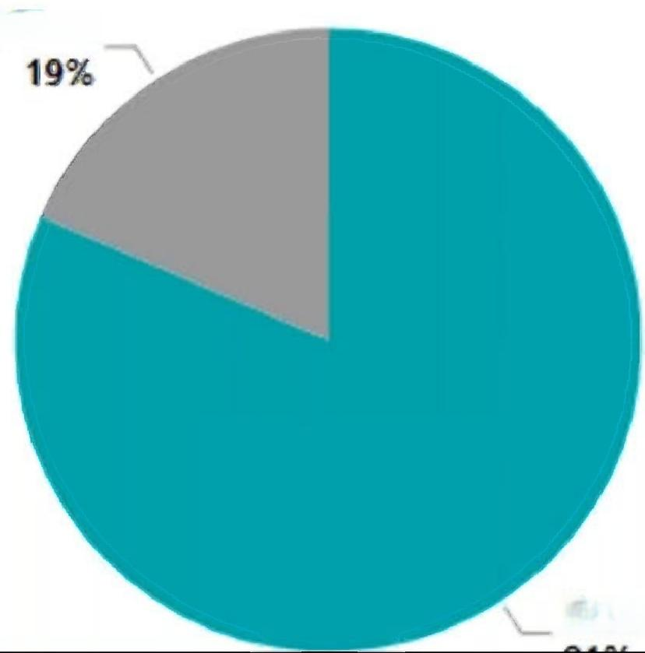
Siemens 1.5T Extremity TR Matrix
Part number:474SI-64F
>60 Repairs
Most frequent failures
1. Intermittent solder connections and physical damage to electrical components
2. Random component failures
3. Intermittent wiring
Normal Use/Wear
Preventable Damage 81%
Component failure due to
Component failure
Intermittent
wiring
Connector
trauma
Electronic tuning
Worn
wiring
Cable trauma

Slide 16
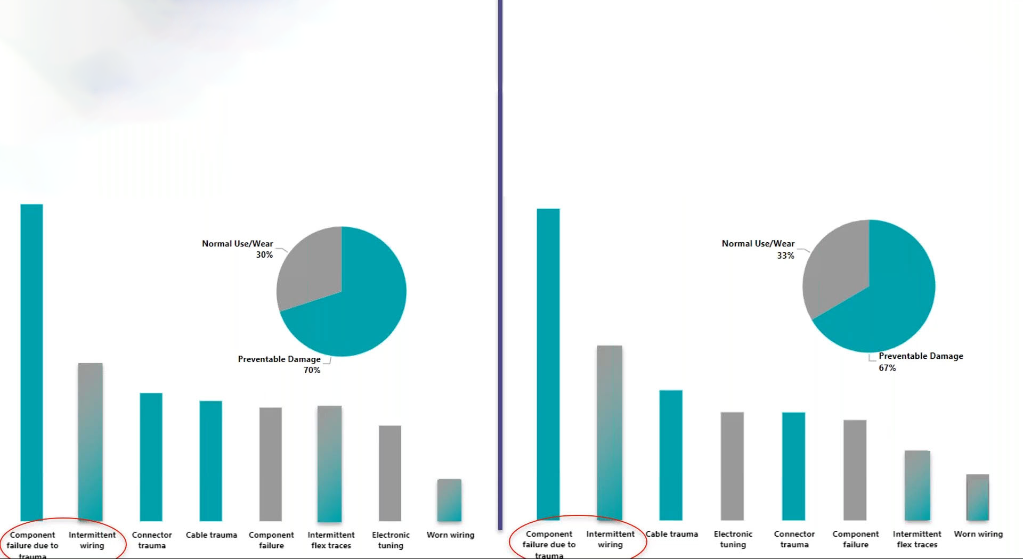
Comparing failures of top-10 to remaining volume
10 coil models
> 1800 repairs
>300 coil models
>1700 repairs
Component Intermittent failure due to wiring
Cable trauma
Electronic Connector
tuning trauma

Slide 17
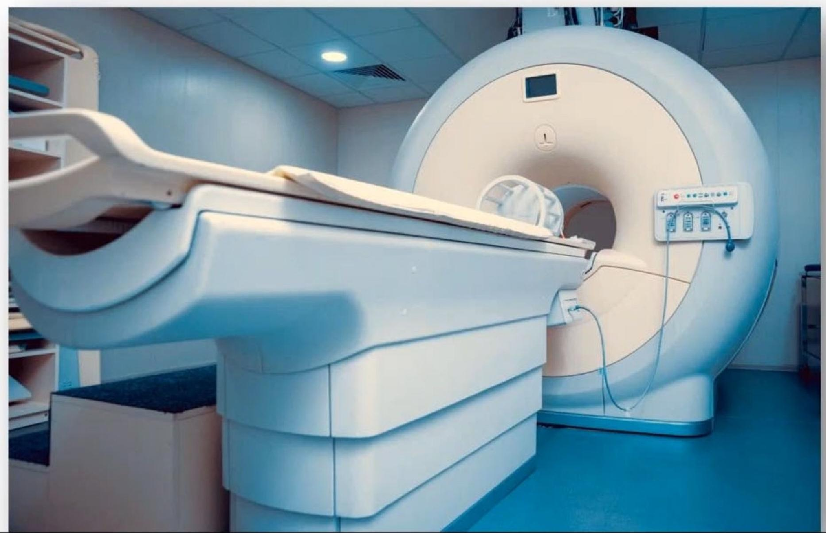
6 Strategies to Minimize Failures and Costs
Visual
Inspection
Early
Detection
Education
Partnership
Physical
Manipulation
Internal Inspection
Prevention
1.Prevention...Observe usage
· Transportation practices
· Patient placement practices
· Cable routing practices
· Cleaning practices

Slide 18
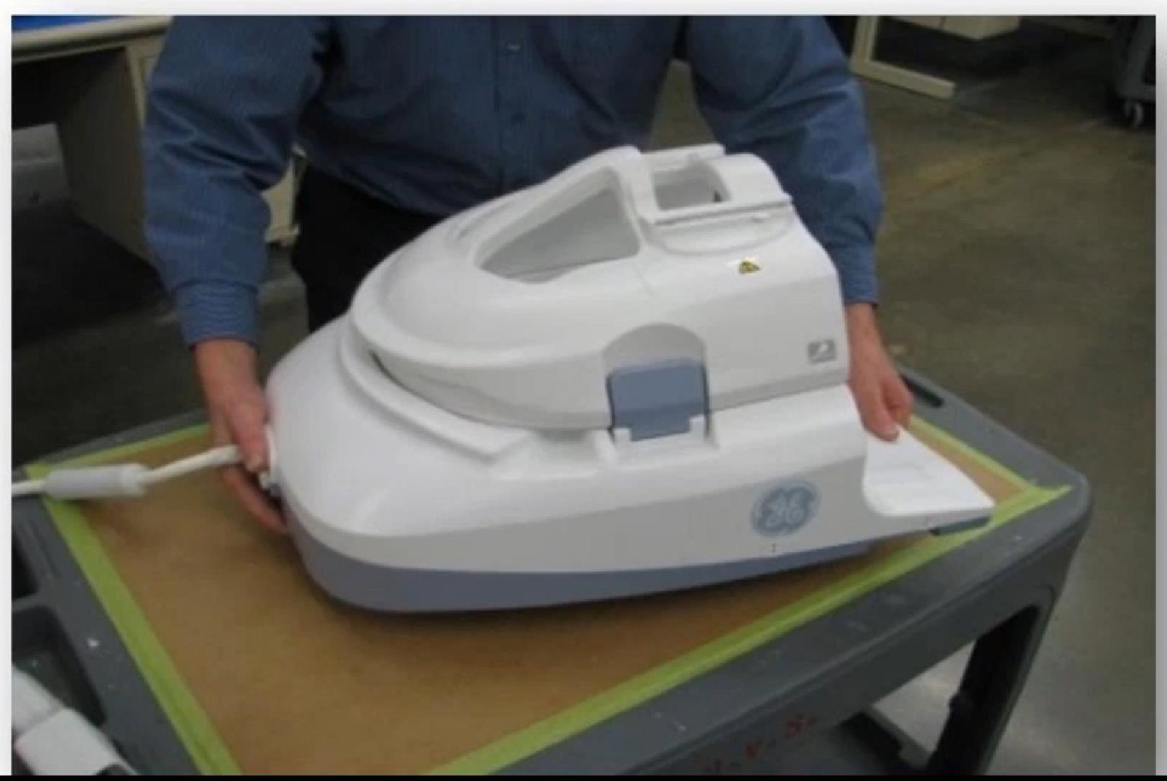
6 Strategies to Minimize Failures and Costs
Prevention
Visual
Inspection
Early
Detection
Education
Partnership
Physical
Manipulation
Internal
Inspection
Transportation Practices
· Transport the coil by gripping and supporting it from the sides
· NEVER pick up the coil from a single section (anterior section).
· When transporting between rooms,
ALWAYS use a cart

Slide 19
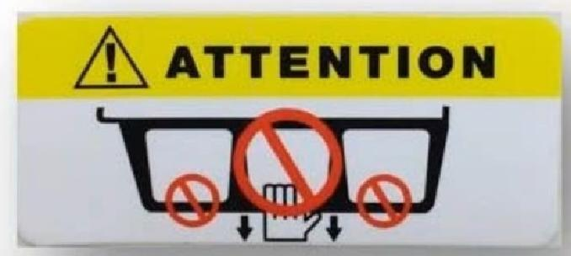
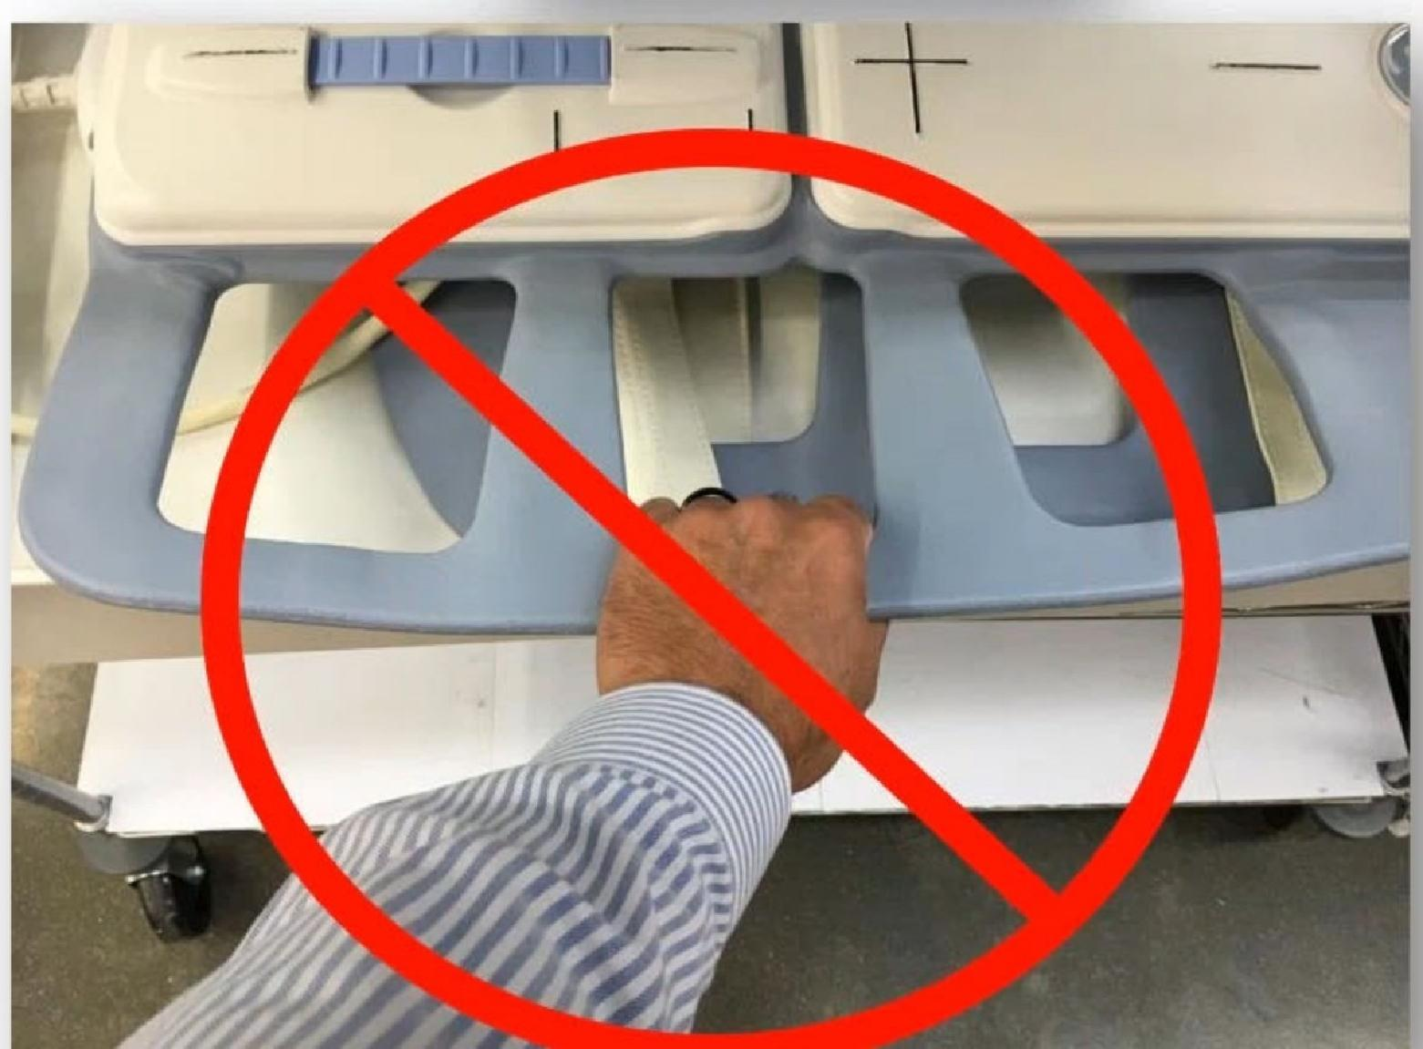
6 Strategies to Minimize Failures and Costs
Visual
Inspection
Early
Detection
Education
Partnership
Physical
Manipulation
Internal Inspection
Prevention
Transportation Practices
· Flex coils should ALWAYS be cradled from the bottom,gripped at the center housing or carried by the designated handle
- The coil should NEVER be carried by the flexible portion,as there are sensitive
components contained within that can be damaged by doing so
· DO NOT carry coils by the cable
- Component damage may occur

Slide 20
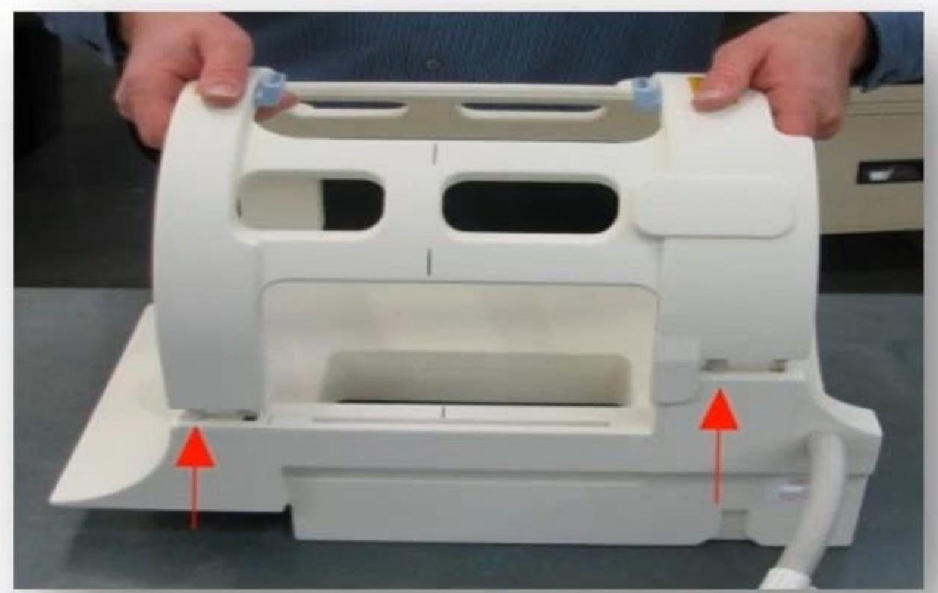
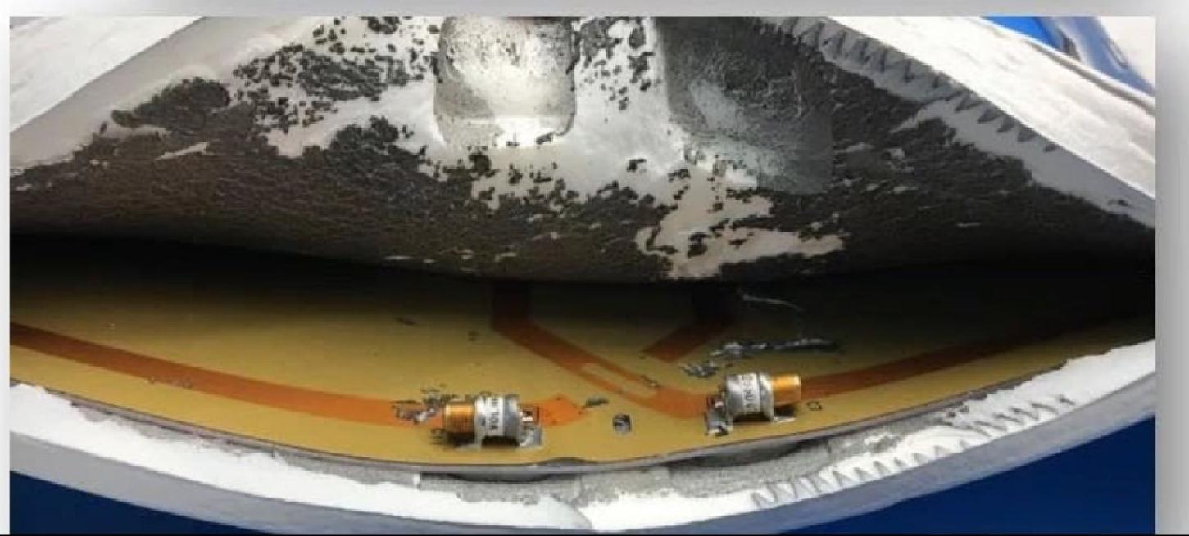
6 Strategies to Minimize Failures and Costs
Visual
Inspection
Early
Detection
Education Partnership
Physical
Manipulation
Internal Inspection
Prevention
Patient Placement Practices
· ALWAYS remove the anterior portion of a coil by pulling straight-up
- If the anterior is removed at an angle,the connections between the anterior and
posterior sections will be damaged
· With flex coils, DO NOT adjust the position of a patient using the coil,as it may cause both physical and electro-mechanical
damage

Slide 21
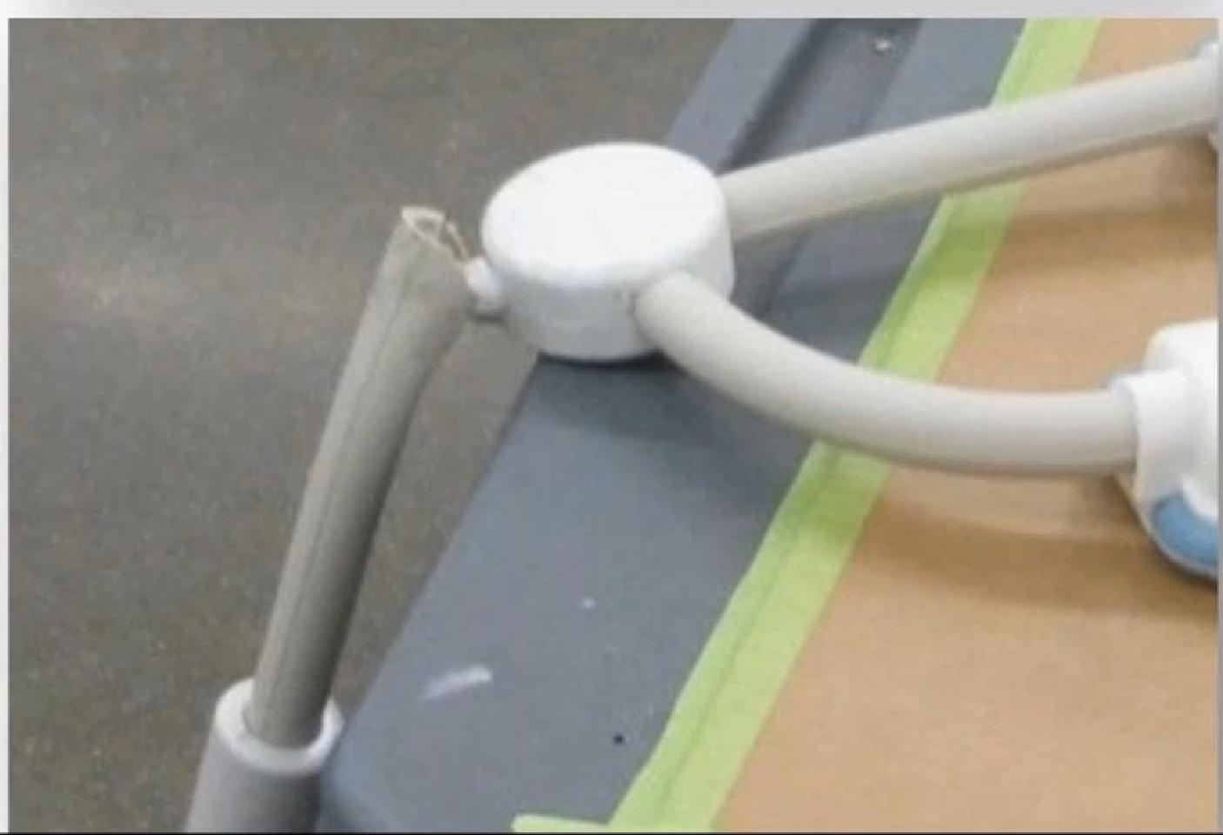
6 Strategies to Minimize Failures and Costs
Visual
Inspection
Early
Detection
Education
Partnership
Physical
Manipulation
Internal Inspection
Prevention
Cable Routing Practices
· DO NOT loop or cross the cable when in use
- Looped cables may cause RF coupling and may degrade image quality
· DO NOT permit the cable to be bent at an extreme angle
- Route the cable using soft angles
- Damage can occur if the cable is bent to an extreme degree
· ALWAYS unplug the coil prior to lowering the table
- Failure to do so may damage the coil,cable or

Slide 22
6 Strategies to Minimize Failures and Costs
Visual
Inspection
Early
Detection
Education Partnership
Physical
Manipulation
Internal Inspection
Prevention
Cleaning Practices
· Clean the coil with a cloth dampened in a solution of:
- 10%bleach and 90%tap water,or
- 30%isopropyl alcohol and 70%tap water
- ALWAYS consult the OEM or OEM manual for approved chemicals
-ALWAYS detach the coil from the scanner before attempting to clean it
- DO NOT submerge any part of the coil
- DO NOT spray/pour cleaning agent directly on to coil,internal circuitry could be damaged
- Electric shock may occur if the coil is attached to the system during cleaning or when it is still wet

Slide 23
Prevention
Visual
Inspection
Early
Detection
Education
Partnership
Physical
Manipulation
Internal
Inspection
2.External Visual Inspection
· OEMs recommend USERS visually inspect prior to EVERY use
· Realistically,managers should assign one MRI technologist to inspect EVERY coil EVERY week
- Alternate technologists every week
Any concerns would be relayed to a service engineer

Slide 24
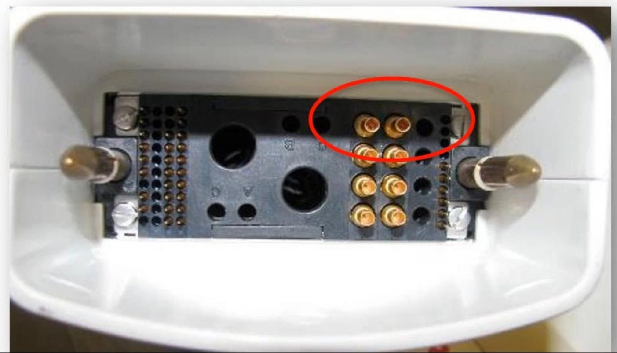
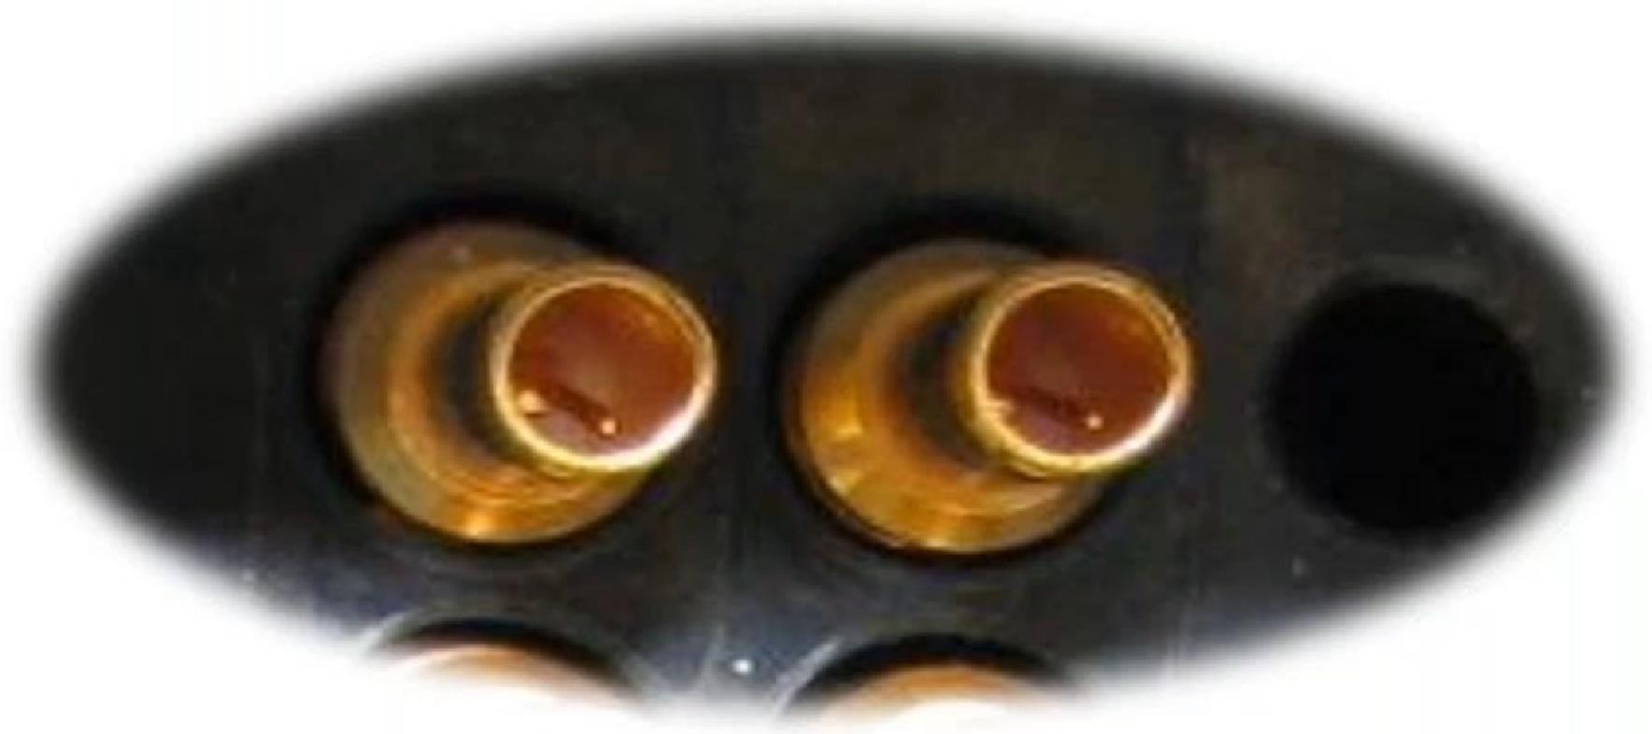
6 Tips to Minimize Failures and Costs
Visual
Inspection
Early
Detection
Education Partnership
Physical
Manipulation
Internal Inspection
Prevention
Bent pins in connectors
· Connectors should slide together with ease

Slide 25
6 Tips to Minimize Failures and Costs
Prevention
Visual
Inspection
Early
Detection
Education Partnership
Physical
Manipulation
Internal Inspection
Cracked connectors and housings and damaged foam indicate trauma and:
· Possible internal mechanical damage
· Broken solder joints
· Intermittent connections
· Broken electrical components

Slide 26
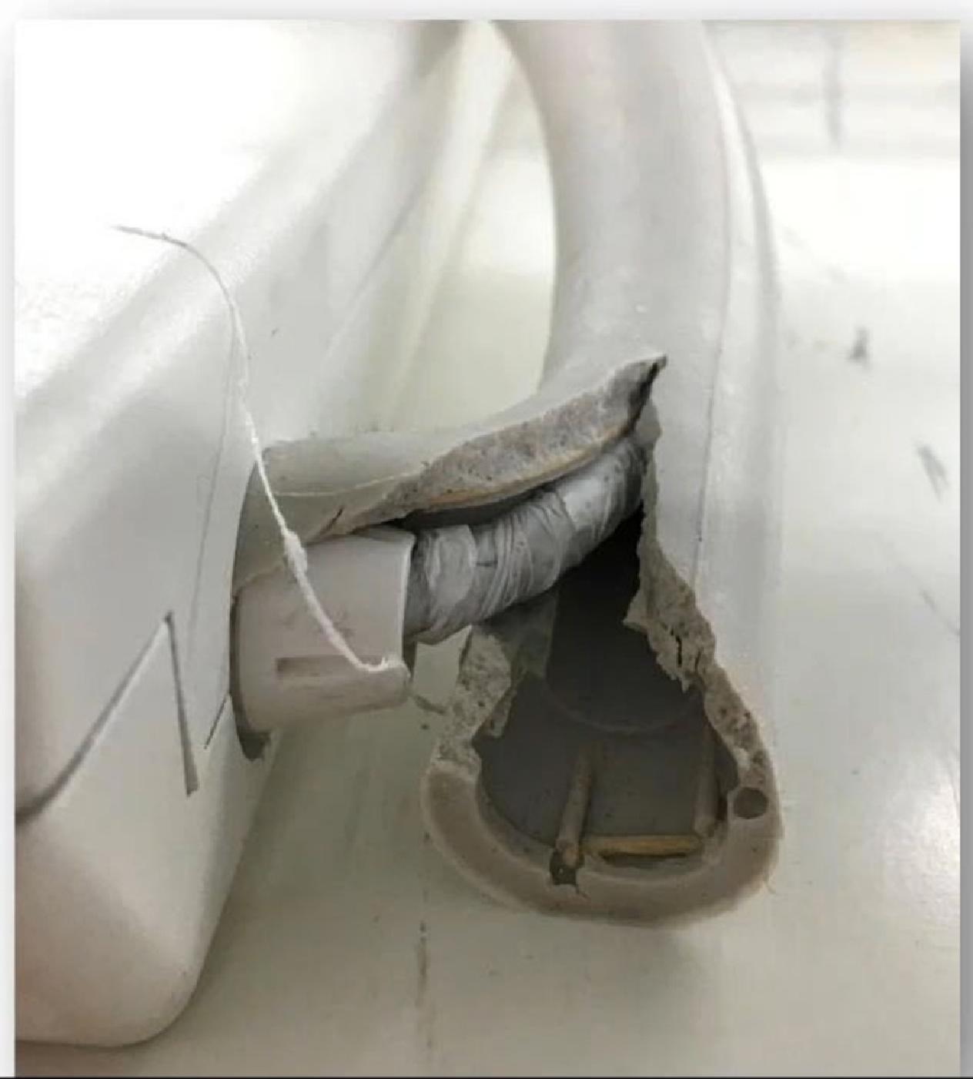
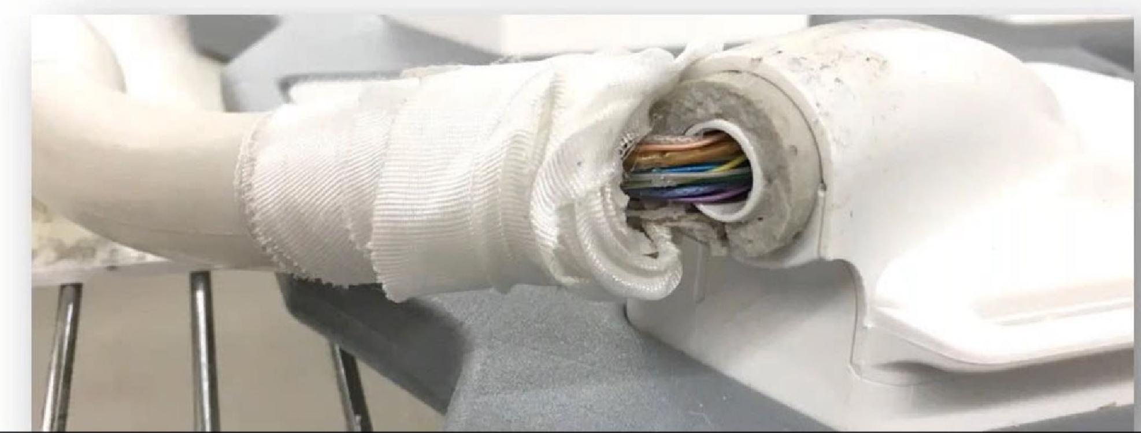
6 Tips to Minimize Failures and Costs
Visual
Inspection
Early
Detection
Education Partnership
Physical
Manipulation
Internal Inspection
Prevention
3.Early Detection
· Users need to alert service engineers as soon as a visual flaw is identified,NOT wait until a failure OCCurs
Cost difference may be hundreds versus thousands of dollars

Slide 27
6 Tips to Minimize Failures and Costs
Visual
Inspection
Early
Detection
Education
Partnership
Physical
Manipulation
Internal Inspection
Prevention
4.Education/Partnership
· Ask for 15-minutes during a department meeting
· Educate technologists on
- Costs associated with repairing/replacing coils
- Best practices for transport,cable routing and patient manipulation
- How to visually inspect a coil
- When to alert you of a finding

Slide 28
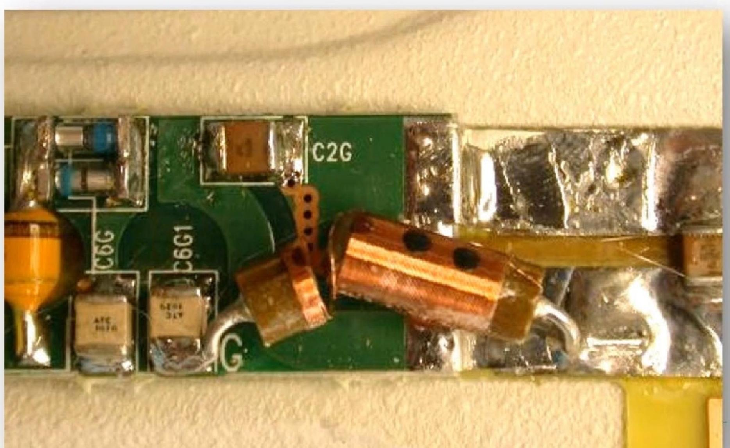
6 Tips to Minimize Failures and Costs
Prevention
Visual
Inspection
Early
Detection
Education
Partnership
Physical
Manipulation
Internal
Inspection
5.Physical manipulation
· Rotate the coil in all directions listening
for internal noise,rattling,or creaking

Slide 29
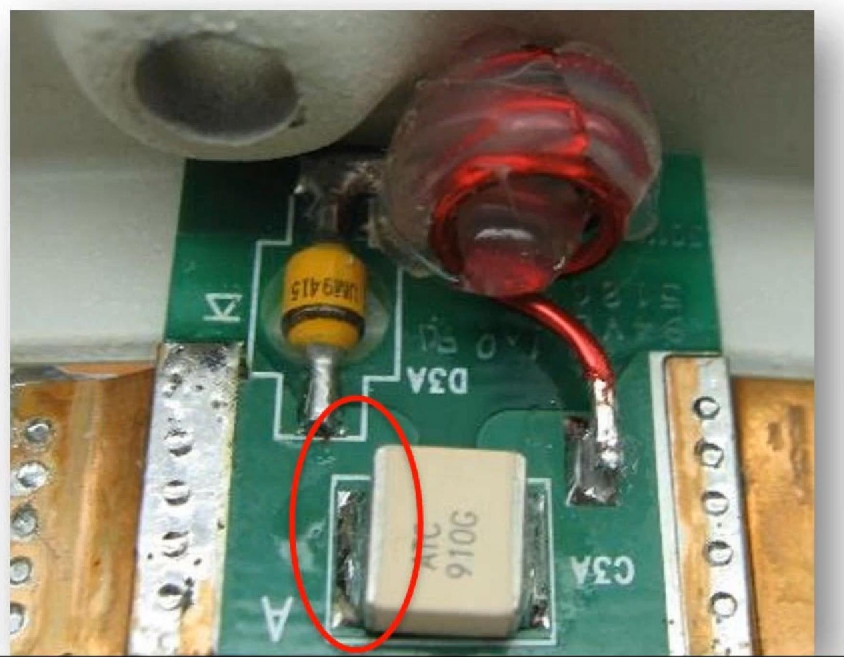
6 Strategies to Minimize Failures and Costs
Prevention
Visual
Inspection
Early
Detection
Education
Partnership
Physical
Manipulation
Internal
Inspection
6.Internal Inspection
· NOT RECOMMENDED
- May induce additional problems
- Requires significant time
Does allow for
- Inspection for broken solder joints
- Perform continuity tests on wiring and cables

Slide 30
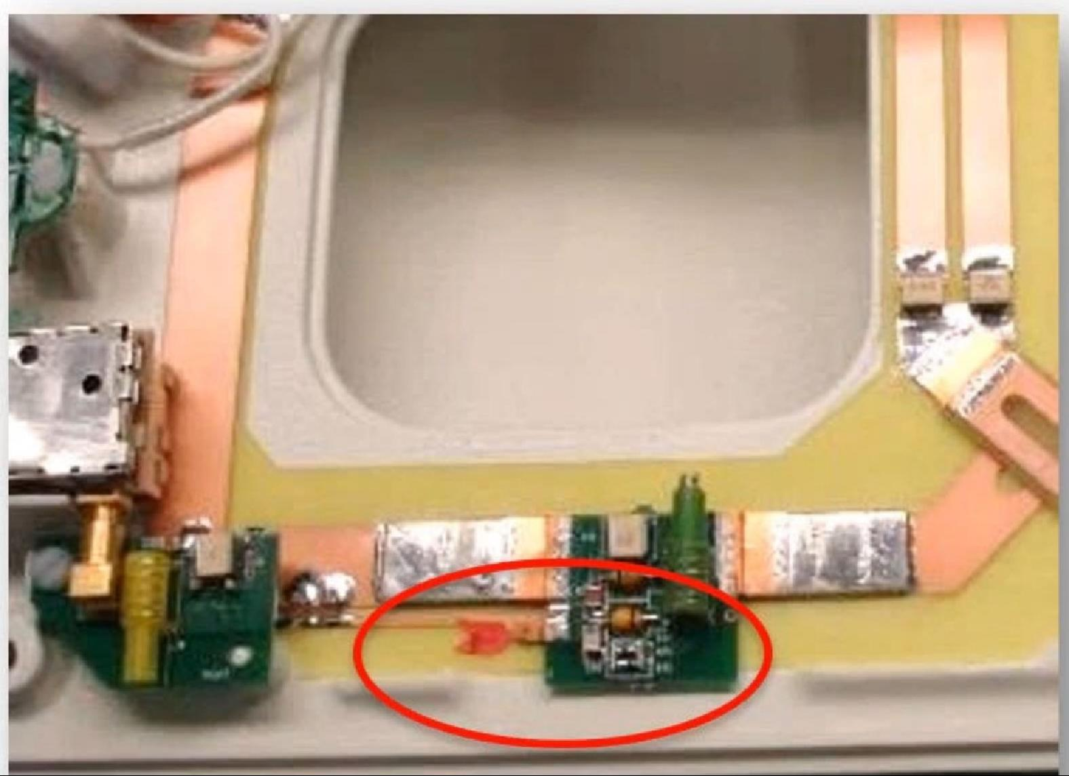
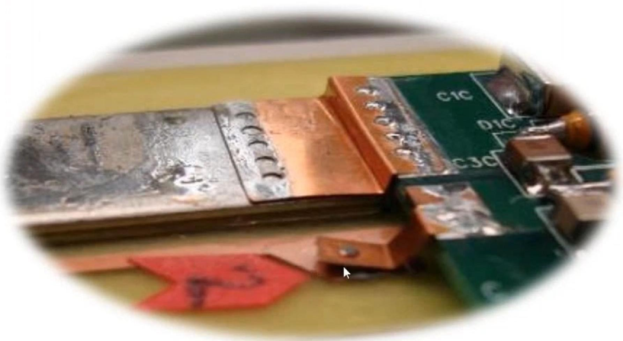
6 Tips to Minimize Failures and Costs
Prevention
Visual
Inspection
Early
Detection
Education
Partnership
Physical
Manipulation
Internal
Inspection
Internal Inspection
· Broken solder joints

Slide 31
6 Tips to Minimize Failures and Costs
Prevention
Visual
Inspection
Early
Detection
Education Partnership
Physical
Manipulation
Internal
Inspection
Internal Inspection
· Broken components

Slide 32
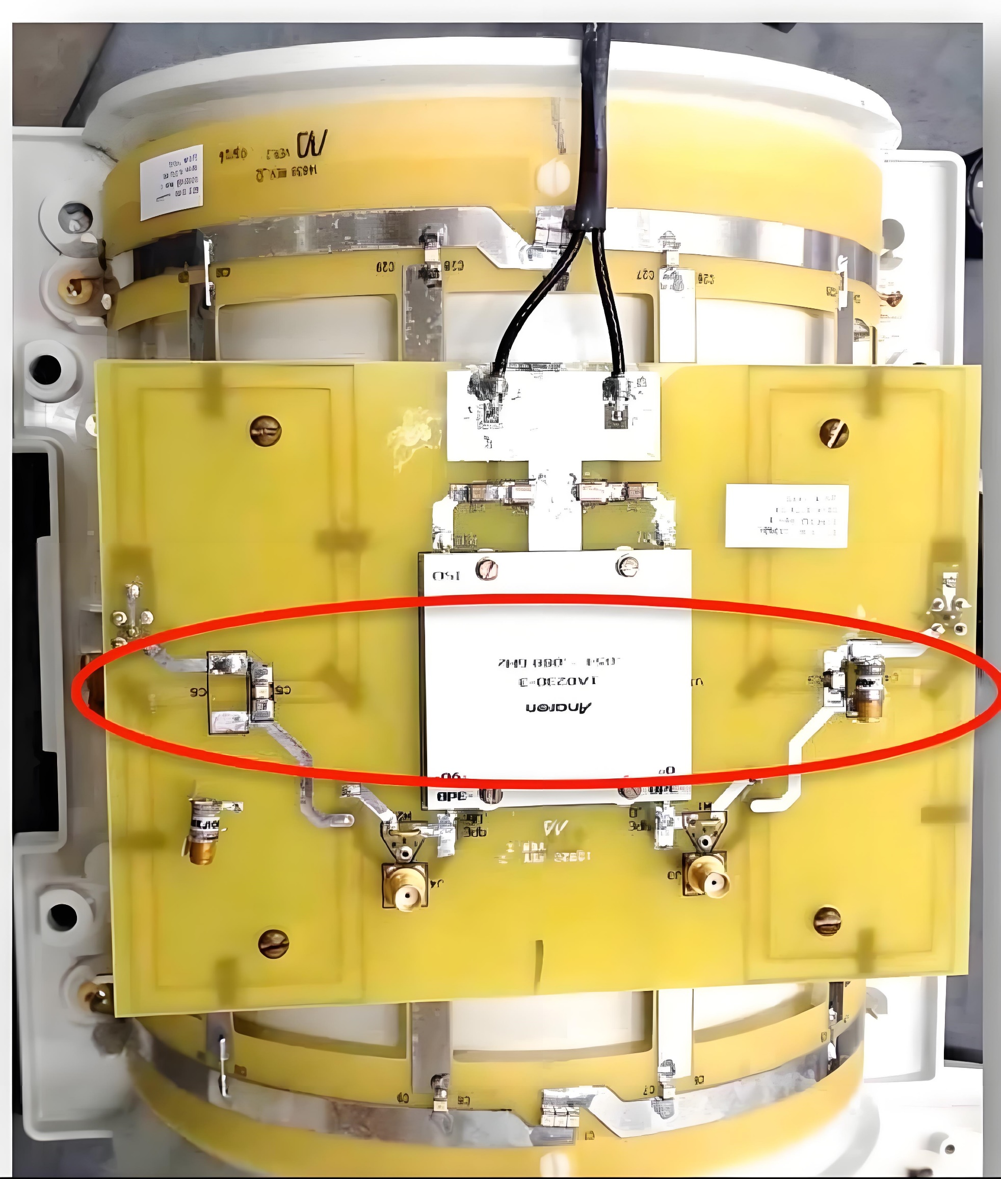
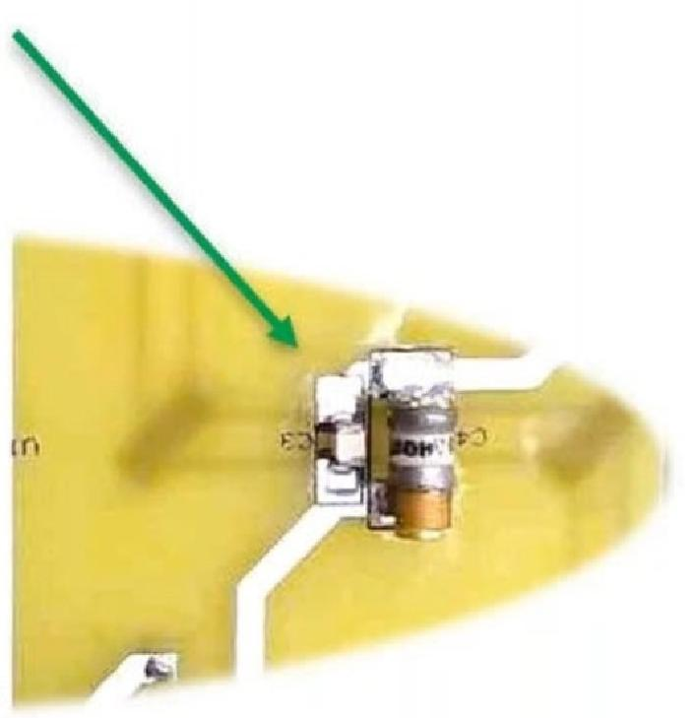
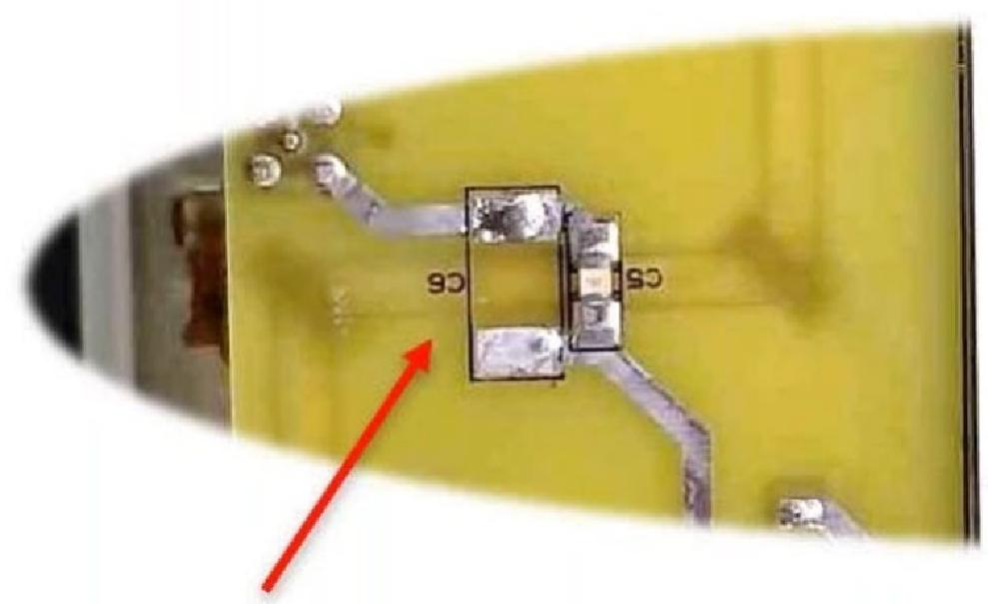
6 Tips to Minimize Failures and Costs
Prevention
Visual
Inspection
Early
Detection
Education
Partnership
Physical
Manipulation
Internal
Inspection
Internal Inspection
· Missing components

Slide 33
Summary
· Based on our data
- >50%of coil failures are due to trauma
- Only 19% are due to actual random electronic failures
· Focus efforts on prevention,early detection,and education
· Base your troubleshooting on visual and functional cues
· Let those with expertise,experience,proper testing equipment, and proven procedures restore your coil's performance

Slide 34
Thank you
Need material for Repair？？？ www.rf-coaxial.com

