Slide 1
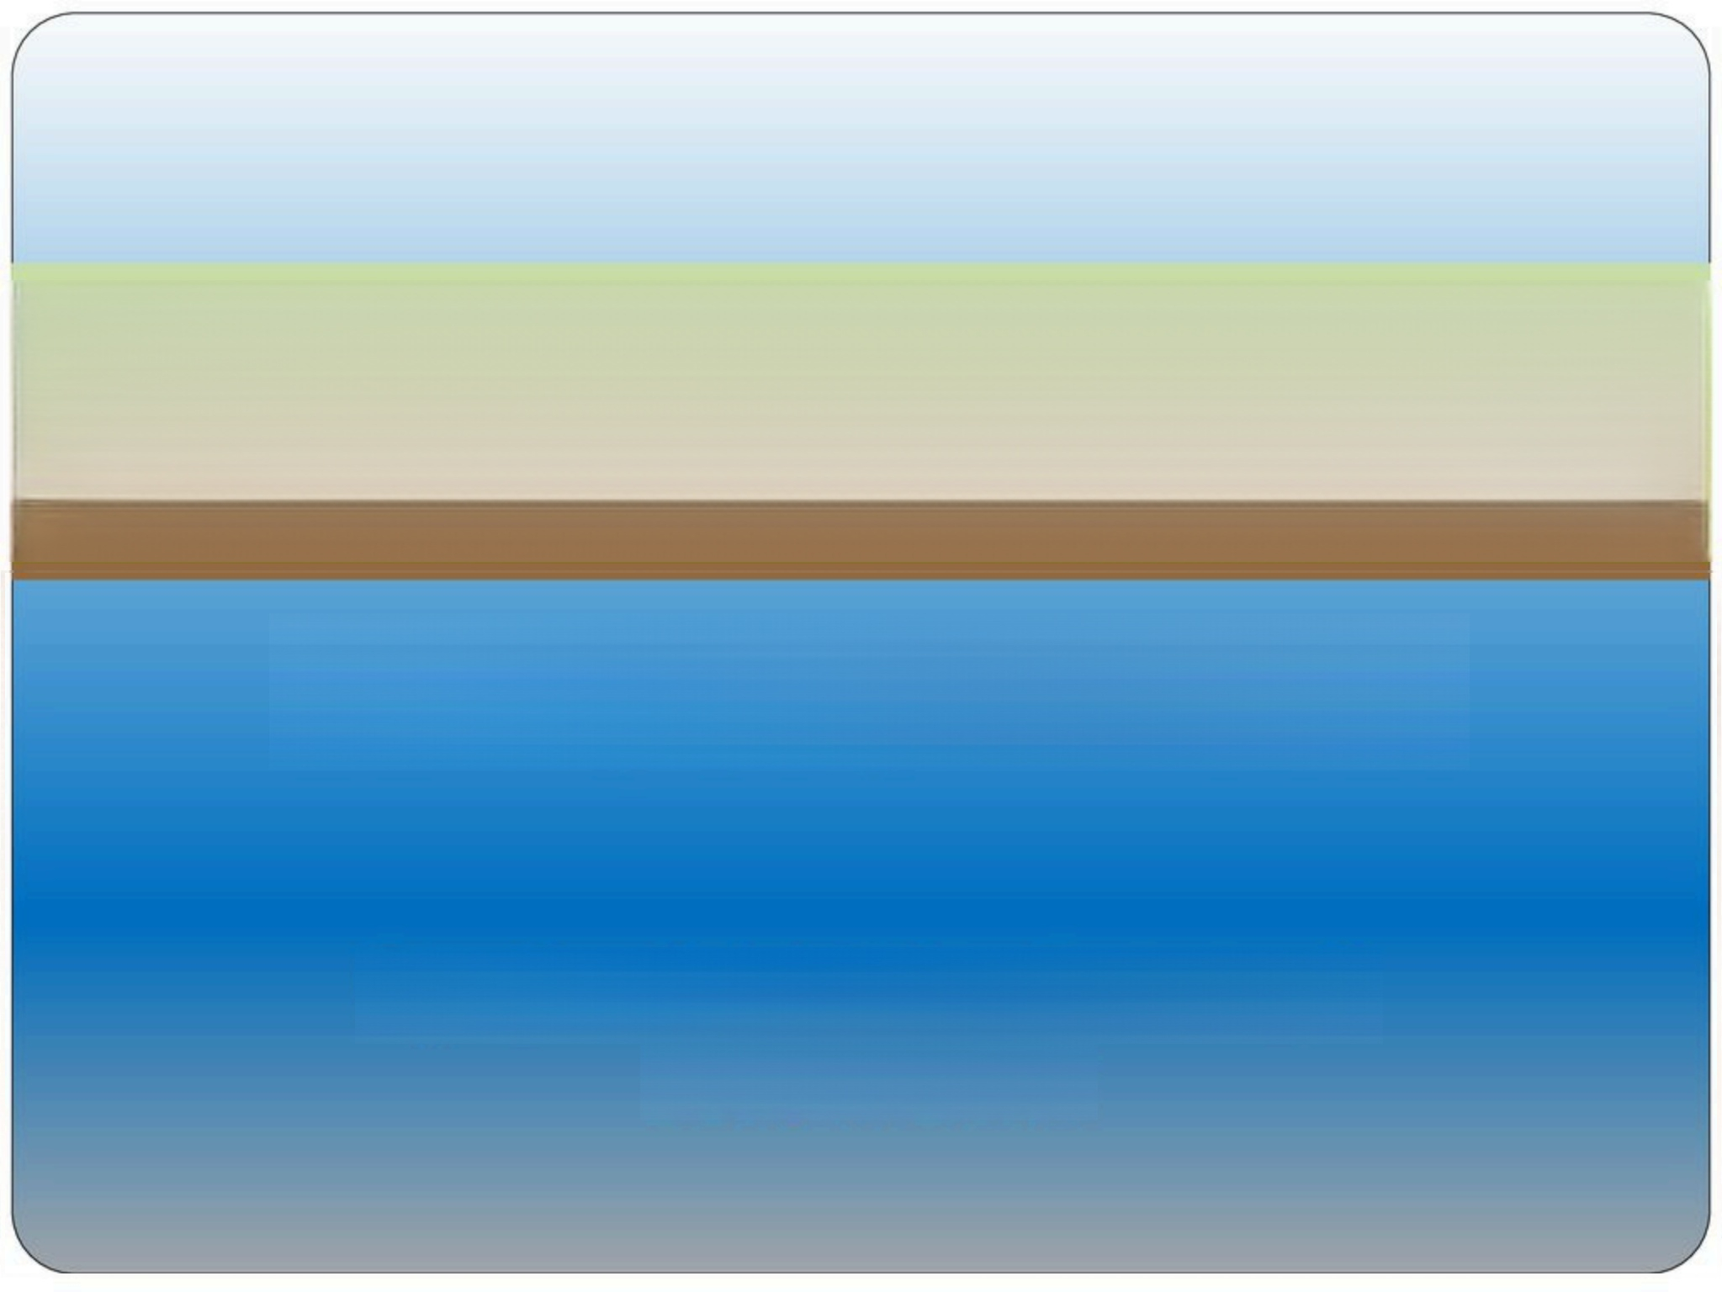
MRI Coil Types
By:RF-Coaxial
www.rf-coaxial.com

Slide 2

Types of coils in MRI
· Gradient Coils
●RF Coils

Slide 3
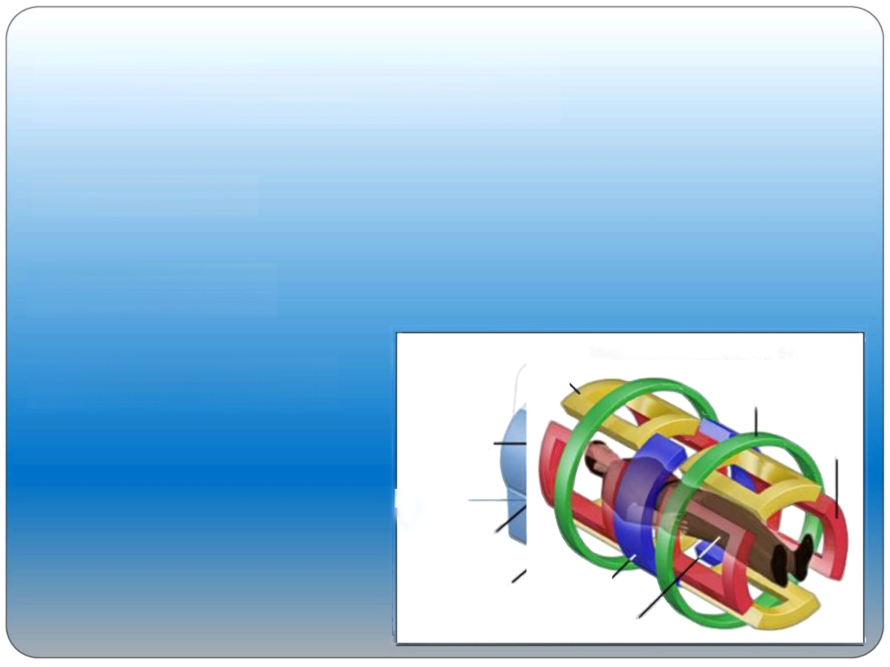
Gradient coils (X & Y& Z)
●Slice selection
· Phase encoding
· Frequency encoding
MRI Scanner Gradient Magnets
Y Coil
Z Coil
RF Coil
X Coil
Shimming Coil、
Gradient Coil、
Magnet
Transceiver
Patient

Slide 4
RF Coils
Surface coils
Phase array coils
Volume coil
Quadrature coils
Helmholtz coils
Some other specific coils

Slide 5
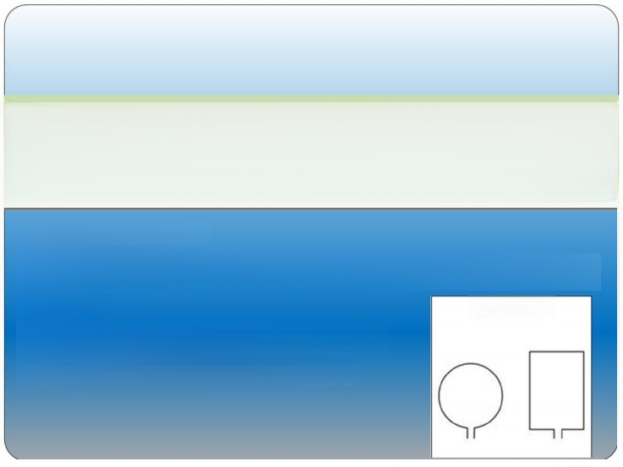
Surface coils
Simplest design
Single channel---no couple with Parallel Imaging (iPAT)
Receiver
For local area due to small coverage
High SNR but low homogeneity
·
Surface coils

Slide 6
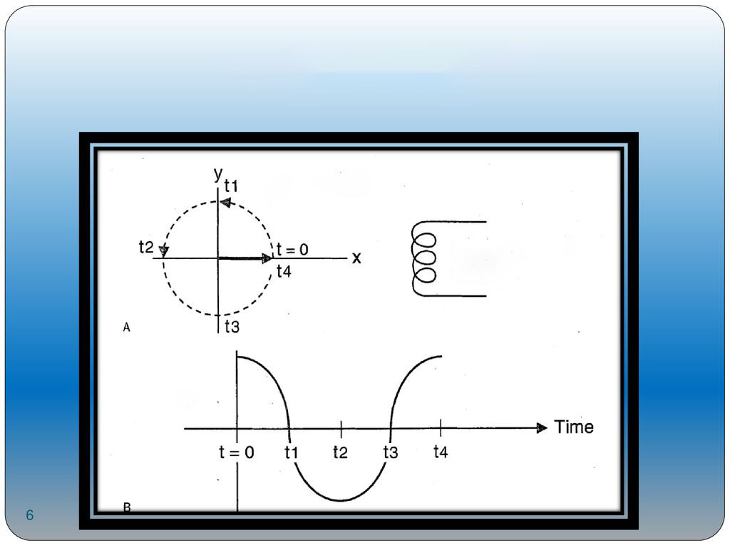
Received signal
Proton spins in x-y plane
RF coil transmitter/receiver
6
B
Received Signal

Slide 7
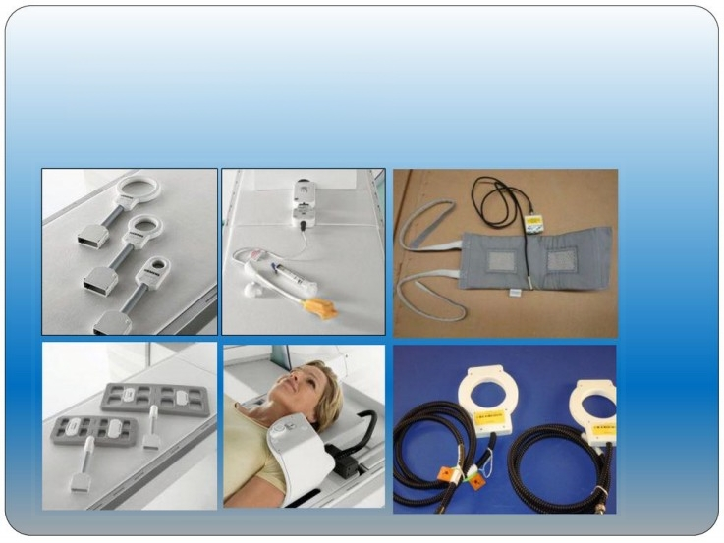
Surface coils types

Slide 8
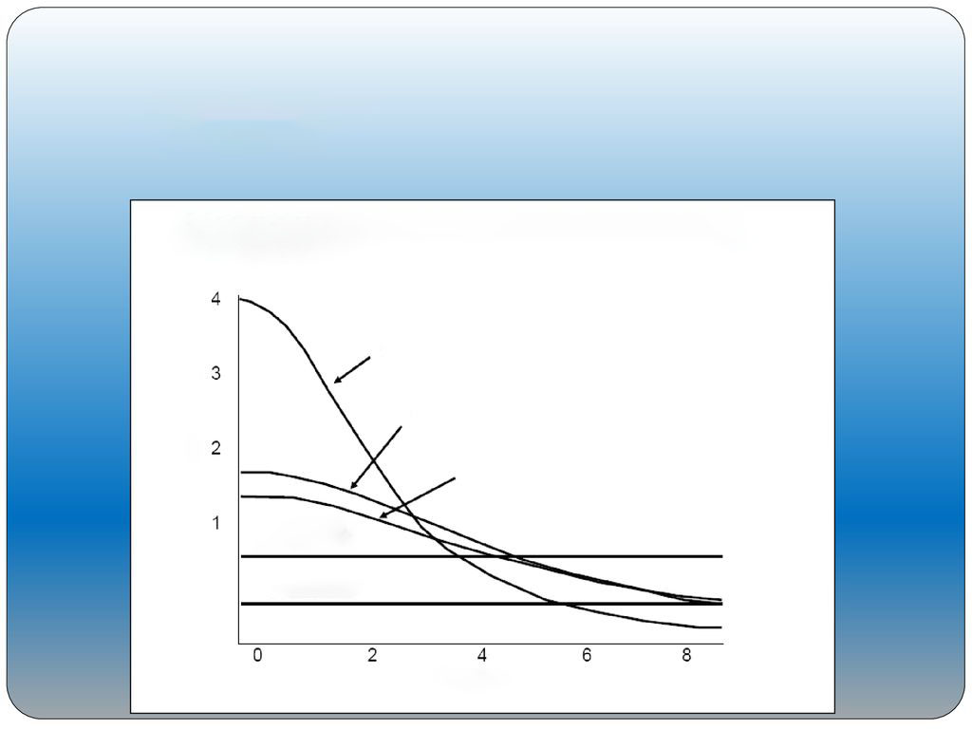
Surface coils
SNR vs. Depth for Surface Coils
3” diameter circle
Relative Coil Sensitivity
6” diameter circle
Head Coil
Body Coil
Distance

Slide 9

Surface Coils Applications
Shoulder
Elbow
Wrist & hand
TMJ
Eyeball
Local anatomy(prostate)

Slide 10

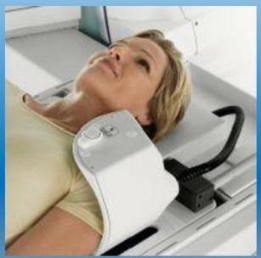
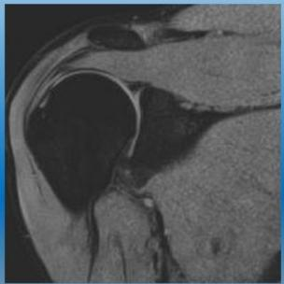
Surface Coils Applications
Shoulder Coil
Coronal PD fat sat

Slide 11

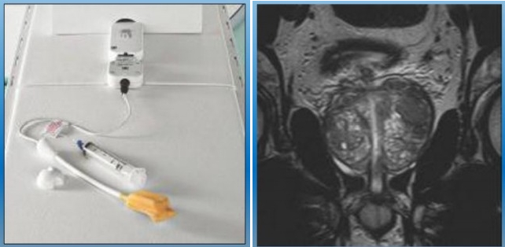
Surface coils applications
Endorectal Coil
Cor T2w TSE

Slide 12

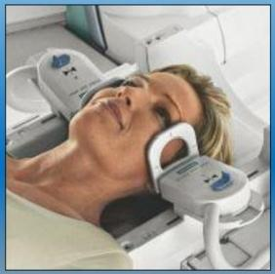
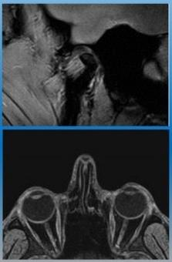
Surface coils applications
Loop coil for TMJ&eye ball &wrist &hand

Slide 13

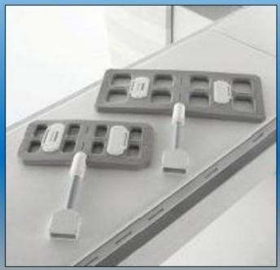
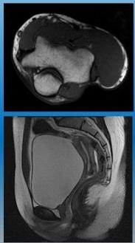
Surface coils applications
Flex surface coil-large &small

Slide 14

Phase array coils
 | Several overlap surface coil
 | More than one channel
 | High SNR but low homogeneity
 | Compatible with parallel image (iPAT/ASSET)

Slide 15

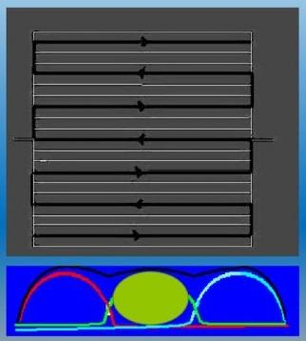
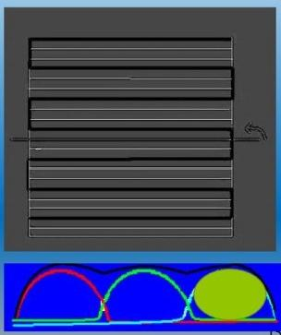
Parallel Imaging(k-space base)

Slide 16
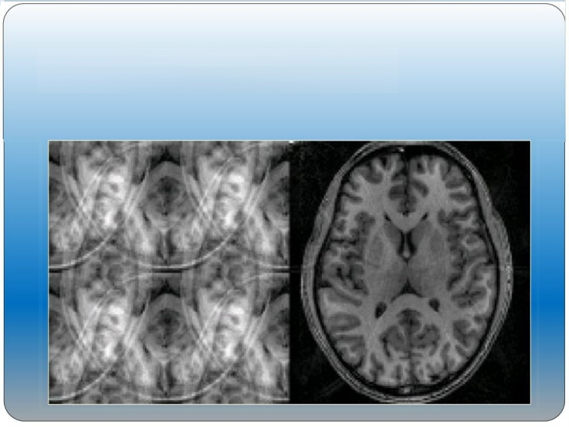
Parallel imaging (image base)

Slide 17
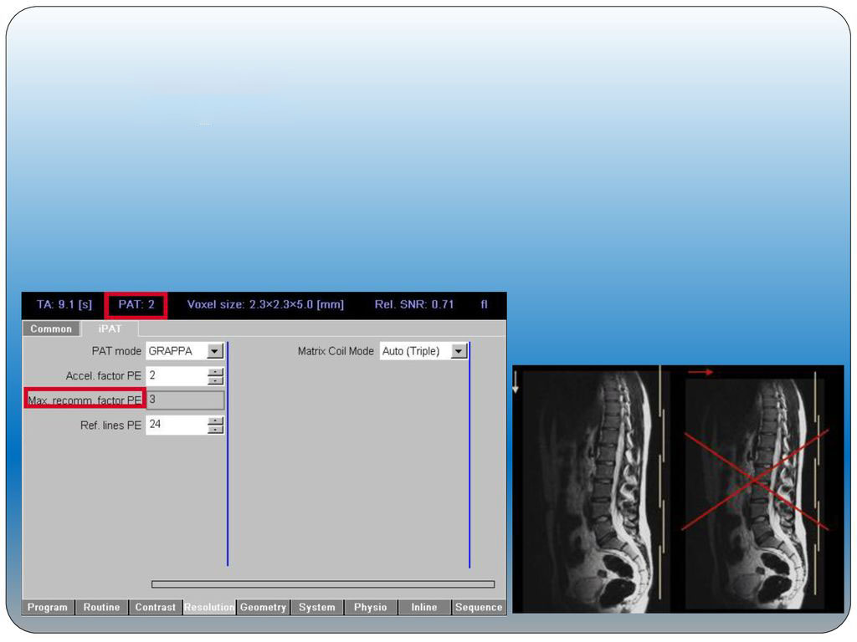
iPAT pitfalls

Slide 18
Phase array coils applications
Thorax
CMR
Abdomen &Pelvic
MRCP&MRU&MR enterography
Extra cranial Angio and venography
Upper and lower Extremity
Total Spine
Breast
Joints

Slide 19
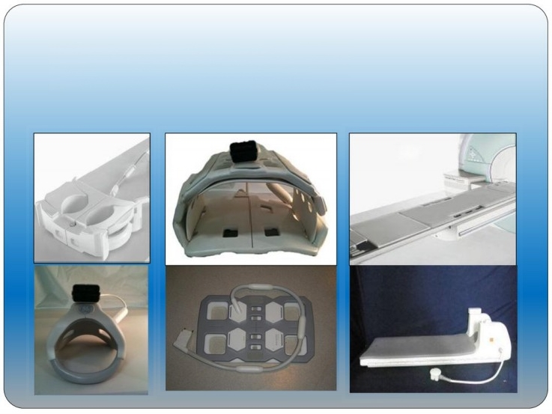
Phase array coils types

Slide 20
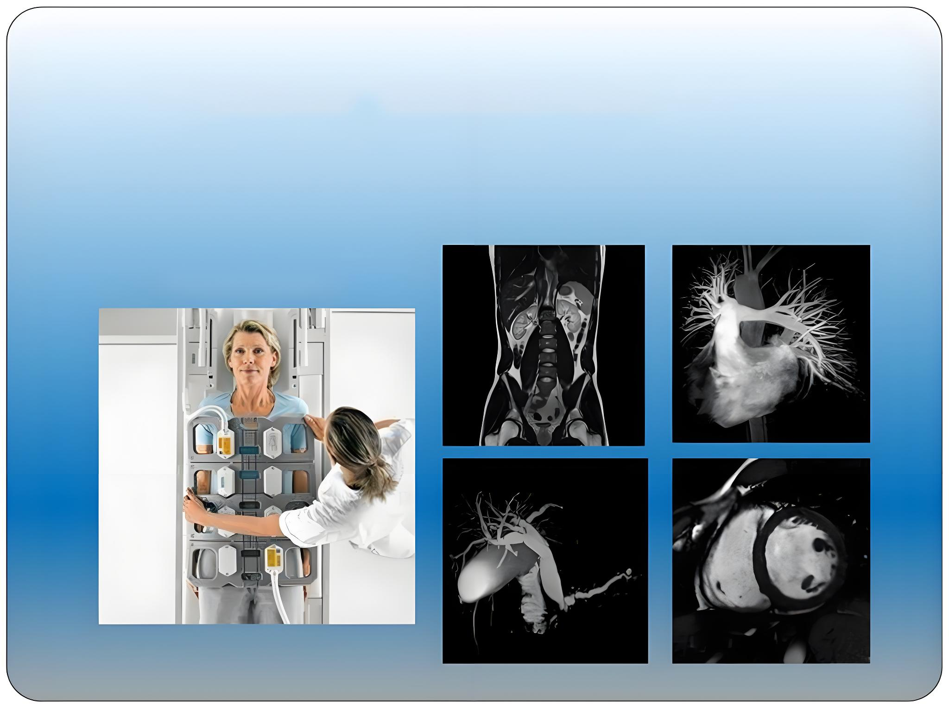
Phase array coils applications
Body phase array coil

Slide 21

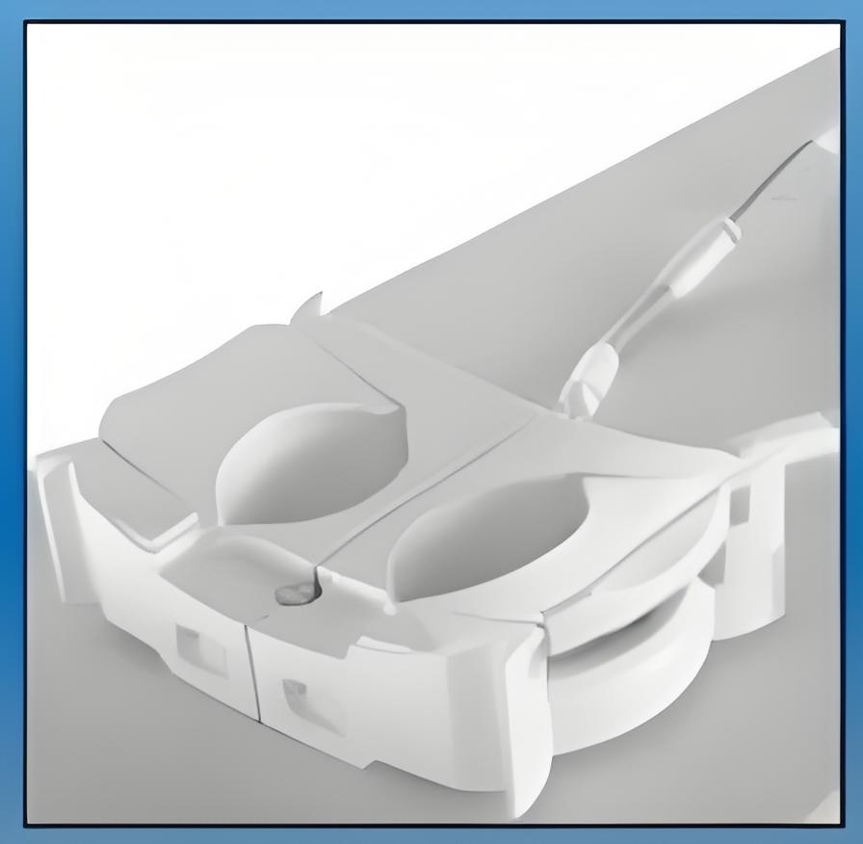
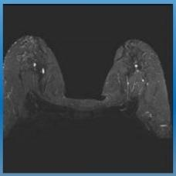
Phase Array Coils Applications
Breast phase array coil
Axial 3D T2 SPAIR TSE

Slide 22

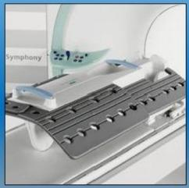
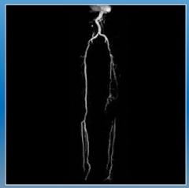
Phase array coils applications
Run-off Angio
Lower Ext. Coil

Slide 23

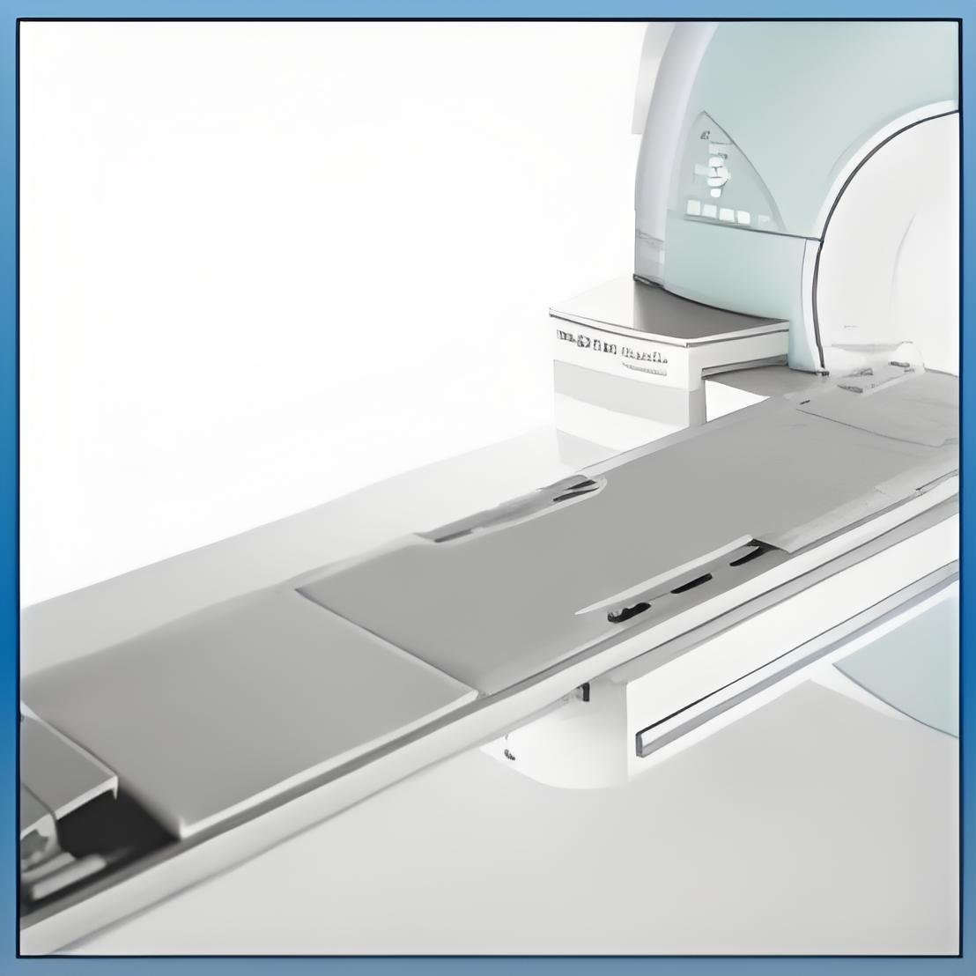
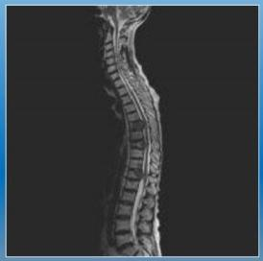
Phase Array Coils Applications
TIM phase array coil
Total spine-sag T2w TSE

Slide 24

Volume coils
Consist saddle &solenoid and some phase array reform coil
Coverage whole ROI
Receiver
High homogeneity &SNR
Usually are single channel
Not Compatible with parallel imaging(iPAT or ASSET)

Slide 25

Volume coils applications
Elbow
Wrist &hand
Knee
Foot
Ankle
Thorax & abdomen (body coil)

Slide 26

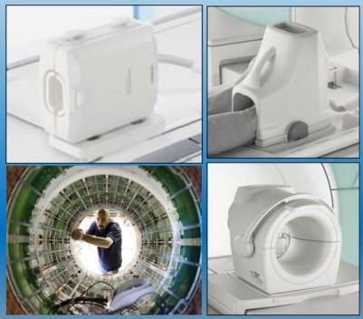
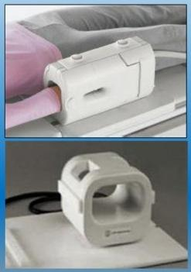
Volume coils types

Slide 27
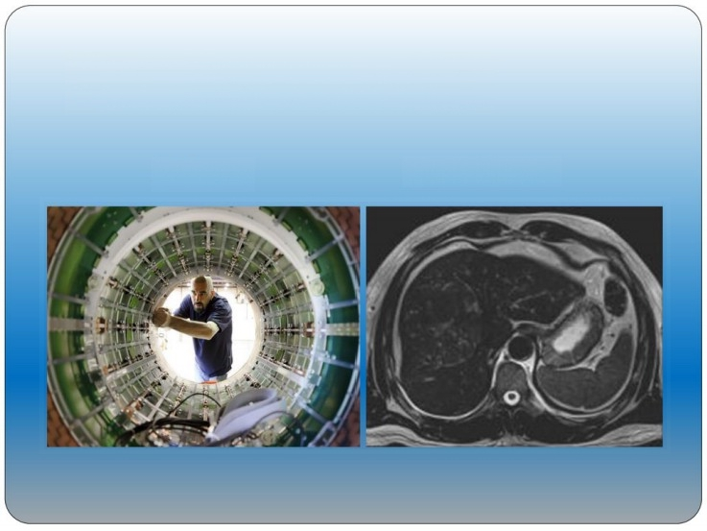
Volume Coils Applications
Body Coil
Axial T2w TSE

Slide 28

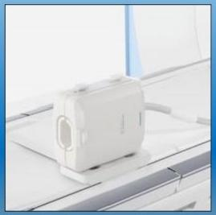
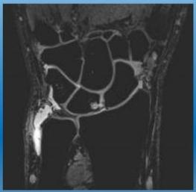
Volume coils applications
3D acquisition
hand &wrist coil

Slide 29

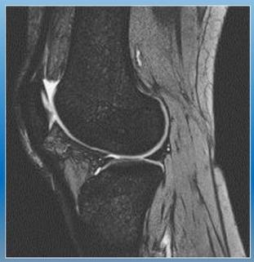
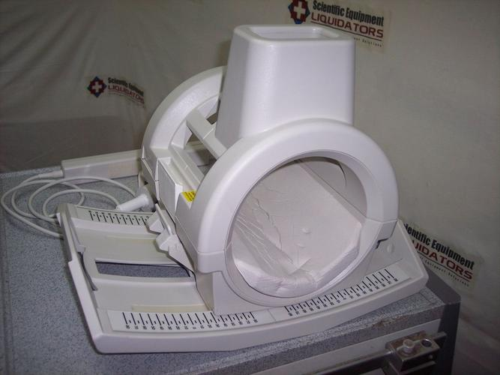
Volume coils applications
Knee coil-Multi channel
Sagittal T2*GRE

Slide 30

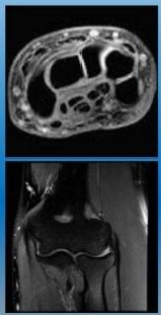
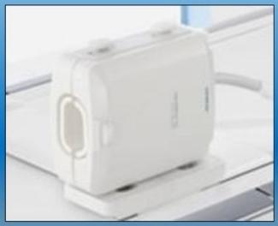
Volume coils applications
Elbow &wrist &hand

Slide 31

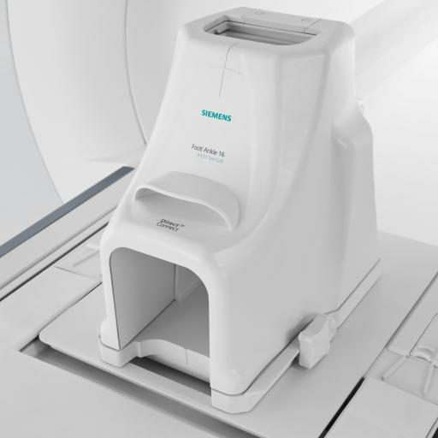
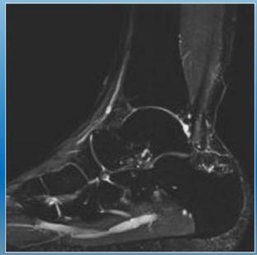
Volume Coils Applications
Multi channel foot &ankle
Sagittal STIR

Slide 32

Quadrature coils
Coverage whole ROI
Transceiver
Usually more than one channel
Compatible with parallel imaging(iPAT or ASSET)
Best homogeneity and high SNR(birdcage coil)

Slide 33

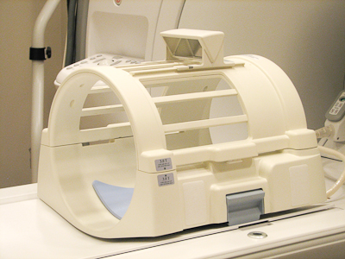
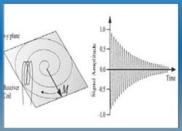
Quadrature coils
Bird Cage Coil
SNR× (√2)

Slide 34

Quadrature Coils Applications
·
Head
Brain MRA&MRV
MRS
Knee
Foot
Ankle
Shimming test

Slide 35

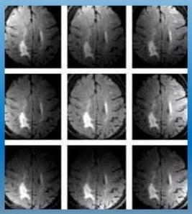
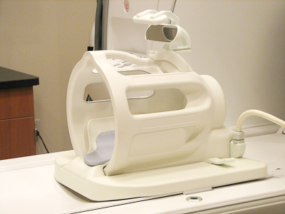
Quadrature Coils Applications
8 channel head coil
Parallel Acquisition technique

Slide 36

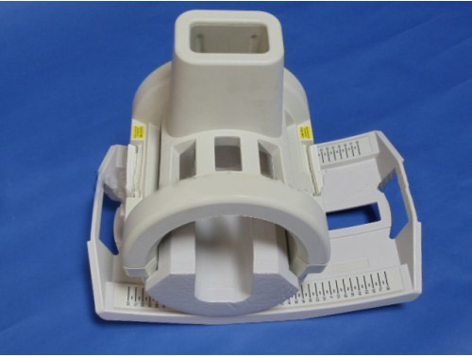
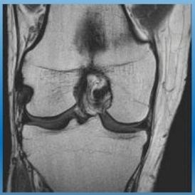
Quadrature coils applications
Knee &Foot &Ankle-Quad.coil
Foot &Ankle-volume coil

Slide 37

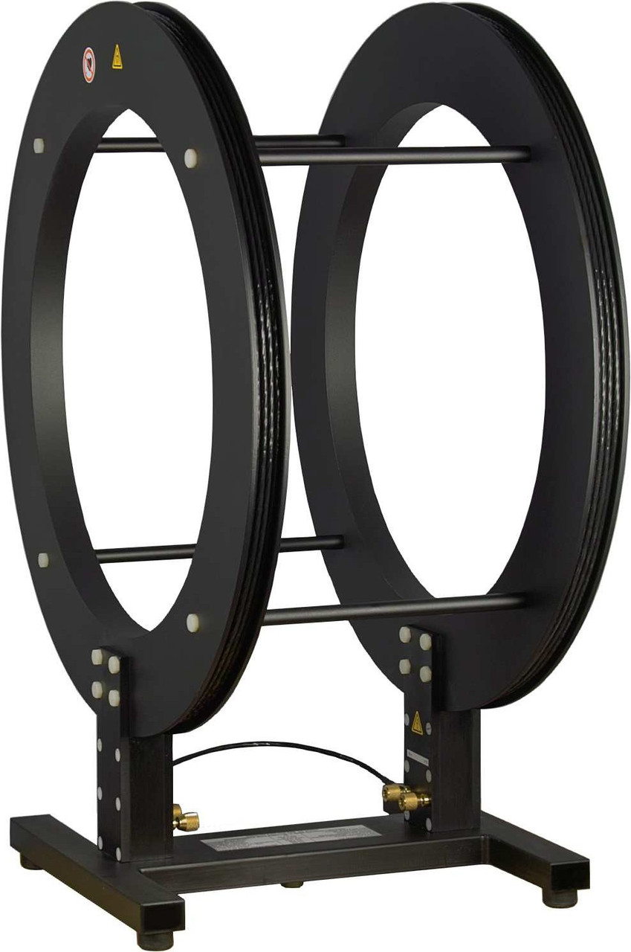
Helmholtz coils
Special for open magnet
Pair loop coil
Detect the signal in Z plane

Slide 38

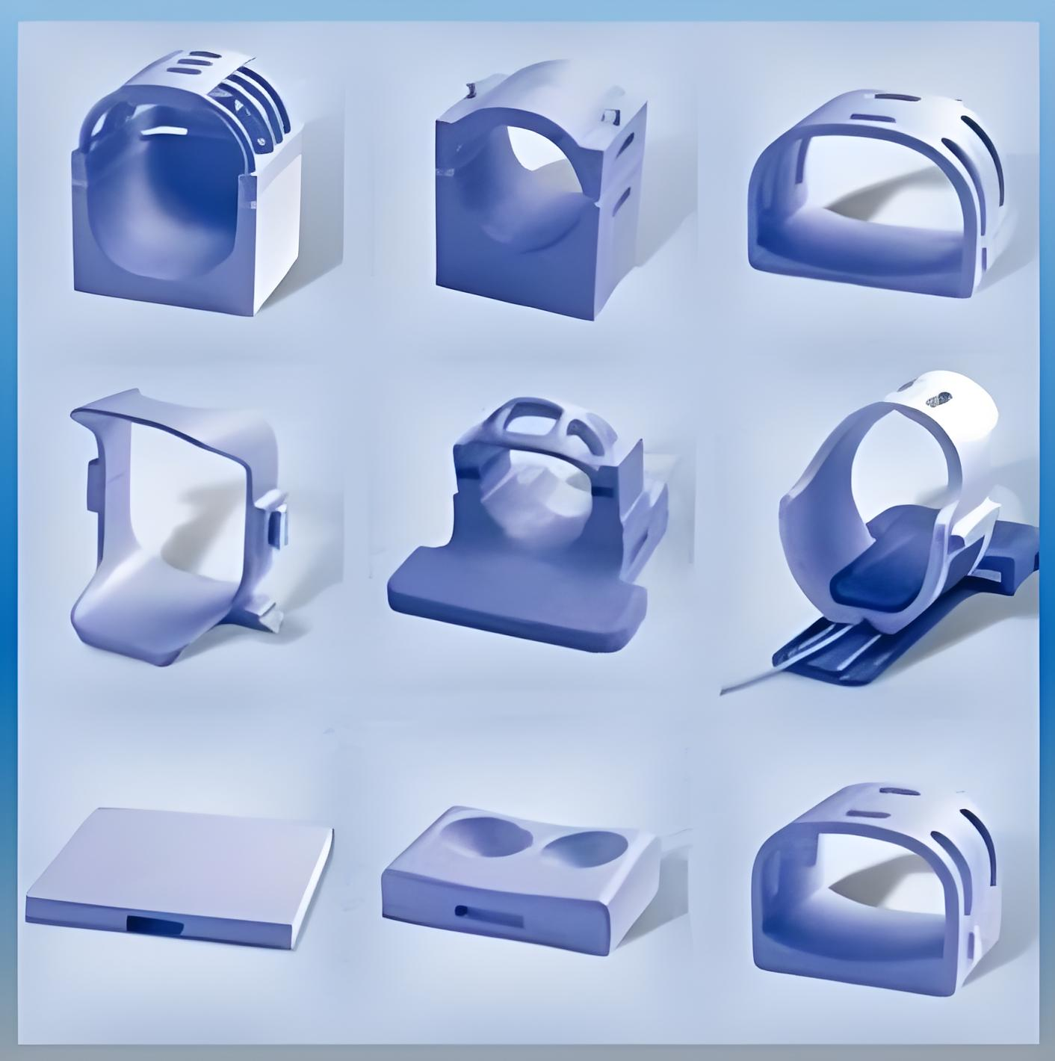
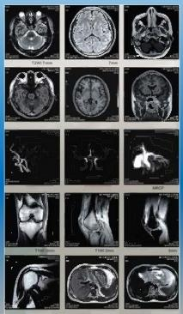
Helmholtz coils types
Tm
T
TKT
T
TM
100
T

Slide 39
Special other coils
Catheter coils(investigational device)
Micro coils (NMR&MRS in Ultra high field magnet
Litz coil(high resolution images of animal)
Millipede coils (best homogeneity for MRS)

Slide 40

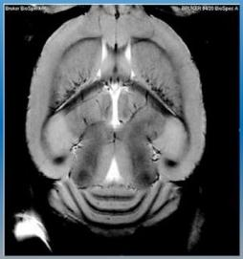
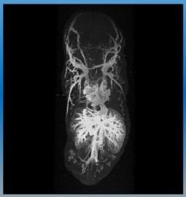
Litzcoils applications
FOV=1/5cm Matrix size=512x512(9/4 T)

Slide 41

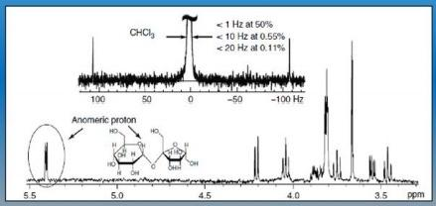
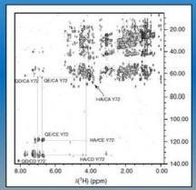
Micro coils applications

Slide 42
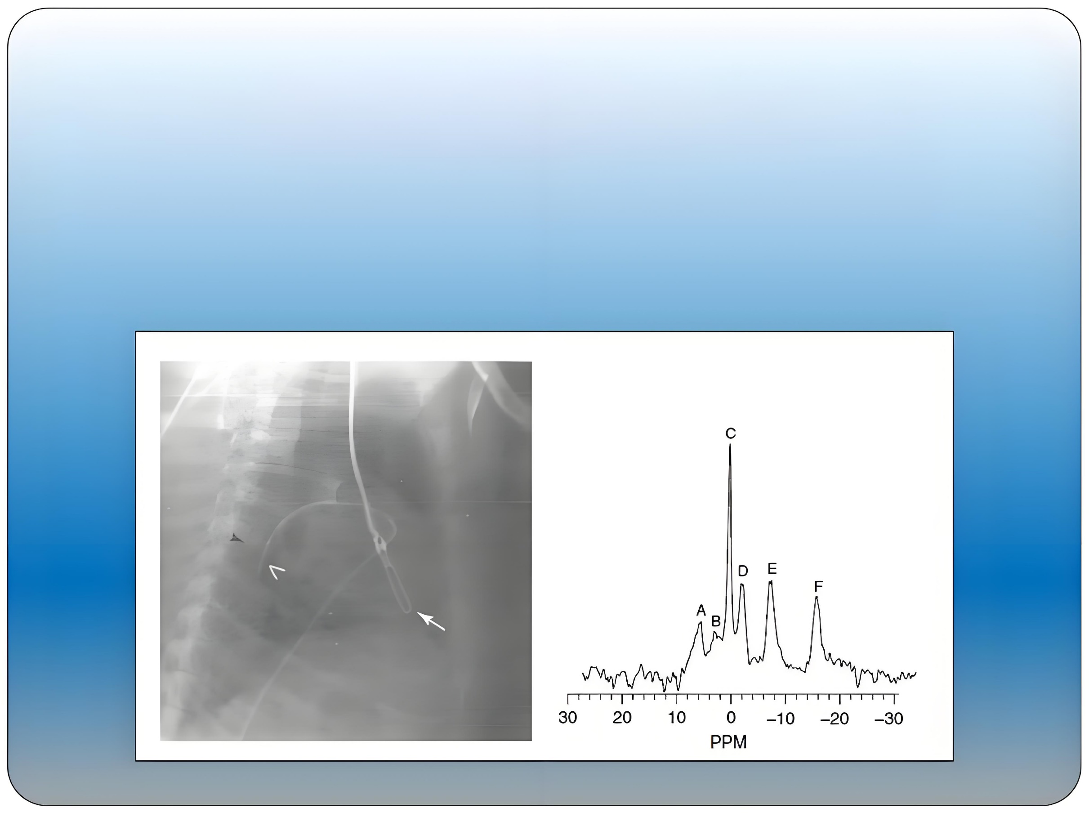
V
。
Catheter coils applications

Slide 43
Thank you
If you need MRi coil repair components,please refer to :
www.rf-coaxial.com

