Slide 1
RF Coils in MRI
MRI COILS AND GRADIENTS
By: RF Coaxial

Slide 2
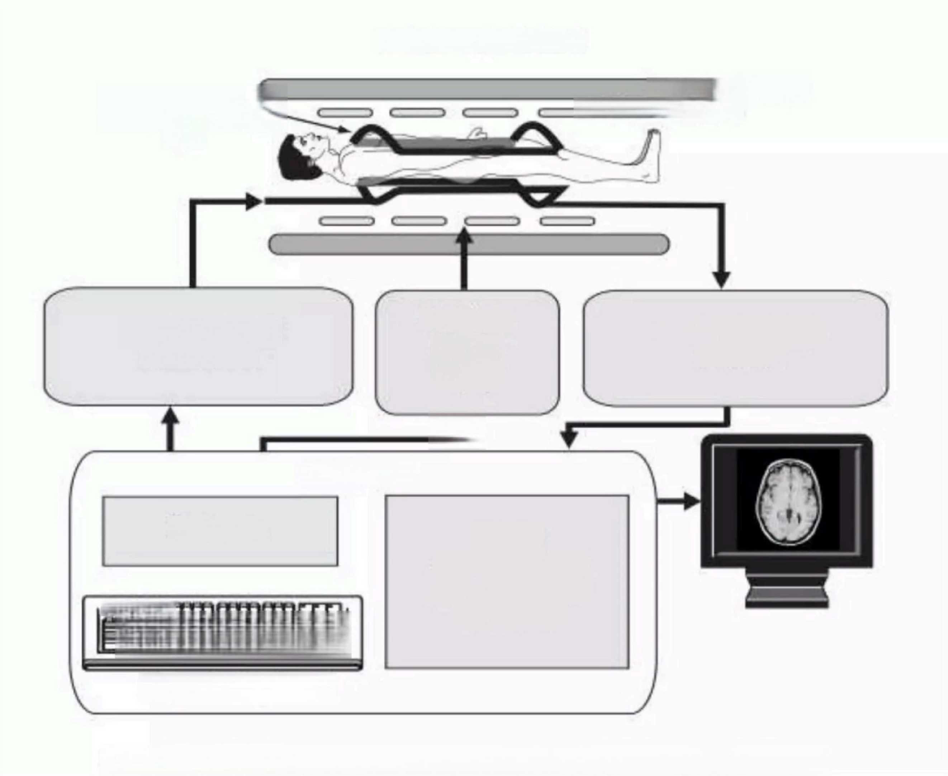
THE MRI SYSTEM
Magnetic Coil
Gradient Coils
Radio Frequency Coil
Radiofrequency Transmitter
Gradient
Power
Supply
Radio Frequency Receiver
个
Computer
Protocols
Image
Reconstruction
Viewing Control
Processing
日
Operator Keyboard
Figure 2-1.The major components of the Magnetic Resonance Imaging System.

Slide 3
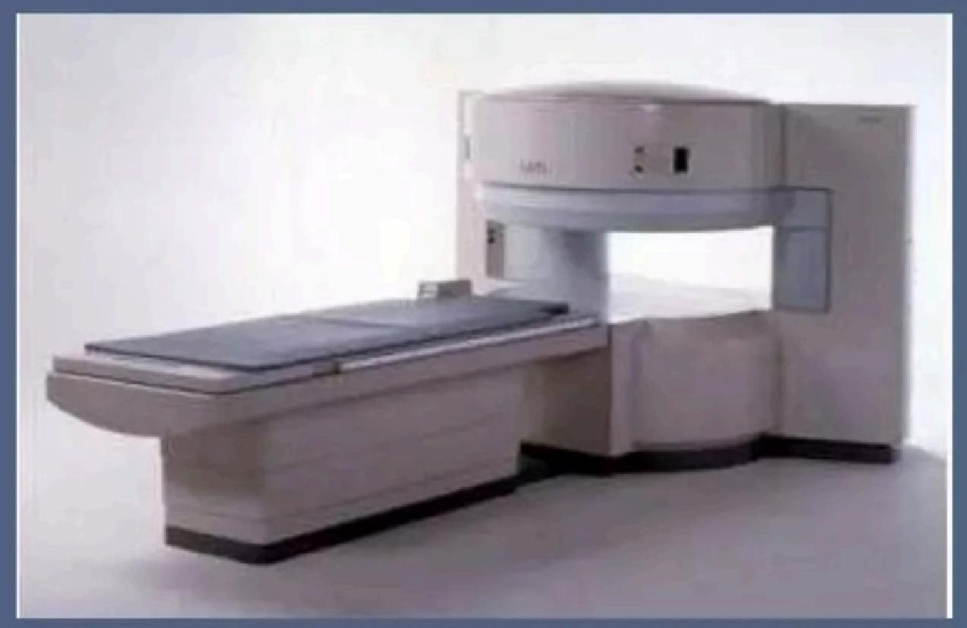
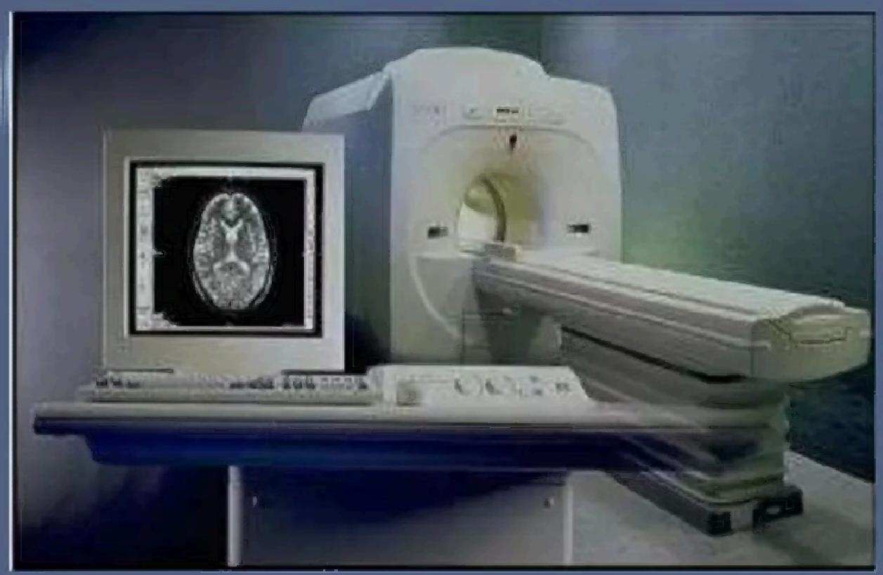
MRI Instrumentation &Equipment
● MRI magnets
● RF Coils
·Shim Coils
·RF shielding
·Magnetic field Shielding
·Gradient Coils

Slide 4
MR magnets
·Permanent magnet
-Consists of a material which has been magnetized such that it won't loose its magnetic field
-Commonly made of an alloy ALNICO and Rare earth materials
·Resistive magnet
-Consists of huge copper or aluminum coils
-They produce a lot of heat so requires water cooling Superconducting magnet
-Special alloys of Niobium-titanium in a copper matrix when super cooled to a temperature of 4K(-269℃)becomes super conductor
-Niobium-Tin alloy,Magnesium diboride is emerging new alloy
-The coolant or the cryogen used is liquid helium

Slide 5
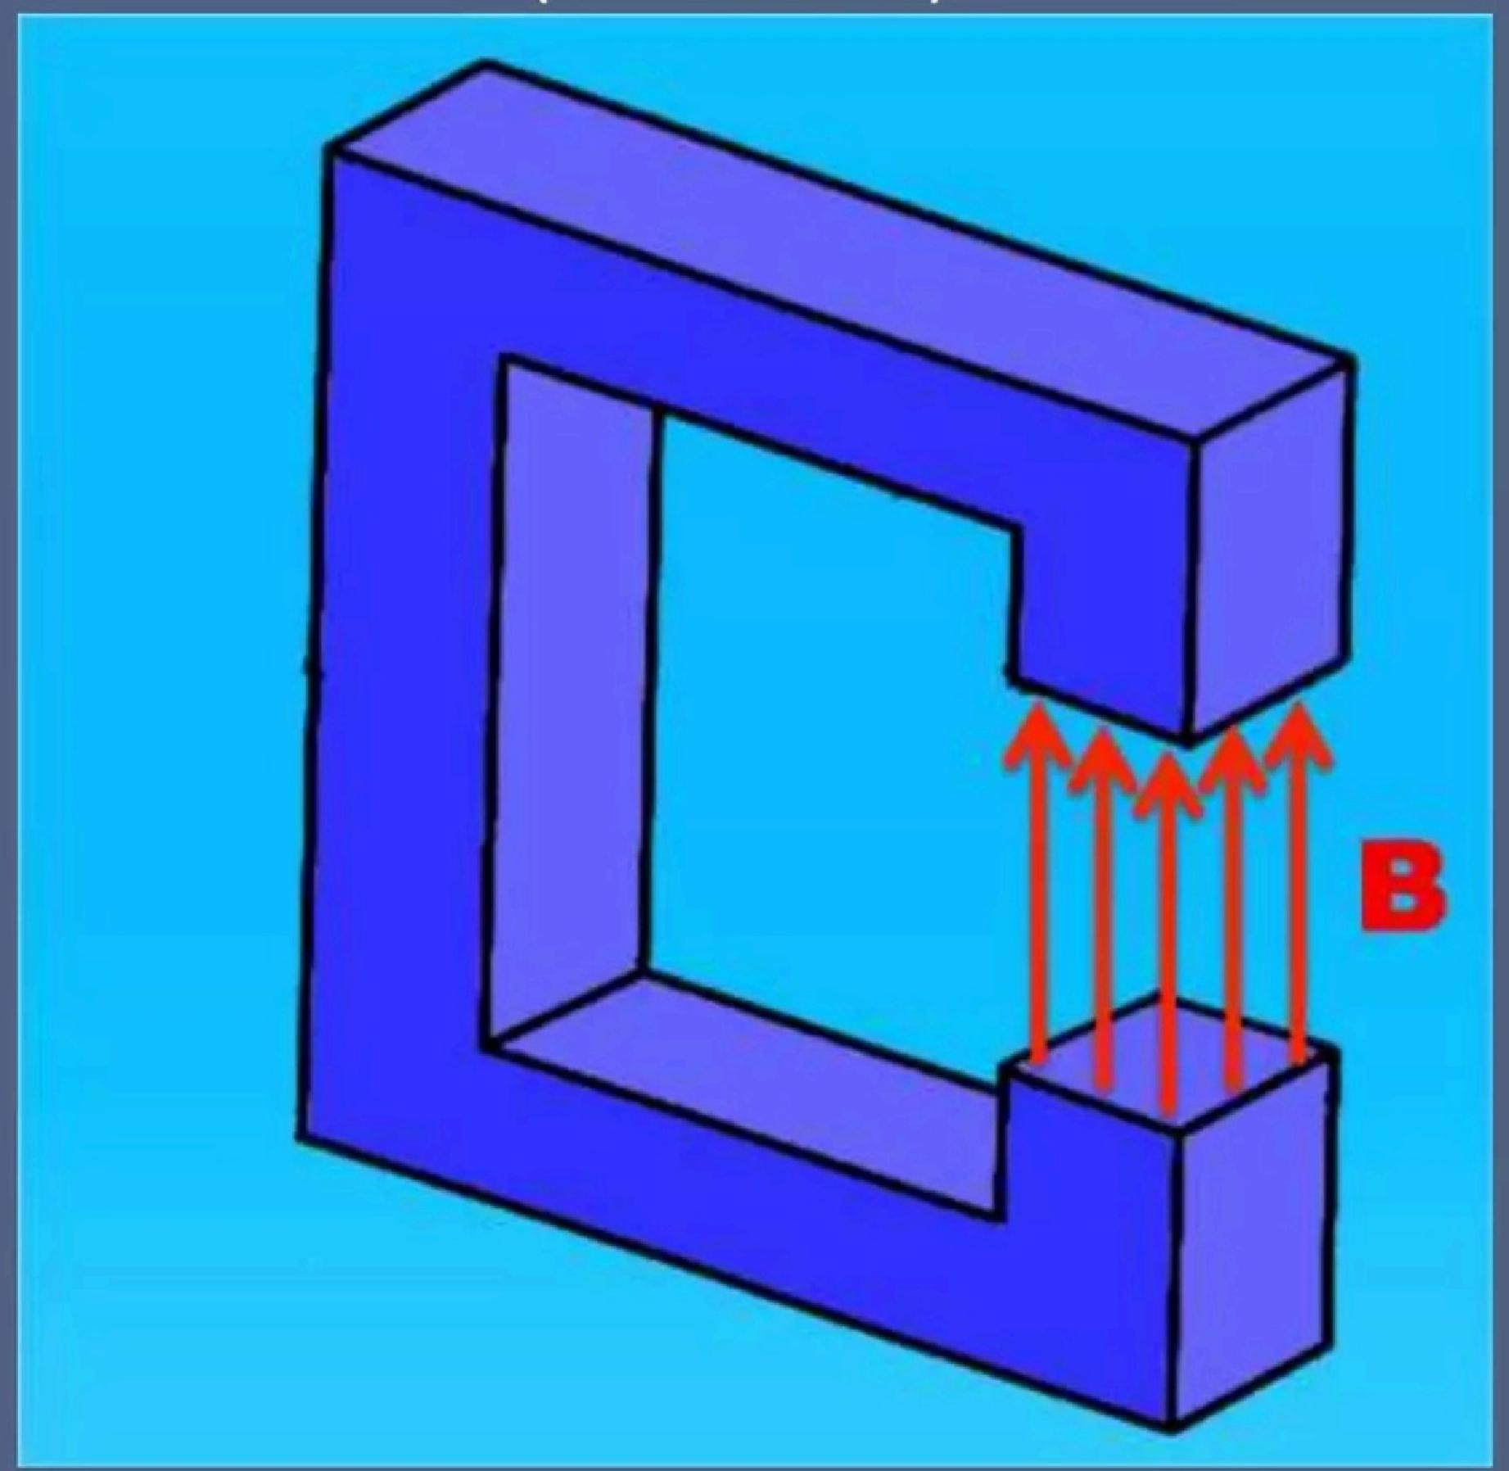
Open bore permanent magnet
(0.2-0.7T)

Slide 6
Advantage | Disadvantage
Low power consumption | Limited field strength.
Low operating cost. | Very heavy.
Small fringe field. | No quench possibility.
No cryogen.
6

Slide 7
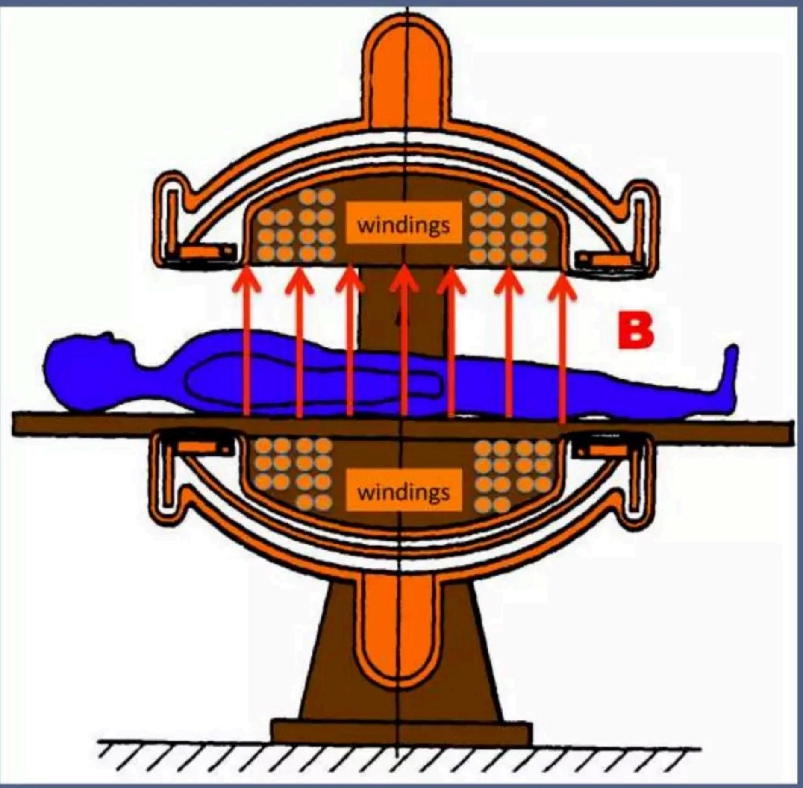
Dipolar electromagnet
(0.5-1.2T)

Slide 8
Superconducting Magnet
Liquid Helium
LHe<4.2°K
Iron Shield
or
Second Niobium-
Titanium Wire
Vacuum
LN₂ <77°k
Liquid Nitrogen
Niobium-
Titanium Wire

Slide 9
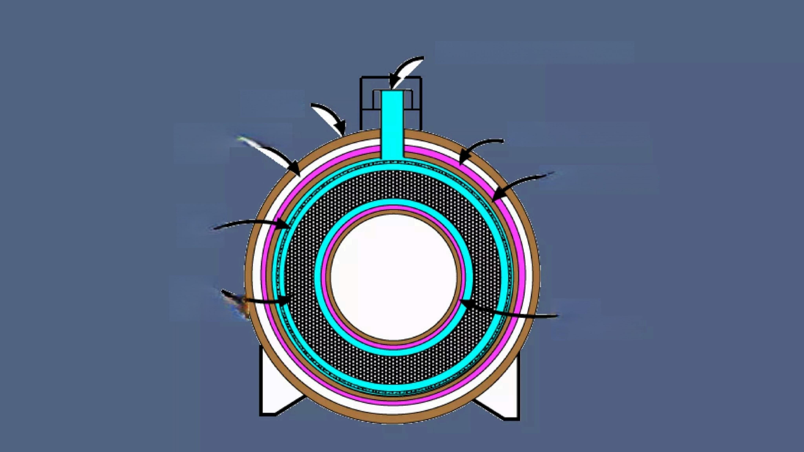
Helium fill and cold head
Outer cold shield
Helium vessel
Inner
cold shield
Casing
Outer vacuum
shield
Shim
coils
Main
windings

Slide 10
● There are 7 reported materials superconductive in the room- temperature range as of Sept 2013.
·The most recent of these (with the impressive chemical formula Tl₅Sn₂ Ba₂SiCu₈O16+)has a transition temperature near 315°K(42℃)
·An upcoming "high temperature"superconductor to watch is magnesium diboride (MgB₂),with Tc=39°K.
·At present Paramed Medical Systems,Genova,Italy whole body cryogen-free superconducting scanner made of 0.5T MgB₂

Slide 11
Superconducting Magnet
·A superconducting magnet is build up by a number of vacuum vessels which acts as temperature shields
·The length of superconducting wire in the magnet is typically several miles
·The coil of wire is kept at a temperature of 4.2K by immersing it in liquid helium
·The coil and liquid helium is kept in a large dewar
·The typical volume of liquid helium in an MR magnet is about 1700 Itrs
·The dewar is surrounded by liquid nitrogen at 77.4K(-169℃) which acts as a thermal buffer between room temperature (293K)and liquid helium

Slide 12
High field strength | High capital cost
High field homogenecity | High cryogen cost
Low power consumption | Acoustic noise
High SNR | Motion artifact
Fast scanning | Technical complexity

Slide 13
Magnet Quench
·Loss of magnet super conductivity with sudden boil- off of liquid helium
● Patient and staff must be immediately evacuated from the scanner room if quench occurs
● Liquid helium in large quantities can completely
displace oxygen and cause unconsciousness within
10 secs when inhaled
·Quench can be planned as well as accidental
·All supercon magnets have a quench button which can turn the field off within few seconds

Slide 14
MRI magnet Characteristics
·Permanent Magnet
-Remains magnetized permanently
-Low field strength (0.2T to 0.45T)
-Magnetic field inhomogeneity-10-20 ppm
-Extremely heavy(up to 80 tons)
-Cheapest to run and maintain
-Cannot be shut down
-Power consumption~20kW
-Flux lines run vertically
-Small fringe fields-<1m (0.5mT)

Slide 15
MRI magnet Characteristics
·Resistive magnet
-Field strength up to 0.5T
-Magnetic field inhomogeneity -10-50 ppm
-Power consumption-50 to 100kW
-Weight of magnet-4 tons
-Field can be switched off immediately
-Flux lines run horizontally
-Modest fringe fields~2m (0.5mT)

Slide 16
MRI magnet Characteristics
·Superconducting magnet
-High field strength 0.37 to 4T(up to 14T for research)
-Magnetic field inhomogeneity -0.1-5 ppm
-Expensive to buy and run &difficult to maintain
-Flux lines run horizontally
-Large fringe fields ~10m (0.5mT)
-Weight of magnet-10 tons
-Power consumption ~20kW

Slide 17
MR Field strengths
Low field
Mid-field
High field
Very high field
Ultra high field
→ below 0.3T
→ 0.3T to 1.0T
→ 1.0T to 3.0T
→ 3.0T to 7.0T
→ above 7.0T

Slide 18
Advantages of low field scanners
·Open design
·Lower fringe field
● Reduction of certain MR artifacts
-Chemical shift,susceptibility &flow/motion artifact
●Lower energy deposition on tissues (SAR)
-SAR is proportional to square of Magnetic field
·Lower initial purchase price
●Lower operational cost

Slide 19
Disadvantages of low field scanners
● Lower signal to noise
-Signal to noise is approximately proportional to field strength
Lower homogeneity
-limits the ability to perform certain pulse sequences(such as chemical shift fat suppression,echo-planar imaging,and MR spectroscopy)
● Impaired detection of calcification and hemorrhage
-Poor in detection of calcification,iron accumulation,or hemorrhage
·Reduced detection of gadolinium enhancement
-Enhancement is less apparent in low field scanners

Slide 20
RF coils
●RF coils are one of the most important
components that affect image quality in MRI
● These are the coils to transmit the RF pulse and receive the RF signal
● There may be separate Transmitter and
receiver RF coils or a transreceiver coil which serves as both transmitter and receiver coil
● There are two types of RF coils: surface coils and volume coils

Slide 21
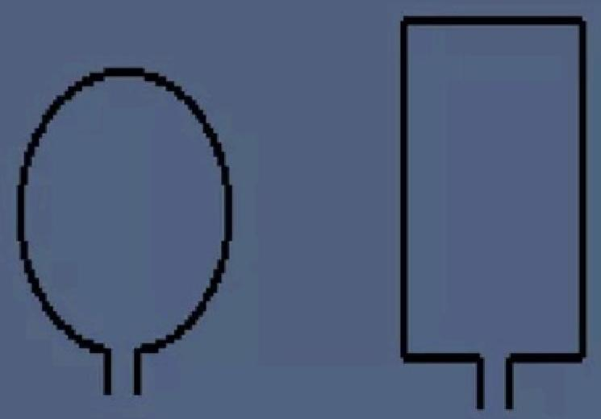
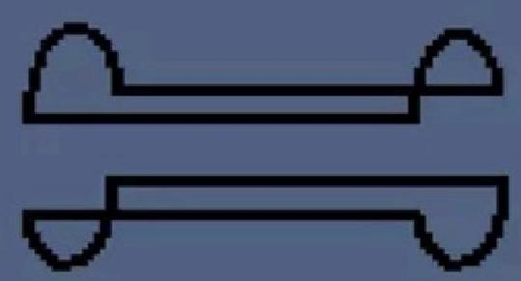
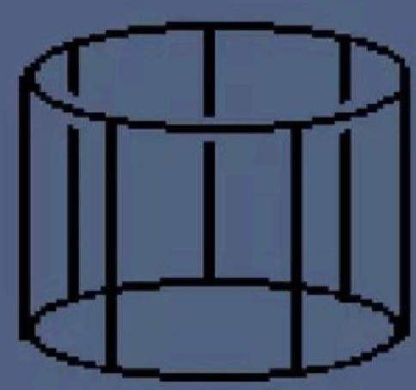
RF Coils
Paired Saddle Coil
(Volume coil)
Surface Coils
Helmholtz
Pair Coil
(Volume coil)
Bird Cage
Coil
(volume coil)

Slide 22
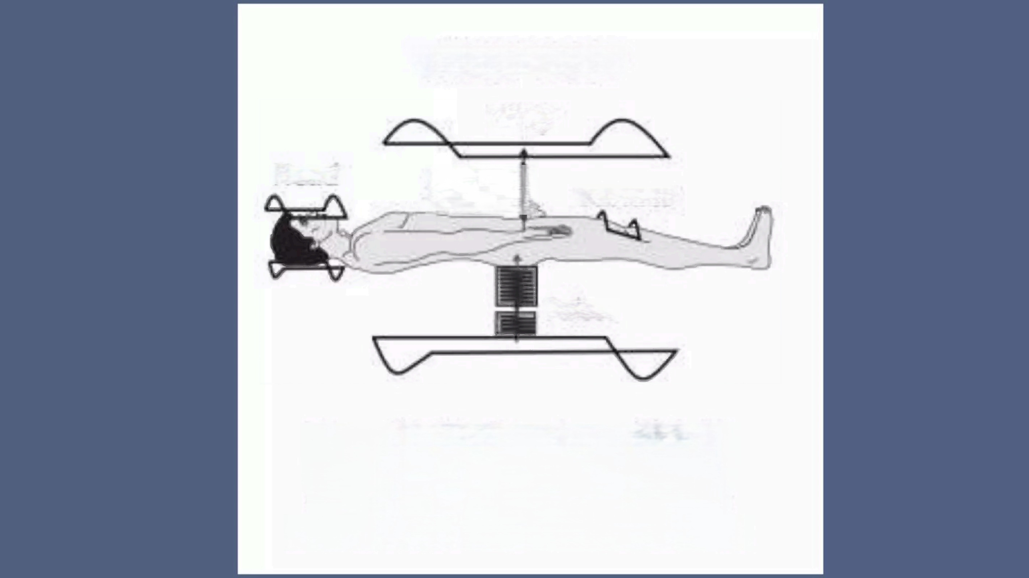
THE RF COILS
Body
^{Head} Signal Surface
Pulses
Figure 2-6. The three types of RF coils
(body,head,and surface)that are the
antennae for transmitting pulses and
receiving signals from the patient's body.

Slide 23
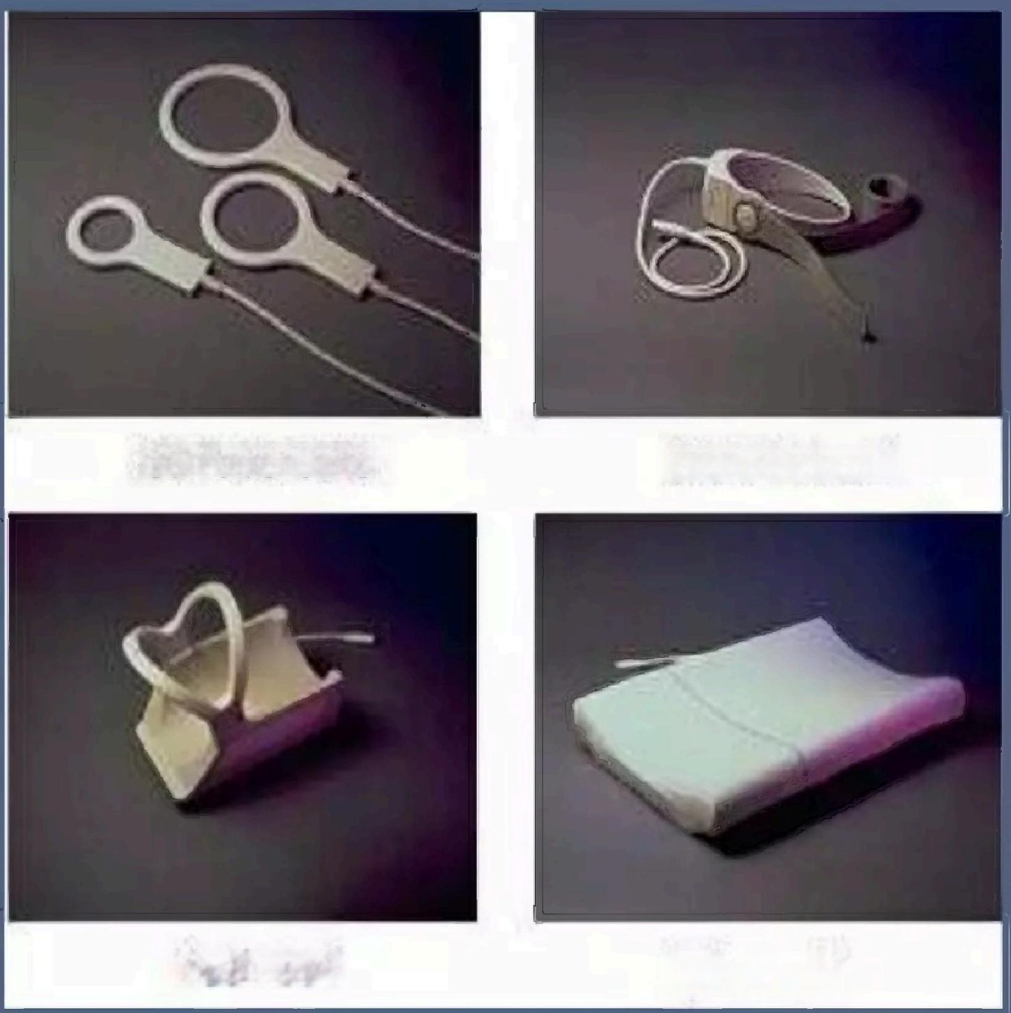
Surface RF coils
· Surface coils are the simplest of the coil designs
· They are either a circular or a rectangular loop of wire
· Surface coils are placed very close to area under examination
· Generally used for spines, shoulders,TMJ etc.
Surface coils
Neck coil
Shoulder coil
Spine coil

Slide 24
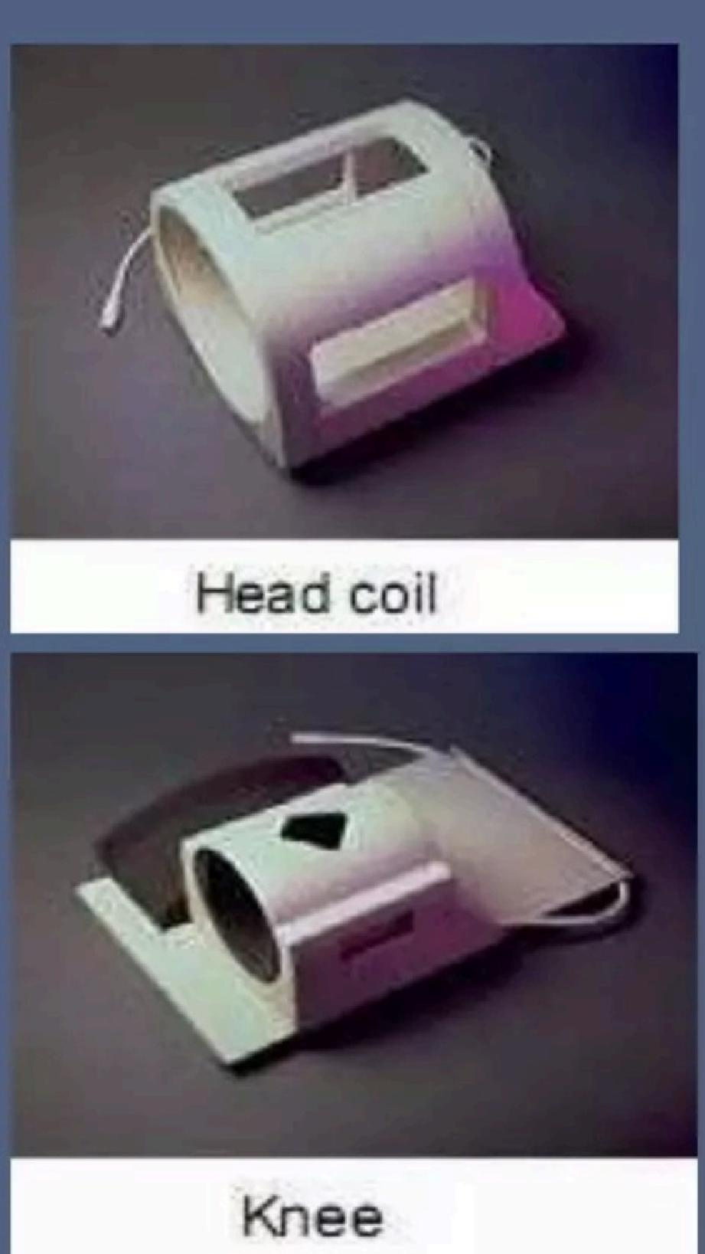
Volume RF coils
· Volume coils can be of:
-Paired saddle coil
-Helmholtz pair coil
-Birdcage coil
· Volume coils need to have the area of examination inside the coil
· They can be used for transmit
and receive,although sometimes they are used for receive only
· The head coil is a
transmit/receive coil and the knee coil is a receive only coil

Slide 25
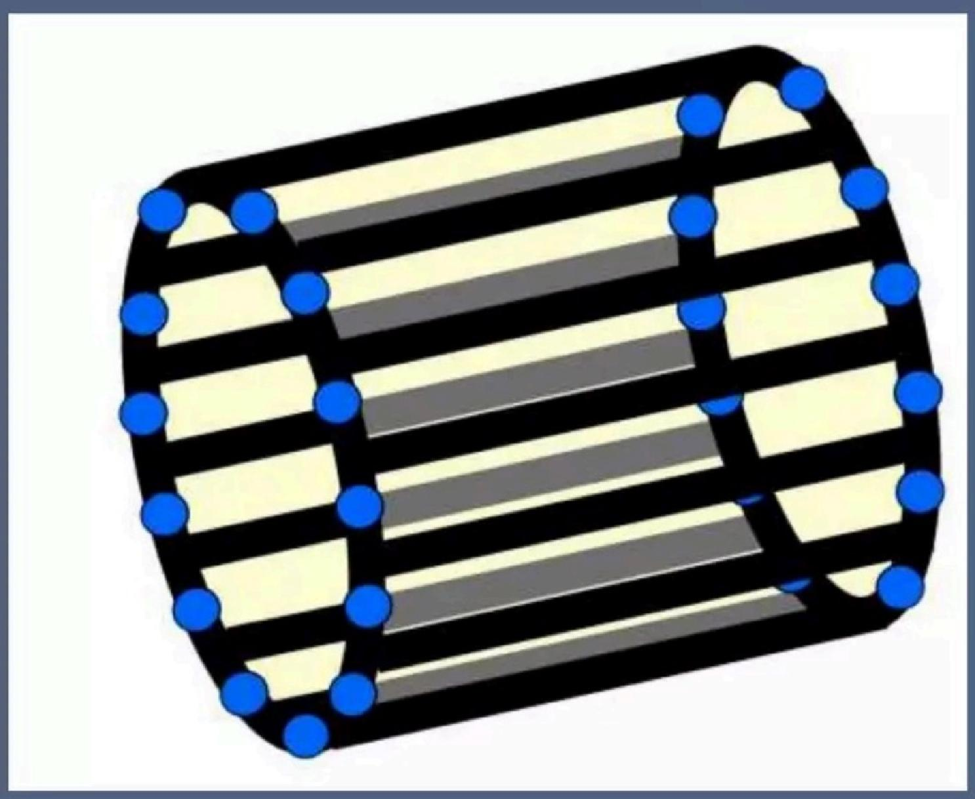
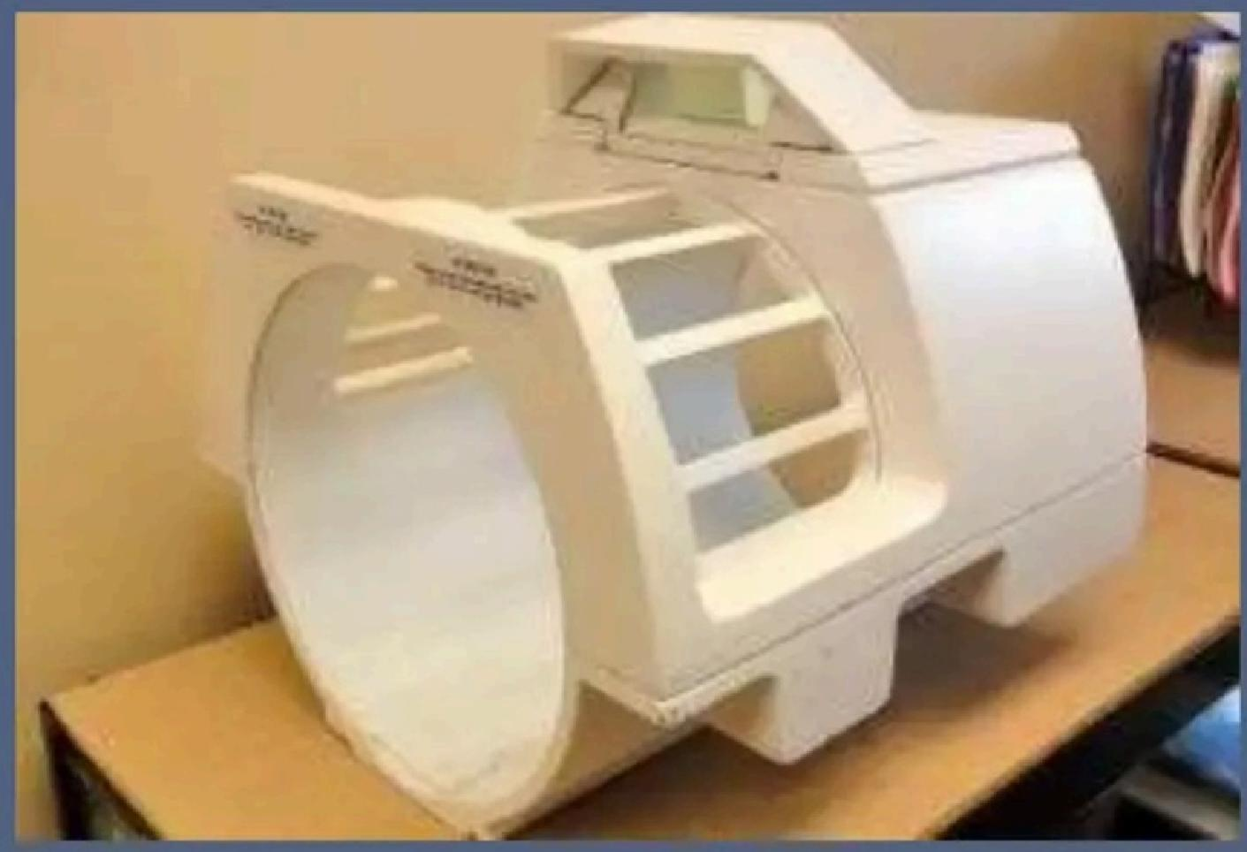
Birdcage coil

Slide 26
Array Coils
·Array coil are collections of small surface coils whose signals are combined and fed into an independent receiver circuitry.
-Phased array
·Groups of overlapping surface coils linked into a common output
-Parallel array
·Groups of non-overlapping surface coils optimized for parallel imaging

Slide 27
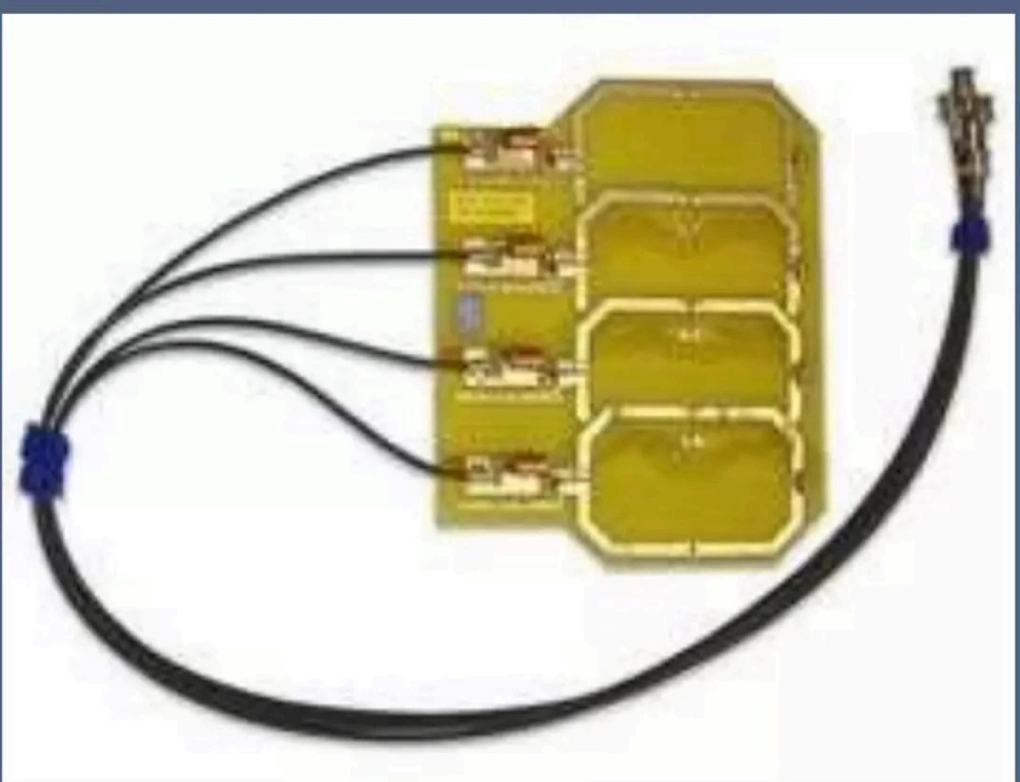
Four coils phased array

Slide 28
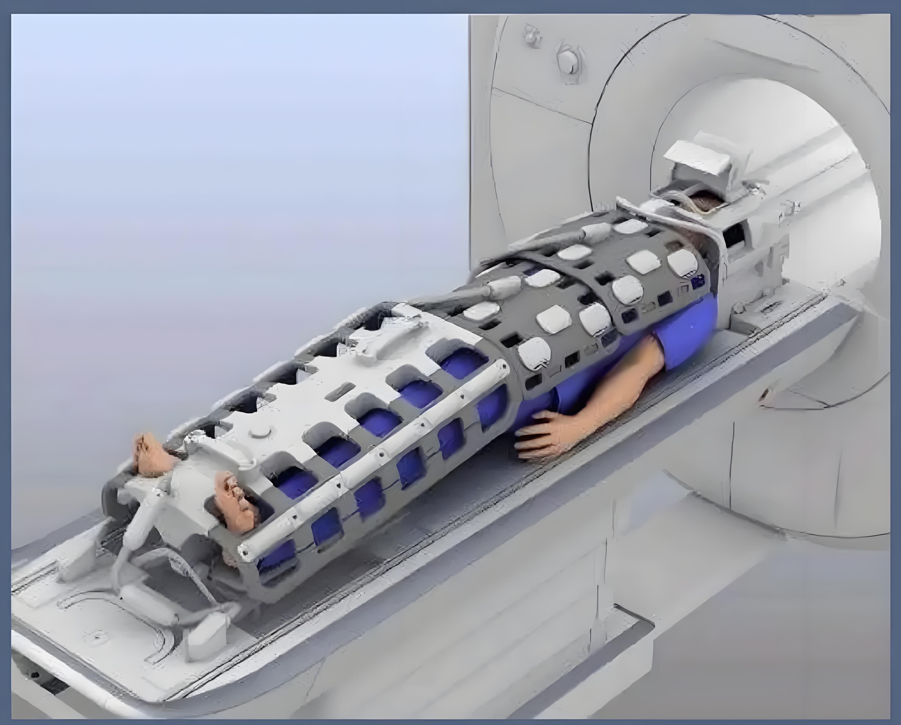
Whole body array coil for vascular imaging

Slide 29
Quadrature Coils
·Quadrature or circularly polarized coils can have either a
saddle shape or as a surface coil.Common is that they contain at least two loops of wire,which are placed at right angles to
one another.The advantage of this design is that they produce more signal than single loop coils.Nowadays,most volume
coils are Quadrature coils.

Slide 30
Shimming
·Shimming is the process by which the main magnetic field (Bo)is made more homogenous
·Active Shimming
-Active shimming uses currents directed through specialized coils to generate a "corrective"magnetic field
-Superconducting shims are within the cryostat and resistive shims are outside the cryostat
·Passive shimming
-Passive shimming is a method of field correction involving the use of ferromagnetic materials,typically iron or steel, placed in a regular pattern at specific locations along the inner bore of the magnet

Slide 31
Shim coils
·One of the requirement for good imaging is a homogenous magnetic field(10ppm)
·Shim coils are the extra loops of coils over the magnetic coils which are used to reduce
magnetic field inhomogeneities
·Shim coils requires a power supply which is
separate from other power supplies within the system

Slide 32
RF shielding
·RF range used in MRI-1-200MHz
● Radio,TV and other communication system works on~1- 100MHz
·In CT scanning the CT room is shielded so that EM radiation (x-rays)do not escape the room but in MRI the scanning room
is shielded from EM radiation (RF)that exists outside the
room
·MRI room is shielded completely by a continuous copper or aluminum sheets or mesh to absorb the external RF,such a design feature is called a RF Cabin or a Faraday Cage'

Slide 33
Magnetic field shielding
·MRI system needs to be shielded because of the fringe fields which can interfere with other mechanical and magnetically activated devices
·MR system can be shielded by two processes:
-Active shielding
-Passive shielding

Slide 34
FRINGE FIELD
·The stray m.f outside the bore of the magnet is the fringe field.
·Permanent magnet have relatively low but in solenoid electromagnet it is significant.
·These must be taken into care so that they do not extend into the areas where potentially contraindicated patients monitoring device and other mechanically and magnetically devices are present.
34

Slide 35
SHIELDING
·Fringe field can be compensated by the use of magnetic field shielding.They are
·Active shielding- uses additional coils built into the magnet assembly, they are designed and oriented so that the electrical currents in the coils produce magnetic fields that oppose and reduce the external magnetic field.
· Passive shielding- Passive shielding:is produced by surrounding the magnet by large pieces of ferromagnetic materials such as iron or by lining the walls of MR scan rooms with steel
35

Slide 36
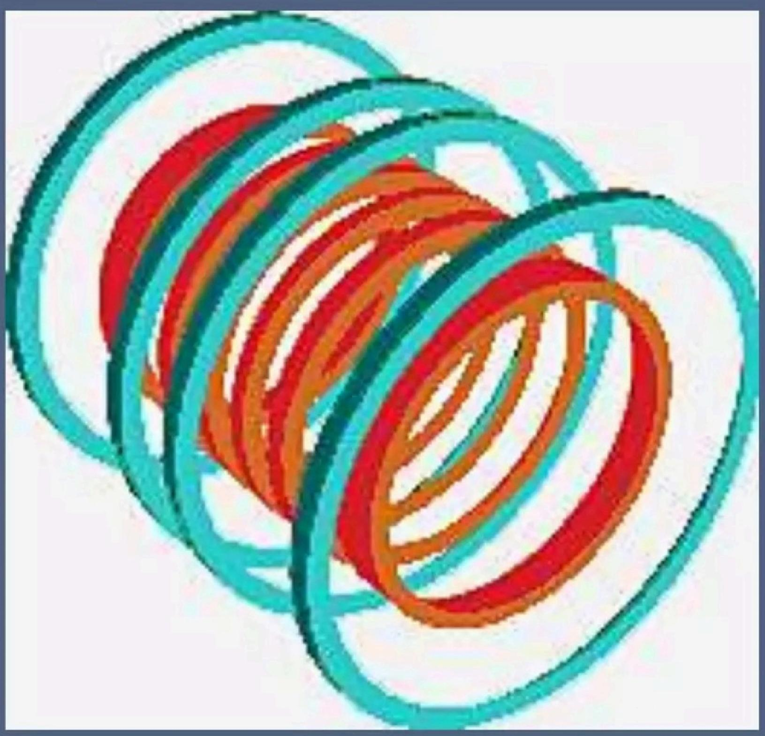
Active shielding

Slide 37
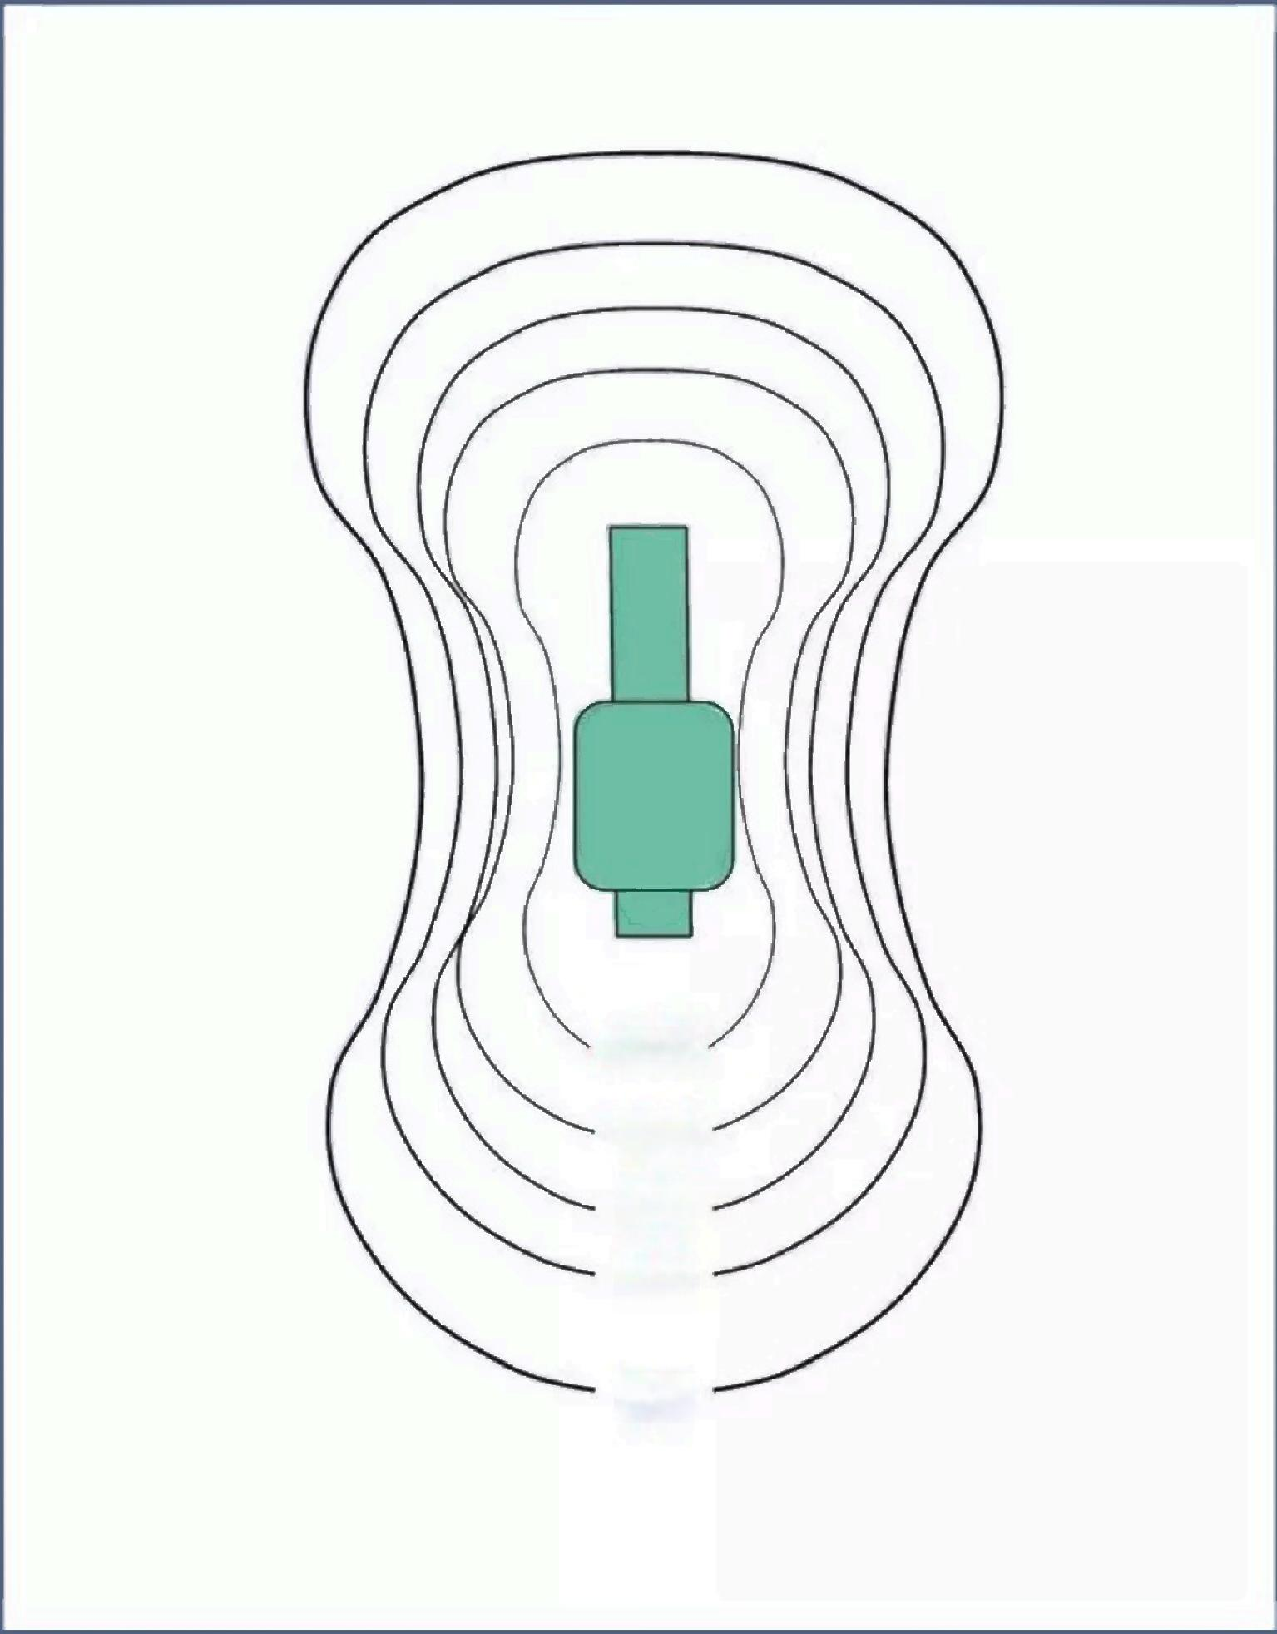
Fringe field
50 G
10G
5G
3G
1G

Slide 38
Gradient Coil
·These are used to produce deliberate variation in the main magnetic field(Bo).
●There are usually three sets of gradient coils,one for each direction.
● The variation in the m.f permits localization of image slices as well as phase encoding and frequency encoding.
● These sets of gradient coil for the z-axis are helmholtz pairs, and for the x and y axes are paired saddle coils.
38

Slide 39
·How gradient coils are produced?
Magnetic field strength is proportional to the amount of
current passed through the loop of wire,number of loops
in wire,the size of the loop and how closely the loops
are spaced.By changing these parameters coil can be
produced,which increases or decreases magnetic field
strength in particular direction.
·Gradient strength (stiffness)is measured in units of G/cm
or mT/m.This means that the magnetic field strength
changes by one Gauss over each centimeter or 10 milliTesla
over each meter.Stronger gradients(15 or 20 mT/m)allow
high speed and high resolution imaging

Slide 40
·Gradient coils are a set of wires in the magnet,which enable us to create additional magnetic fields,which are,in a way,superimposed on the main magnetic field B.
·There are 3 sets of wires.Each set can create a magnetic field in a specific direction:Z,X or Y.When a current is fed into the Z gradient,then a magnetic field is generated in the Z direction.
40

Slide 41
D:\谷歌浏览器下载内容
41

Slide 42
·Gradient coil provide linear gradation or slope of the magnetic field strength from one end of the solenoid to the other end.The gradient are applied by passing current through the gradient coil in certain direction.This either increases or decreases the magnetic field on either side of isocentre.
·The magnetic field,which is generated,is very strong. Although the gradient coils are very tightly fixed in a kind of resin,the forces,exhibited by the gradient coil,are enough to make them vibrate,hence the noise.

Slide 43
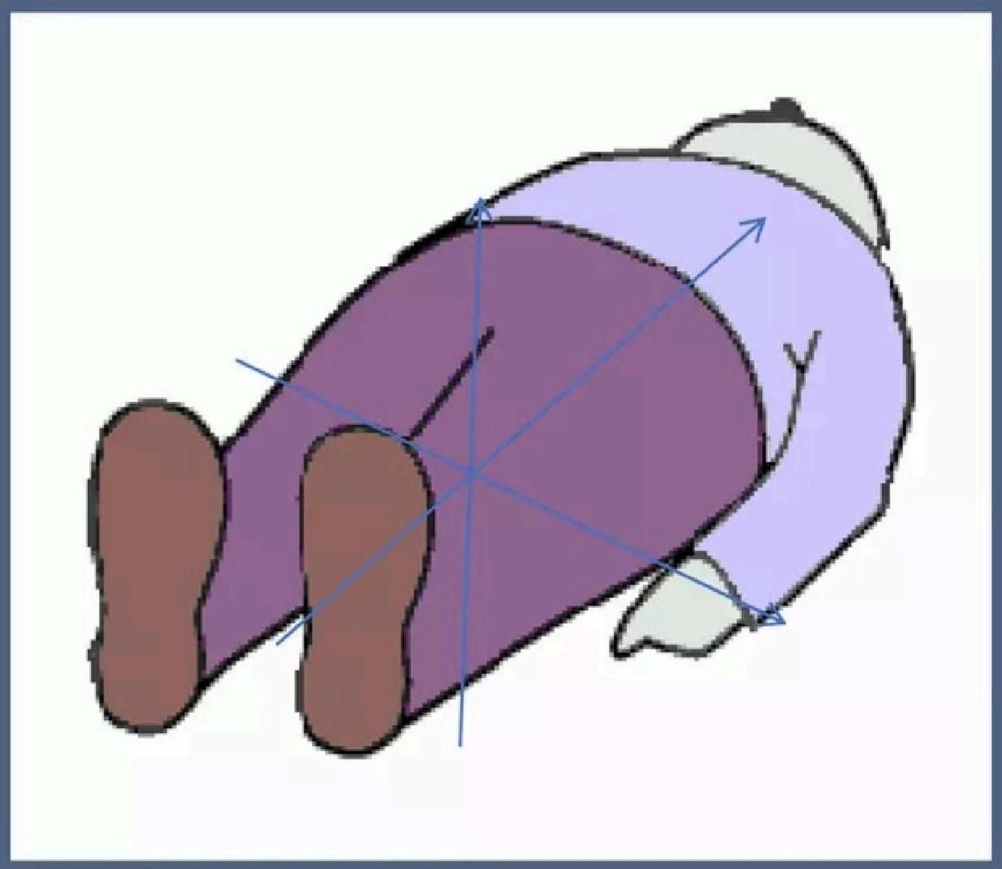
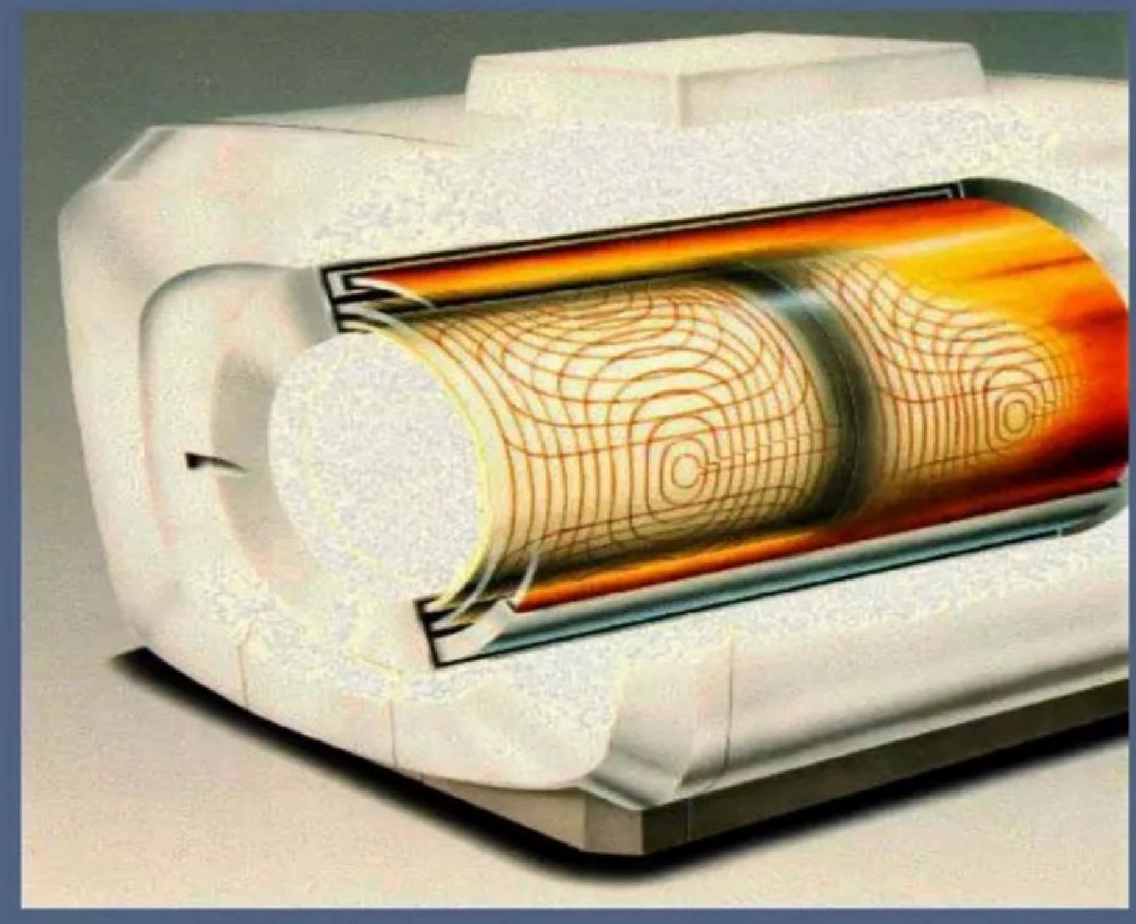
Figure shows schematically how the 3 gradient coils form a cylinder. This cylinder is
then placed in the magnet bore.
43

Slide 44
Objects to be excluded from different level
of magnetic field
Nuclear
camera
mT
Analog Disk
drives
Video
Pacemakers
0.1
0
Magnet
watches ^{camera}
5
0.5
/ oo
/Computers
Credit Cards
CRT's
Image
intensifiers
CT scanner

Slide 45
ACR safety zones in MRI facility

Slide 46
Specific Absorption Rate (SAR)
·The physiologic measure of intensity of RF energy deposition in body is called the specific
absorption rate(SAR)with units of W/kg
·SAR is the RF energy deposited per unit mass of tissue.The mean SAR should not exceed 0.4W/Kg (FDA)
·SAR is greater for large body parts,high static
fields,180 degree RF pulse and high conductivity tissues e.g.brain,blood,liver&CSF

Slide 47
MR Safety
RADIO FREQUENCY HEATING
Specific Absorption Rate(watts/kilo)
Maximum Limits
3.2
Averaged Over Head
8
Peak
In Any
Gram
of Tissue
0.4
Averaged Over Body
Power
Unit Time
Magnetic Field Strength Pulse Flip Angles
Pulses Per Cycle
TR
(watts)

Slide 48
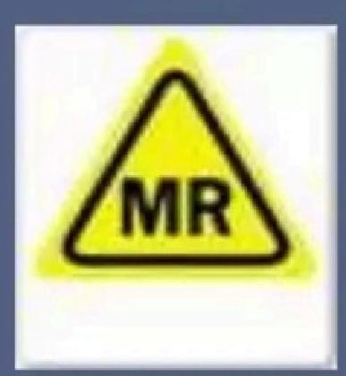
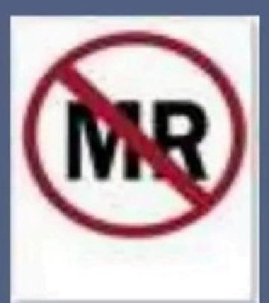
MR safety
MRI safe
(An item that poses no
Known hazard in MR environment)
MRI safe in certain conditions
MRI Unsafe

Slide 49
PRECAUTIONS
1.Always screen the patient and accompanying person
for any metallic objects.Metallic objects can form
projectile because of strong magnetic attraction.This
can lead to life threatening consequences.
2.Always see to it that wires and coils are well insulated and are not touching patient's body.It can cause burns. Patient's body part should also not be touching magnet bore.

Slide 50
3.Avoid loop formation:Wires of pulse oxymeter,ECG leads etc should never form a loop.Loop formation can lead to induction of current and burns.Even loop formation of body parts for example crossed arms or legs can form a large conductive loop and can result into induction of current.
scanner room.
4.In case of emergency first approach must be to remove the patient out of scanner room as early as possible
and start resuscitation.
5.Doors of scanner room should have label with pictures of object that are strictly prohibited to take inside

Slide 51
·ABSOLUTE CONTRAINDICATIONS
1.Internal cardiac pacemakers
2.Implantable cardiac defibrillators
3.Cochlear implants
4.Neurostimulators
5.Bone growth stimulators
6.Electrically programmed drug infusion pumps,vascular access ports
7.Intraocular foreign body
8.Aneurysm clips

Slide 52
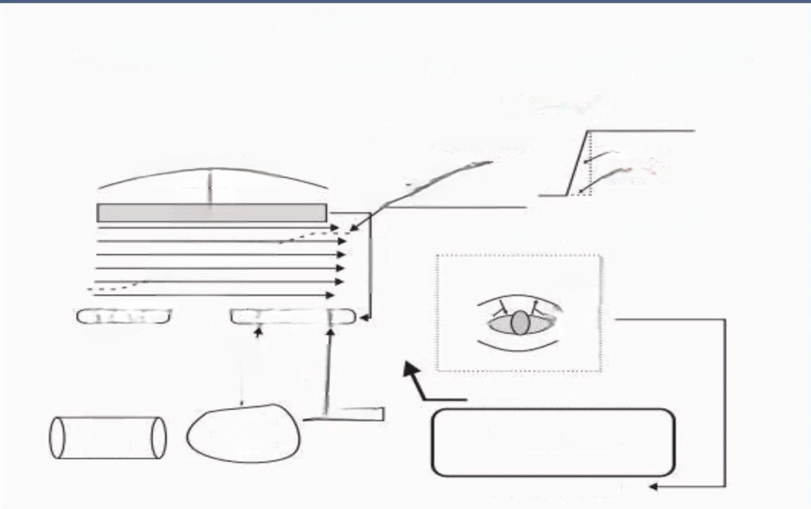
Mind Map Summary
Magnetic Resonance Imaging System Components
GRADIENTS
Strength
Slew Rate
Rise Time
ZGradient
DIRECTIONS
EXTERNAL FELD
Reduces
Shielding
MAGNETIC
FIELD
Z Gradient
Shielding
Radio Frequency Coils
Puhes Sgnab
Improves
Strength
/
Type
ard
Design
Direction)
Homogeneity
…
mmaa
Controls tmaging Process
COMPUTER
Reconstructs Images
Magnetic
Shiming
Magnetic
Susceptible
Materials

Slide 53
FAQ
·What are the types of magnet?
·Permanent magnet advantage and disadvantage ?
·What is fringe field and shielding?
·Why are shim coils used in MRI?
·What are the types of RF coils used in MRI
·What is Gradient coil?

Slide 54
Thank you
www.rf-coaxial.com

